Slide 1
Scientific Posters: Introduction to Mastery
Dr. Gail P. Taylor
Associate Director of STEM Initiatives
Asst. PD MBRS-RISE
Research Training Programs
University of Texas at San Antonio
Rev 9/2012

Slide 2
Acknowledgements
ABRCMS poster Guidelines. http://www.abrcms.org/posterguidelines.asp
Colin Purrington: Advice for designing scientific posters. http://www.swarthmore.edu/NatSci/cpurrin1/posteradvice.htm
Knowledge Management in Health Services; HSERV 590A: Creating a Poster Using MS PowerPoint – University of Washington http://courses.washington.edu/~hs590a/weblinks/poster.html
Creating Effective Poster Presentations – Hess and Liegel. http://www4.ncsu.edu/~grhess/posters/
University of Buffalo- Designing effective poster presentations http://ublib.buffalo.edu/libraries/units/sel/bio/posters.html
University of Kansas- Jeff Radel http://www.kumc.edu/SAH/OTEd/jradel/Poster_Presentations/PstrStart.html

Slide 3
Acknowledgements - Abstracts
Online How-To Presentation from SACNAS
http://www.vimeo.com/3968357
How to construct a Nature summary paragraph
http://www.nature.com/nature/authors/gta/Letter_bold_para.doc

Slide 4
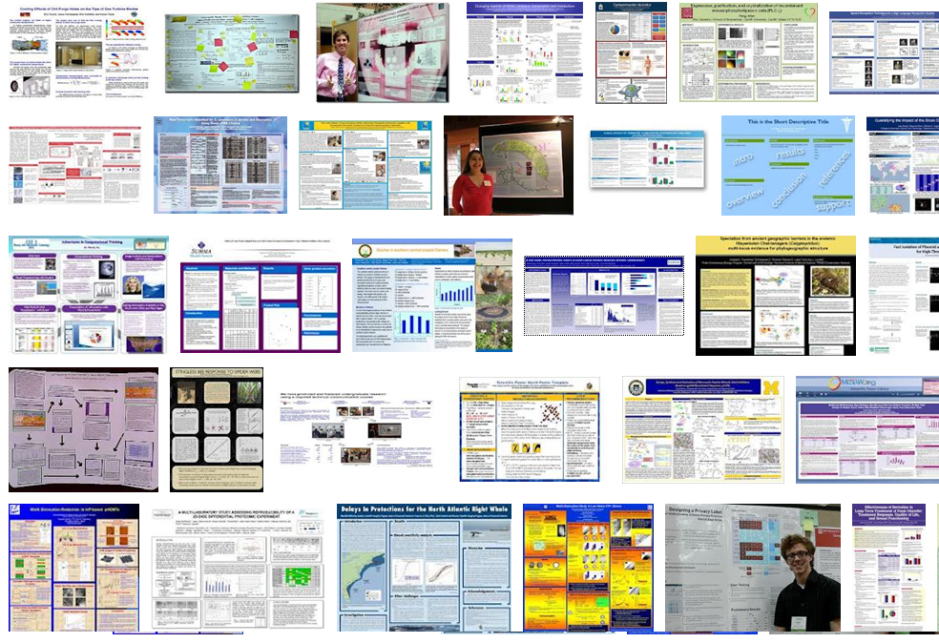
The Scientific Poster

Slide 5
Today:
The Poster
RUBRIC!
What to include
How it should look
How to make (Fast)
How to present

Slide 6
Scientific Poster
A form of Scientific Expression
Summary of Research (5 – 10 minutes)
Visually augmented discussion/interaction
At conferences viewers come to you (or you can invite)
People search published abstracts
Posters may be grouped by field & folks may wander
New Information
Characteristic Fields
Appearance/Content varies by Field or Lab

Slide 7
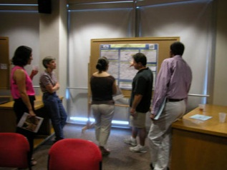
Where are Posters Used?
On Campus – Poster days, Conferences, symposia
Tack up poster
Stand by poster (1-3 h)
Conferences
Abstract submitted
Limited orals (15 min ea)
Mostly Posters
Time/location included in program
Hallways
Often posted around labs after presentation
Online:
http://posters.f1000.com/
http://eposters.net/

Slide 8
Additional Poster Impact
Represents you and you mentor
Demonstrate expertise
Demonstrate attention to detail
Practice public speaking
Learn about most current results in field
Deepens understanding of topic
Opportunity for teaching and learning
Share ideas
Create collaborations

Slide 9
PRIMARY GOAL
Sell Yourself and Your Research!!
Confident
Competent
Great Future Colleague
Need to Prepare!
Need to tell a good story!

Slide 10
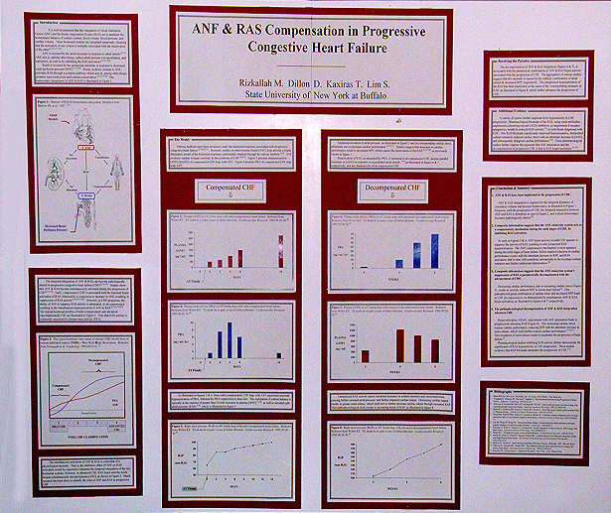
Poster History

Slide 11
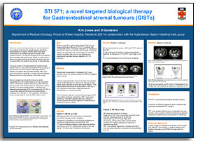
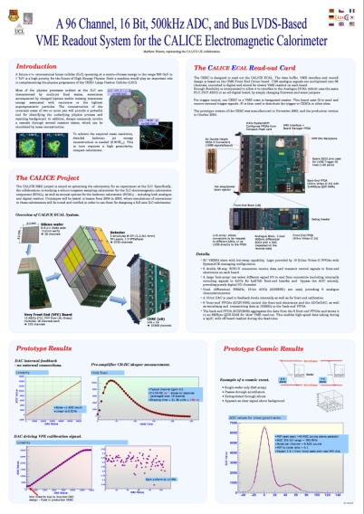
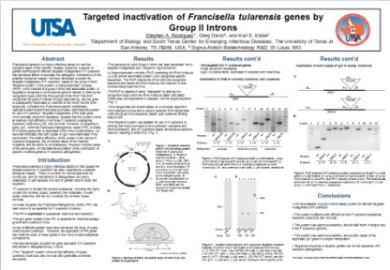
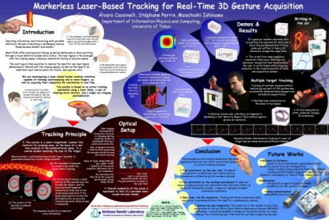
Which is a “Correct” Poster?

Slide 12
Approaching Posters
Characteristic sections with expected information
Consult rules of conference/rubrics
Work in collaboration w research mentor
Decide on experiments to include
Create a storyboard/plan
Visually appealing
Primarily image driven but stand alone
Simply and tightly written
Know what to say for each figure
Transitions between sections
Practice for your audience
KNOW all details of project
Master questions

Slide 13
Can be Personalized…

Slide 14
Sections - Content
Title
Names and Affiliations
(sometimes extra email contacts)
Abstract * (SAME AS SUBMITTED)
Introduction
Purpose/Hypothesis/Goal
Methods
Results
Discussion/Conclusions/Future Directions
References *
Acknowledgements *
*Can use smaller font

Slide 15
Consult Rules of Conference
http://www.abrcms.org/index.php/abstracts-posters/presentation-guidelines
Size Max (board size) vs Size Requirement
36”x54” COS Research Conference
Possible “sentence case” in titles
Abstract number
Abstract included or not
Contact Information (extra?)
Section headings (Abstract, Intro, etc)
Font size

Slide 16
Work with Mentor
Represents their laboratory
They need to be involved
New data available – what should be included?
Will want to make revisions (several times)
Need final approval EVERY submission
You should also arrange to practice w lab!

Slide 17
Find RUBRIC if possible
Published expectations
Usually with student competitions
Assists Judges to judge fairly
http://www.abrcms.org/documents/11_Judging_Rubric.pdf
Emphasis on 6 areas:
Posterboard or Powerpoint
Hypothesis/Purpose and statement of problem (INTRO)
Methods and controls/comparison (METHODS)
Results (RESULTS)
Conclusion and future work (DISCUSSION)
Overall Presentation and handling questions

Slide 18
Who is Your Audience?
Researchers in your field
Will read even if bad
Researchers in related fields
Easily persuaded to view
Previously uninterested passers by
Can be attracted by a good poster
***You want to attract these people!***
Perhaps Freshmen?
Don’t vary content, vary explanation

Slide 19
Your Poster’s Appearance
Make rough plan of your poster
Will have “standard” headings
Poster provides visual aids as you talk
Picture worth 1K words
Carry information with colorful images and figures
Estimate space that will be needed –
How many experiments reported
How many figures needed?
What types of figures?
How much text to explain
3 or 4 Column Poster
Space for text
Poster must be “stand alone” (understandable in halls, unmanned)
Has to have words
Word amount varies with field
Balance your text and images

Slide 20
Appearance 2
Select (or design) figures/bullets.
Where do you need help explaining something? (napkin?)
Intro - Can have image of existing model, or eye catching photo
Methods - can be a flow chart
Results – Figures, Line Graphs common.
Discussion – Often bulleted
Select number of columns
Average 4 (range 3-5)
36”x54” good for 4 column (have results)
36”x48” good for 3 column (Proposal or one experiment).
>42” tall is quite big- can be used if not enough room.

Slide 21
Appearance 3
Should be Visually Appealing
Understand reader “gravity”
Top left to bottom
Left to right
Have an obvious flow
Headings
Numbers
Use “white space” or color frames to organize
Unobtrusive/Neutral backgrounds
White
Lt grey
Lt beige

Slide 22
Appearance 4
Use very large font for title (~90 pt)
Fairly large for names (~72 pt)
Use at least 20 (24 better) pt text for body text
Read ~4/5 feet away
Figure lettering must also be large enough

Slide 23
Visually Appealing

Slide 24
Title
SAME AS ABSTRACT

Slide 25
Names and Affiliations
Names/Authorship (always more than you as student)
Department, University, Centers, etc
Address of Univ. (option)
Email Address (may be required)
Logos for Universities, Depts, Centers
Use superscripts to match person to place

Slide 26
More on Logos
Large or High Resolution
not Jaggy when print!
Near 300 DPI
> 1 MB
~6 Inches

Slide 27
Abstract
Most people insert entire abstract in upper first column
Can reduce font size if needed
Does NOT replace the normal Introduction
Unless your mentor says so.

Slide 28
Simply and Tightly Written
Use figure legends/captions as text (not additional narrative)
Assess every sentence and word
Avoid long sentences and paragraphs
Combine very short sentences
Put related text and images near one another
Typos reflect badly on you and your mentor
There is no good writing, only good rewriting

Slide 29
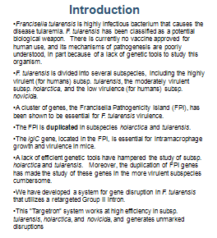
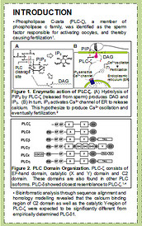
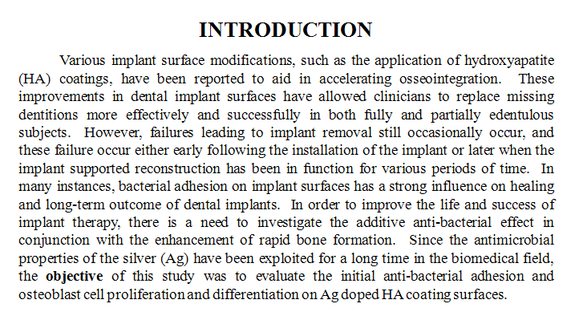
Introduction
Or Background
YOU SAY IT…
If you are there, they won’t read!
Get viewers interested
This is separate from your abstract!
Reason you chose to study
Foundation for your work (Models)
General topics to specific
Equivalent to 1 double spaced 12 pt page
Usually contain citations/references (cite!)
May have Purpose and Hypothesis embedded
Generally completes first column

Slide 30
Purpose & Hypothesis
Sometimes a separate section, to emphasize
Purpose or…Objective, Aim, Goal, etc.,
Why you did experiment
The purpose of this project…
Good for Student Conference
(Promotes solid judging)
Hypothesis
Same as for abstract

Slide 31
RUBRIC: HYPOTHESIS AND/OR STATEMENT OF PROBLEM
For Maximal Impact/Points:
A logical hypothesis/statement of problem was presented clearly
Background information was relevant and summarized well. Connections to previous literature and broader issues were clear
Goal of project was stated clearly and concisely; showed clear relevance beyond project

Slide 32
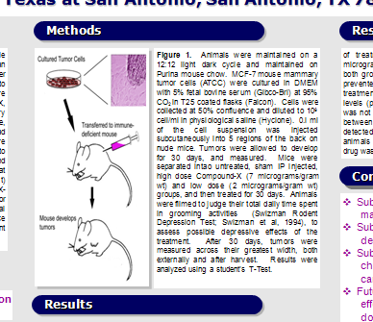
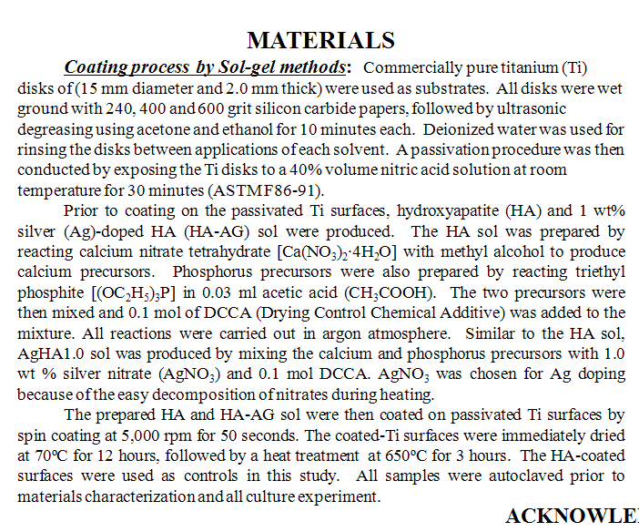
Materials/Methods
Text with subheadings
Can include a flow chart to summarize
May include citations
Make sure to include:
subjects
experimental design
drugs and equipment used
statistical methods
Why you chose the method

Slide 33
RUBRIC! METHODS AND CONTROLS/COMPARISON
Maximize Impact/Points!
Clear discussion of controls or comparative groups; all appropriate controls or comparative groups were included
Thorough explanation of why particular methods were chosen

Slide 34
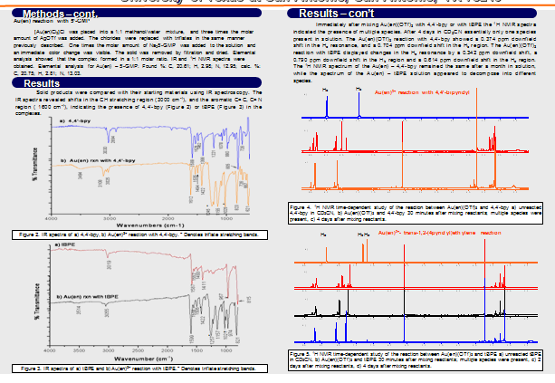
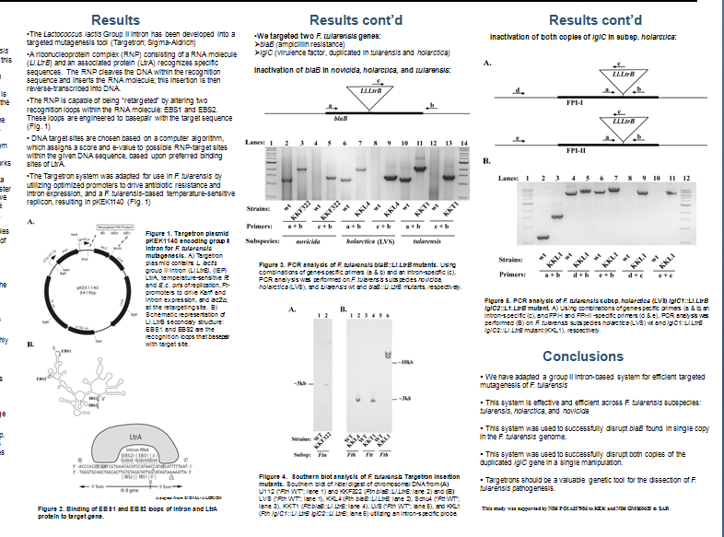
Results
Largest section
Vary with field
Often two middle columns
Experiments- what you found
Don’t present raw data
Make Image-based; use few words
Maximize use of Figures
Make them simple
Must be easily seen
Make all lines wide enough
All text large enough!
Consistent axes across poster

Slide 35
Results Cont:
Minimize use of tables
Difficult to grasp quickly
Use figure legends/captions as text
Put text near figure it’s describing
~1 paragraph per image/image group

Slide 36
RUBRIC! RESULTS
Maximal Impact/Points from:
Substantial amounts of high quality data were presented sufficient to address the hypothesis
Presentation of data was clear, thorough, and logical

Slide 37
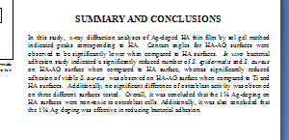
Conclusions/Discussion
Or discussion or summary
Very few words
Bullets good
Bigger font if needed
*Summarize “take home” results
*How did hypothesis work out?
*Tie back to real world problem
*Why Important/Implications

Slide 38
RUBRIC! CONCLUSION AND FUTURE WORK
Highest Impact/Score if:
Reasonable conclusions were given and strongly supported with evidence
Conclusions were compared to hypothesis and their relevance in a wider context was discussed

Slide 39
References
If someone’s work is cited (usually in introduction), you must include a reference
Generally “short” (title optional)
Can use smaller font if needed

Slide 40
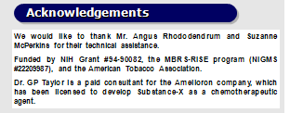
Acknowledgements
Should be included
Thank people
Mentor
Lab Mates
Technical assistance, etc.
Reveal possible conflicts of interest
Identify funding utilized
Ex. NIH/NIGMS MARC U*STAR GM007717
Font can be smaller than rest of text

Slide 41
RUBRIC! POSTER BOARD OR POWERPOINT PRESENTATION
Highest possible Impact/score when:
All expected components are present, clearly laid out, and easy to follow in the absence of presenter
The text is concise, legible, and consistently free of spelling or typographical errors; the background is unobtrusive
The figures and tables are appropriate and consistently labeled correctly
Photographs/tables/graphs improve understanding and enhance the visual appeal

Slide 42
Creating the Poster

Slide 43
Software
Actual layout:
Powerpoint (one big slide)
Pagemaker
Canvas
Illustrator
Quark
Postergenius: http://www.postergenius.com/cms/index.php
Ask print shop about requirements
Print directly or convert to pdf
Images (compatible with printer driver!)
Photoshop
MS Photo editor
Tables/Graphs
Directly from Office (Excel or Word)
For PRINTING: PowerPoint or full sized PDF.

Slide 44
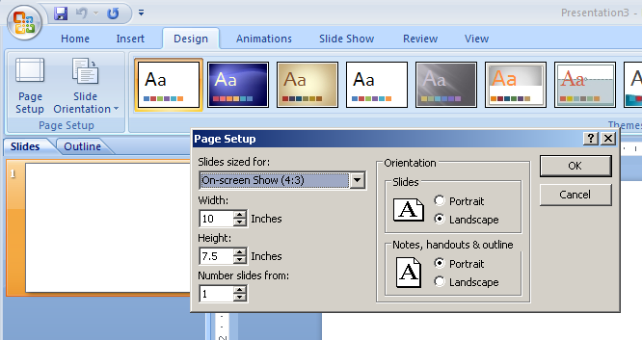
PowerPoint
Has 56” maximum dimension
Create at full size (or nearly so) to prevent pixelation
Set page size to desired size

Slide 45
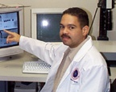
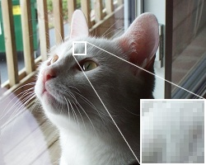
Pictures
Use standard formats
.jpg, .gif, .tiff, .tif, .bmp
Watch resolution of photos
72 dpi vs 300
72 dpi will look pixelated on a poster
230 dpi prints like a photo
Insert high dpi photos
Make them relatively large
Stretch to correct size

Slide 46
Enlarging Images/Tables/Figures
To enlarge proportionally:
Click on image
Put cursor on corner ←→
Left click and slide diagonally

Slide 47
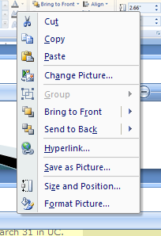
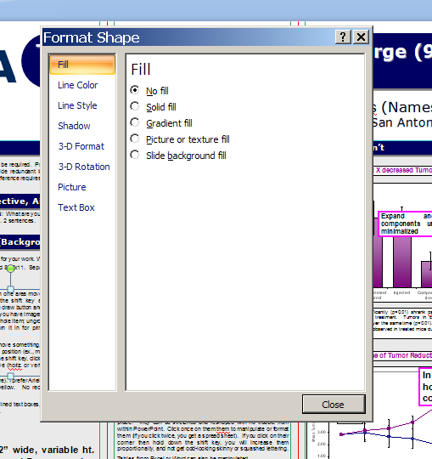
Additional Info
Insert individual text boxes
Text
Labeling
Right click on images for sizing, formatting and arranging
Right click on Text Boxes for manipulation
TEXT BOX can be manipulated!
This is how you do it!
Woooo!

Slide 48
Additional Info
Turn green dots for rotation
Drawing tools can order objects
Drawing tools can align objects
Great for sizing and location on poster!

Slide 49
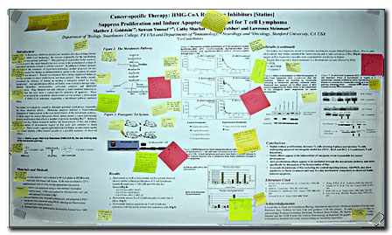
Leave time for Critiques
Your mentor will inevitably change your poster….
Have friends read as well…
Pimp My Poster: http://www.flickr.com/groups/688685@N24/
PHOTO BY COLIN PURRINGTON
http://www.swarthmore.edu/NatSci/cpurrin1/posteradvice.htm

Slide 50
Look at Sample Posters and Critique…

Slide 52
Analyze

Slide 53
Mechanics of Presentation

Slide 54
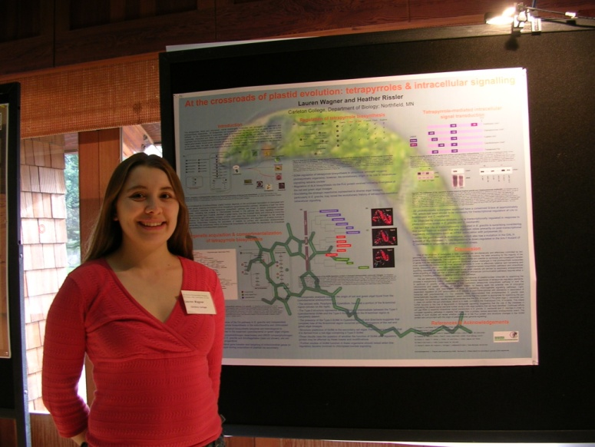

Slide 55
Remember the Selling Yourself Thing…
Look good!

Slide 56
Practicing
Finish early enough to practice
MAKE SURE TO PRACTICE!
Develop 5 minute presentation
Know first sentence
What to say for each figure (3 pts…)
Transitions between figures
What to point at for each figure
Notes:
Brief Opening- this represents work that I did ………………
Don’t give away results

Slide 57
First Contact
Stand to left of poster (where start reading)
Take initiative
Smile, but stay near poster
If they come closer
Say, “Hello” and shake hands
Give name. Get their name.
Give level, and school (if you are not at UTSA)
Ask if they’d like “you to walk them through your poster”
YES? Then GO!
This is work that I performed this summer in the ___ program in the laboratory of Dr. _________ at UT San Antonio.
(Optional) Ask if they are familiar with this field of research
No- More introduction, careful with acronyms
Yes- Can go more quickly through intro

Slide 58
Flow
Start with Intro that will catch them
No pointing if you have no figure!
Move to Methods
Briefly summarize
Move to Results
Longest section
Indicate at beginning if did not work
Walk thru all figures
Transition to Conclusions
Say Conclusions
Acknowledgements (optional)
Any Questions?
Notes:
Brief Opening- this represents work that I did ………………
Don’t give away results

Slide 59
Practice
Practice with labmates and laymen
Run through ENTIRE poster
Be friendly
Don’t sound like you’ve memorized
Be excited about your work
Remember to refer to your poster!
They may interrupt with questions
Pause long enough for them look at figure
Know what questions may be asked….
Can practice them

Slide 60
RUBRIC! OVERALL PRESENTATION & HANDLING QUESTIONS
Highest Possible Impact/Score when:
Demonstrates a very strong knowledge of the research project
Speaks clearly, naturally and with enthusiasm; makes eye contact
Comfortably uses visual aids to enhance presentation
Answers difficult questions clearly and succinctly
Presentation is consistently clear and logical

Slide 61
Transporting Poster
Buy tube for rolling
Do not be separated from it
Plane
Hotel
Carry it yourself
Have it also in electronic format
Do not leave it at home or in car trunk

Slide 62
Supplemental Materials
Mini-poster printed out
Poster repair kit
Pins
Business cards
Water
Notebook

Slide 63
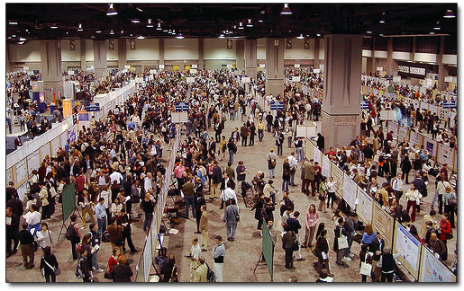
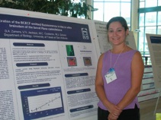
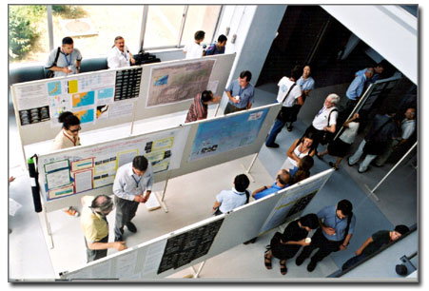
Set up conditions vary
May be hard to hear
Must speak up!!!
PHOTOS BY COLIN PURRINGTON
http://www.swarthmore.edu/NatSci/cpurrin1/posteradvice.htm

Slide 64
Final Preparations
Dress for situation
Follow culture of conference
Student conference – suit…or minimally khaki's
Comfortable shoes
Be there on time!
Have friend there to help
Water bottle
Don’t leave unless it is very important to do so (if so, leave a friend there momentarily)

Slide 65
Extras
Networking – write down ideas and names!
Don’t be discouraged if only a few come!
Can provide a mini version of poster
Have a business card for professional meetings
May tack envelop, with picture of card, to poster

Slide 66
Coming Home Again
Keep promises that you’ve made
Drop emails to folks whom you’ve met
Hang poster outside of lab
Can Deposit your Poster if desires (or allowed by mentor)
http://posters.f1000.com/

Slide 67
Poster Templates…
Sample posters can be seen online
google search
A “template” can be found at:
http://www.utsa.edu/mbrs/resources.htm

Slide 68
Thanks for Coming… Good Luck with your posters!

