Slide 1
Cognos Analytics v12
How to Guide for New Users

Slide 2

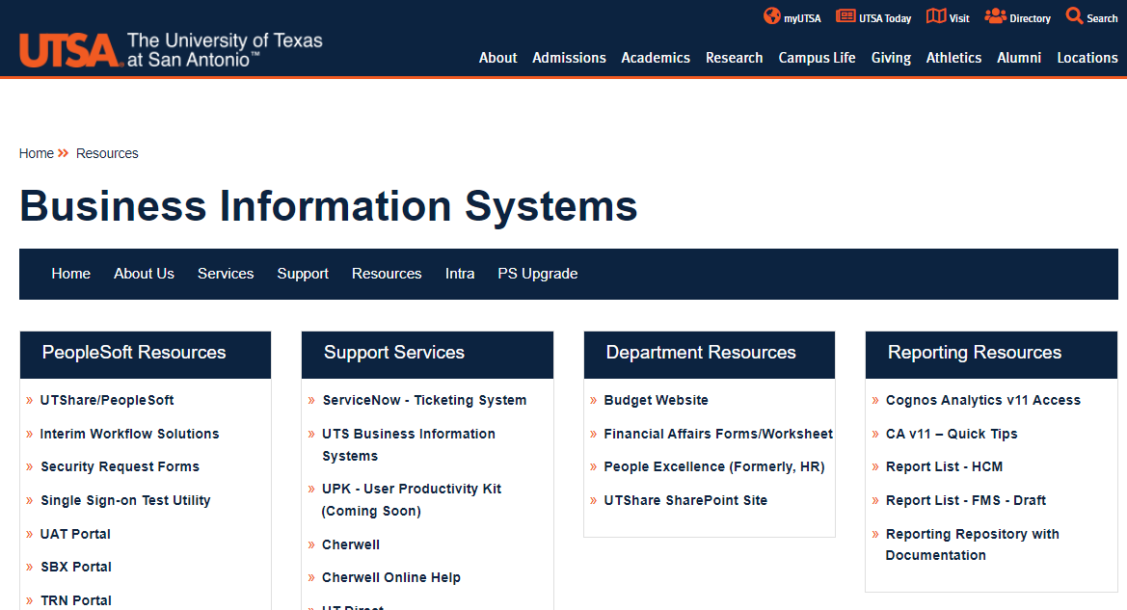

Accessing Cognos
You can access Cognos via the link on the BIS/Resources website
or
Directly thru the Cognos URL
When prompted, enter your network credentials (abc123).
Note: You must be connected to VPN (Global Protect) before accessing Cognos.
or

Slide 3
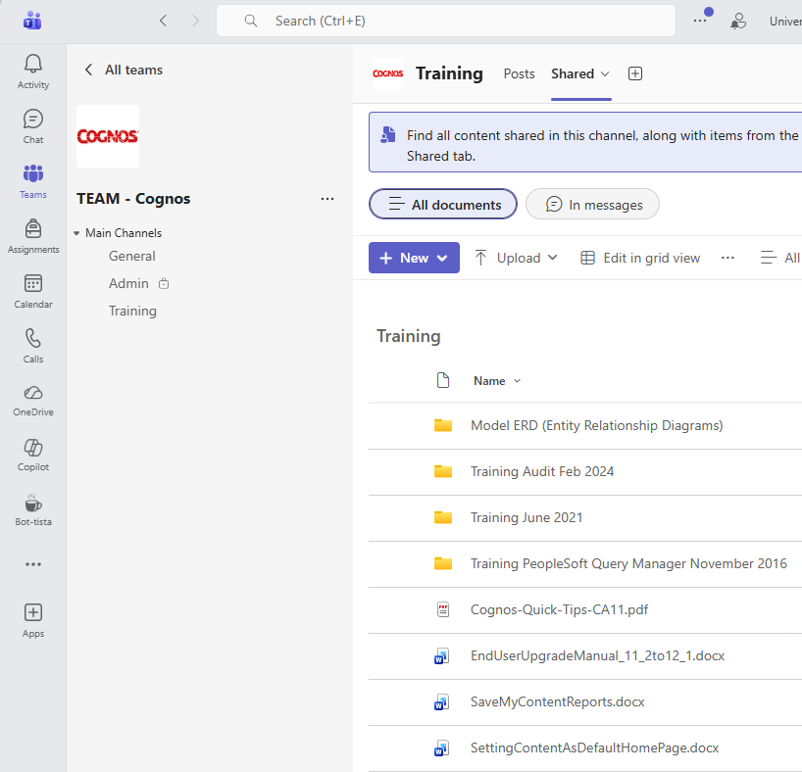
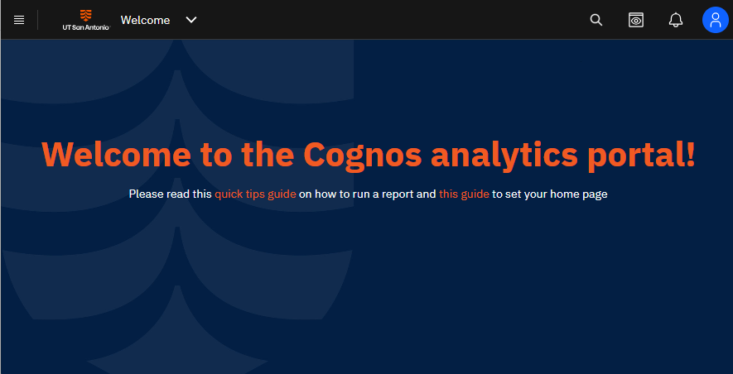
Resources for Getting Started
On the default Cognos welcome screen there are a couple of links including this guide as well as how to set your preferred home page.
You also have access to the MS Team – Cognos where we post helpful documents under the Training channel.
Communications about outages, upgrades, etc. will be posted in this team.

Slide 4
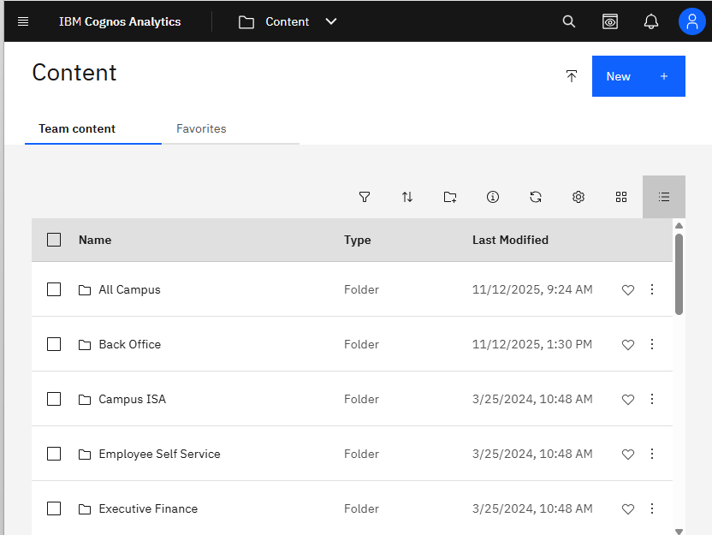
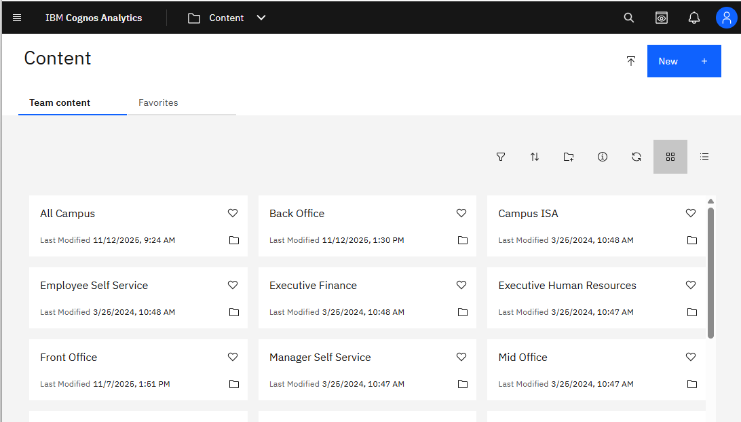
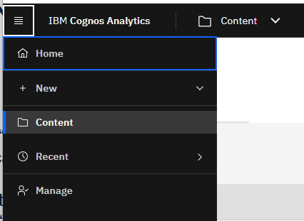
List Layout
Navigating to a Report
Click on the hamburger menu in the upper left. Then select “Content” from the menu.
The default view of the Content screen is a tile layout, but you can change it to a list layout using the icons above. The remainder of this guide will use the list layout.
Tile Layout
You can also access a list of your recent reports here!
Note: You will only see the folders you have been granted access to.

Slide 5
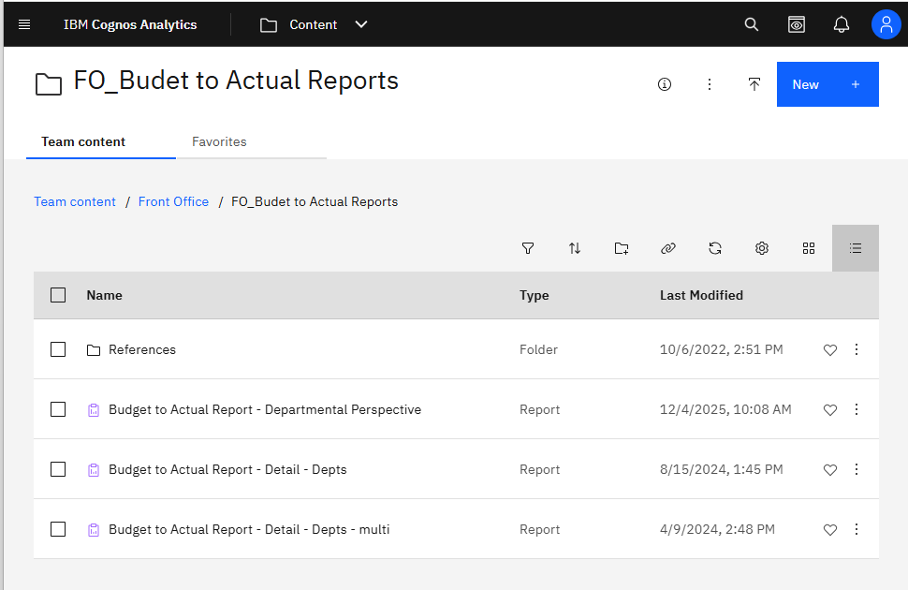
Navigating to a Report
You can sort the folder/report list by clicking the up/down arrows on the tool bar.
Click through the folders and sub folders to locate your report.
Notice the breadcrumbs of the folder navigation path that brought you to this point.
You can click on a folder in the breadcrumbs to go back to that point.

Slide 6
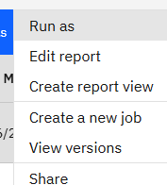
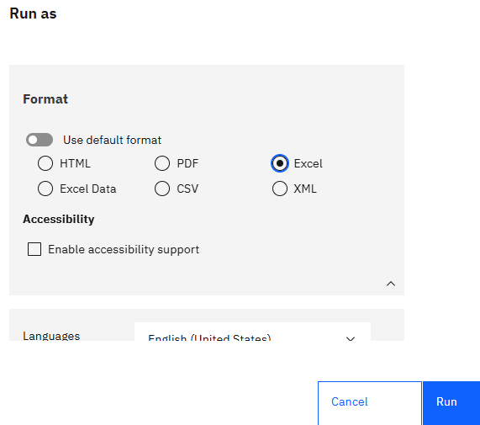
Running Reports
Run to Screen (html):
Simply click on the report name.
Run to Other Formats:
Click the three dots next to the report name on the far right.
Click “Run As”
On the next screen, scroll down to the format box and select a format.
Click “Run”.
The report will be in your browser’s download list.

Slide 7
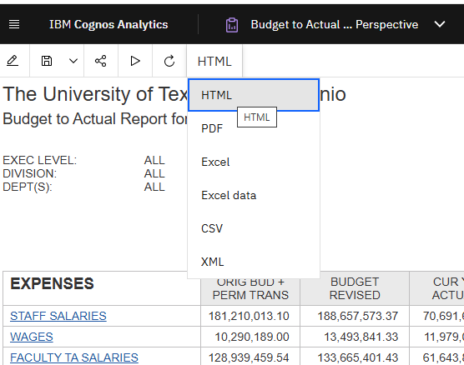
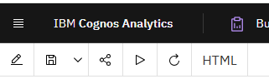
Other Tips
Changing to Another Format
If you already ran the report to the screen and want to switch to another format, simply click the format button on the right end of the toolbar, and select a new format.
Printing Reports
Run in PDF format and use the print functionality in your PDF viewer or run to Excel and print from there.
Re-running Reports
Click the run button on the tool bar to re-run the report with new prompt values.

Slide 8
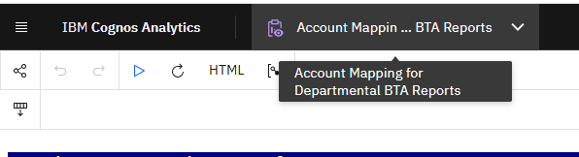
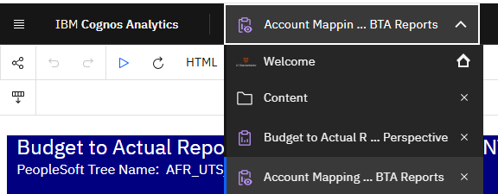
Managing & Navigating thru Open Content
When you run a report, the window stays open until you close it or exit the application.
The second item in the black band at the top displays the current report name. Hovering over it will display the full name.
Click the dropdown arrow to display a list of open reports and screens you have visited. You can use this to navigate back to one of them or click the “x” to close the report.
Click the arrow again to close the list.
Hovering shows the full name of the current report.
Clicking shows the list of reports you ran and screens you visited.

Slide 9
Favorites
Marking a Favorite:
From the list of reports, click the heart icon next to the report or folder name to mark it as a favorite.
Once you have marked items as favorites, you can access your list of favorites here.

Slide 10
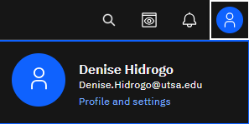
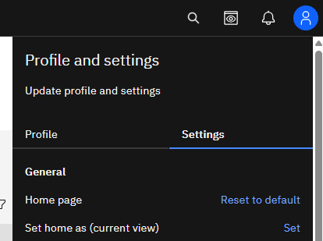
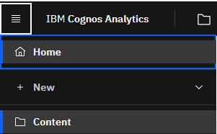
Setting Your Home Page
If you want to skip the blue Welcome screen when you log on and go straight to the content location you use most, you can customize your settings.
Navigate to the content folder you want. In this example, “Front Office”.
Click on the person icon in the upper right.
Select “Profile and Settings”
Select the “Settings” tab.
Click “Set” next to “Set home as (current view)”.
Now you can easily go to this screen from anywhere in the application by clicking the hamburger menu in the upper left and select “Home”.

Slide 11
For further assistance, requesting access, modifications, new reports, or reporting an issue with a Cognos report, click here to submit a UTShare/PeopleSoft Reporting ticket via Service Now.

