Slide 1
Download Details to Excel
Disbursements & Travel Services
Revised July 8, 2024

Slide 2
Important note
This PowerPoint file is optimized for assistive technology.
Please use the PDF instead if you:
Don’t use a screen reader
Aren’t sure if you use a screen reader
To ensure you have the most current information, please get this job aid from the website rather than referring to a locally-saved version.

Slide 3
Summary
PeopleSoft’s “Download Details to Excel” has improved functionality. The feature is available in Classic View and Certification pages for the following sections:
Vouchers
Travel Authorizations
Cash Advances
Expense Reports

Slide 4
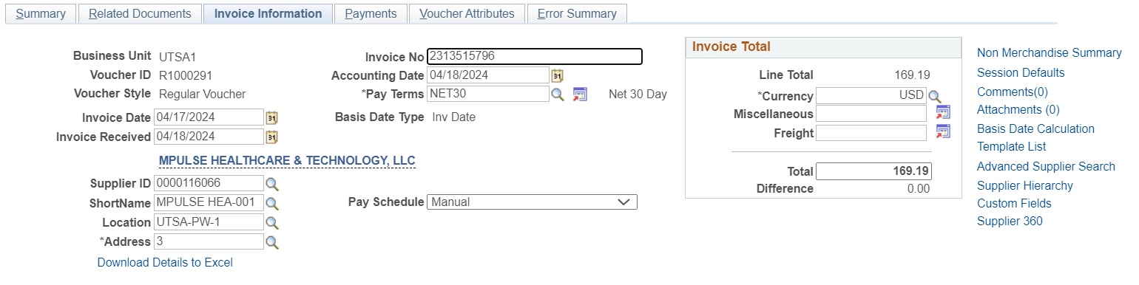
Voucher Search Page
Navigation: Menu > Financials > Vouchers > Accounts Payable > Add/Update > Voucher Search >
Enter a voucher and select search.
Navigate to the Invoice Information tab and select “Download Details to Excel” under the Address field.

Slide 5
Voucher Download Details Include (1)
Business Unit
Supplier Number
Supplier Name
Voucher Number
Line
Distribution Line
Description
Start Date
End Date
Merchandise Distribution Amount
Merchandise Line Amount
Quantity
GL Business Unit
Account
Fund
Department
Cost Center
Function

Slide 6
Voucher Download Details Include (2)
Department
Cost Center
Function
Program
PC Business Unit
Project
Activity
Affiliate
Fund Affiliate
Budget Date
Budget Status
Accounting Date
PO Business Unit PO Number
PO Line
Schedule Number

Slide 7
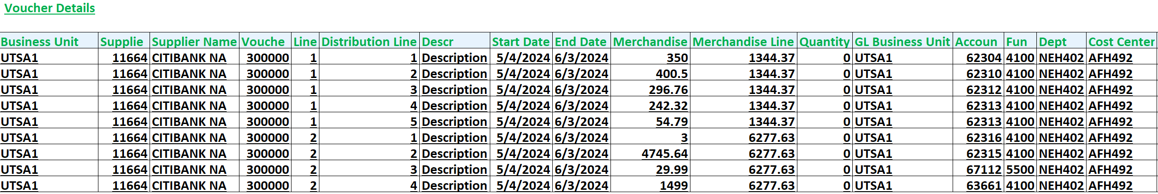
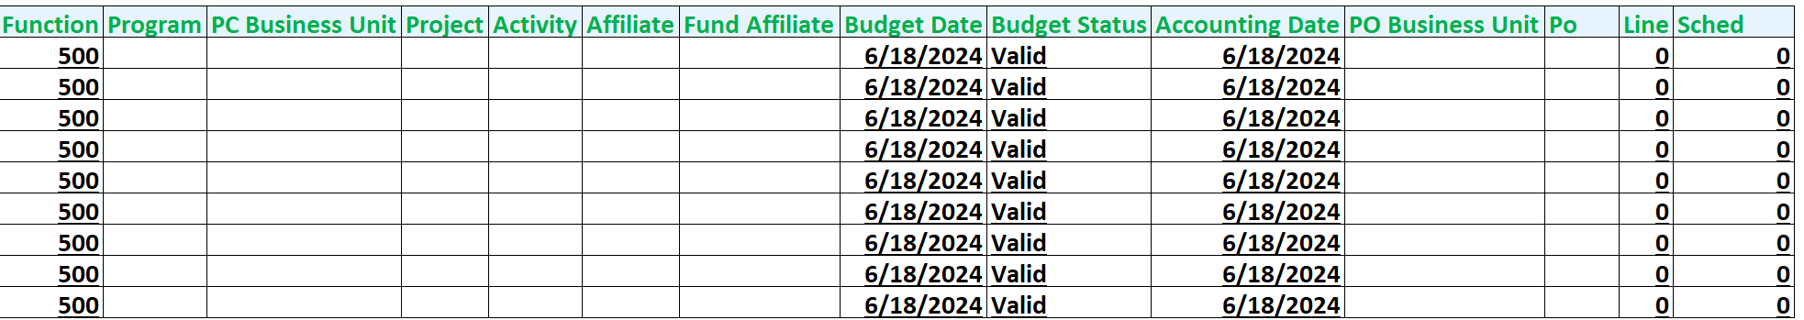
Voucher Download Details Example

Slide 8
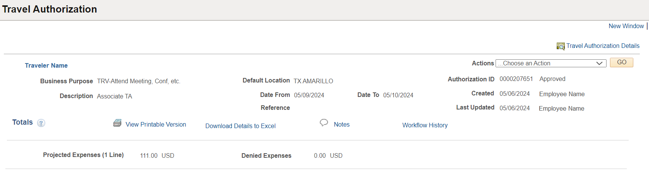
Travel Authorization View Page
Navigation: Menu > Financials > Travel and Expenses > Travel Authorization > View >
Select the “Download Details to Excel” hyperlink located in the middle in between the View Printable Version and Notes hyperlinks:

Slide 9
Travel Authorization Download Details Include (1)
Travel Auth ID
Employee ID
Employee Name
Location
Location Descr
Line
Distribution Line
Transaction Date
Expense Type
Expense Type Description
Line Comment
Line Location
Line Location Desc
Distance Traveled
Dist Type
Distance Rate
Payment Type
Payment Type Description

Slide 10
Travel Authorization Download Details Include (2)
Billing Type
GL Unit
Account
Fund
Dept
Cost Center
Function
Program
PC Bus Unit
Project
Activity
Affiliate
Fund Affil
Budget Status
Distribution Line Amount
Currency
Total Line Amount
Currency

Slide 11
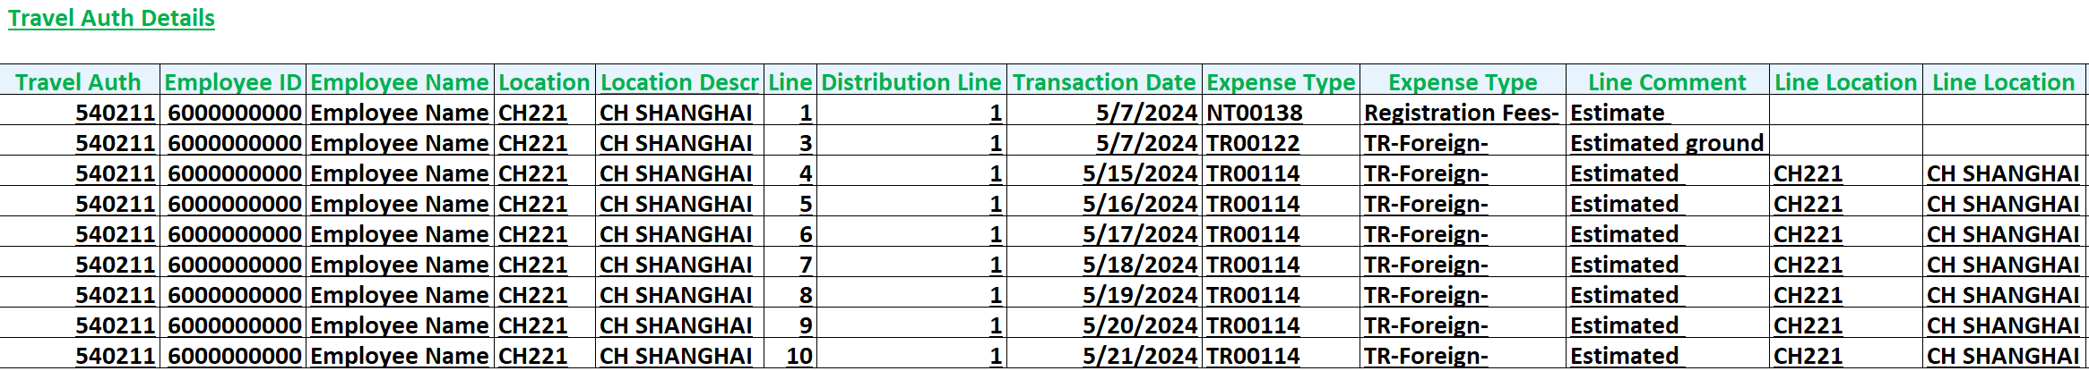
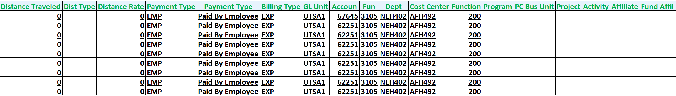
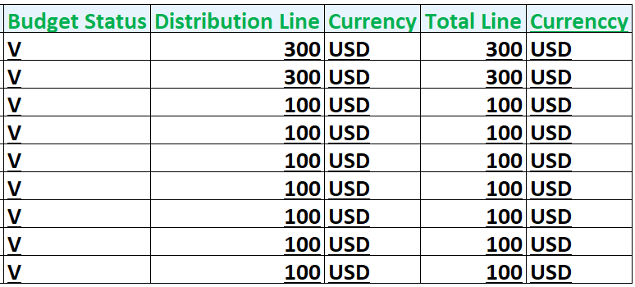
Travel Authorization Download Details Example

Slide 12
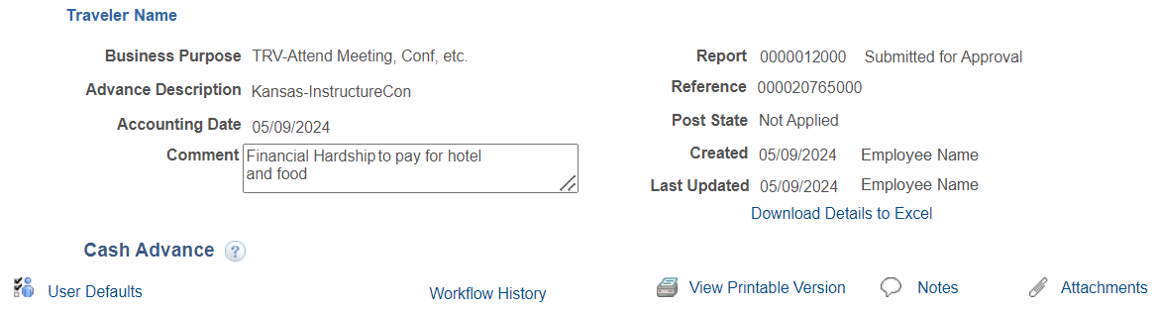
Cash Advance View Page
Navigation: Menu > Financials > Travel and Expenses > Cash Advance > View >
Select the “Download Details to Excel” hyperlink located under the Last Updated date field

Slide 13
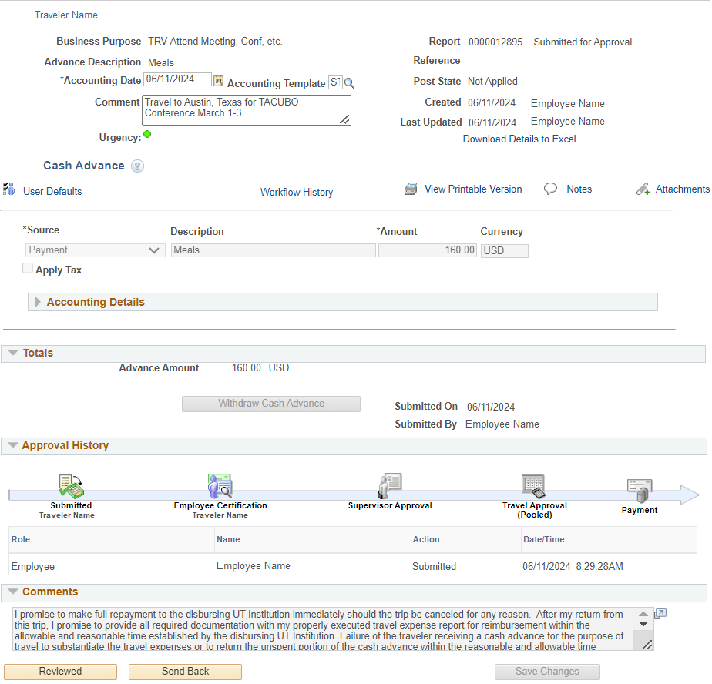
Cash Advance Certification Page
Navigation: The Classic Certification Approval page for Expense Reports will need to be accessed via the Fluid Approval page after the cash advance (CA) is created and routed for Employee Certification.
Select the “Download Details to Excel” hyperlink located under the Last Updated date field:

Slide 14
Cash Advance Download Details Include (1)
Advance Id
Employee ID
Employee Name
Business Purpose
Business Purpose Description
Reference
Report ID
Source
Source Description
Line Description
Line
Distribution Line
GL Unit
Account
Fund
Department
Cost Center
Function

Slide 15
Cash Advance Download Details Include (2)
Project
Affiliate
Fund Affiliate
Program
Accounting Date
Distribution Line Amount
Currency
Line Amount
Currency

Slide 16
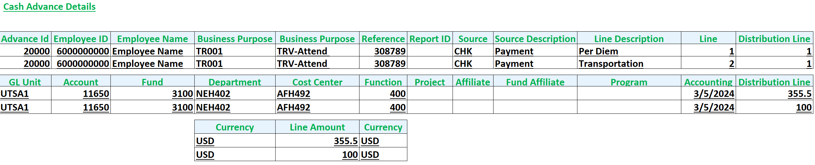
Cash Advance Download Details Example

Slide 17
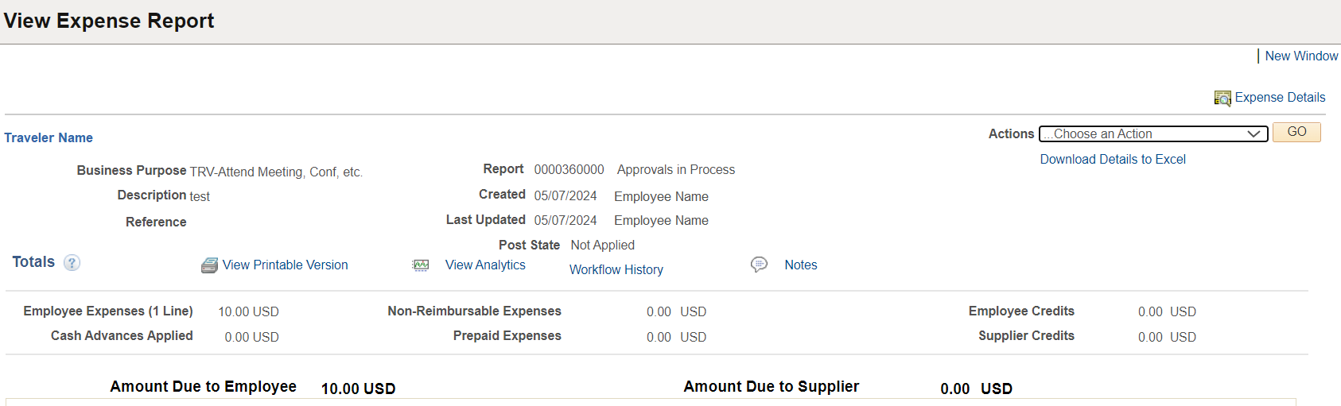
Expense Report View Page
Navigation: Menu > Financials > Travel and Expenses > Expense Report > View >
Select the “Download Details to Excel” hyperlink located on the upper right corner under the Actions drop-down menu:

Slide 18
Expense Report Download Details Include (1)
Report ID
Employee ID
Employee Name
Trans
Expense Type
Expense Type Description
Line Comments
Location Description
Distance
Distance Type
Mileage Distance Rate
Payment Type Description
Billing Type
Reimbursable?
No Receipt
Line
Distribution Line
GL Unit

Slide 19
Expense Report Download Details Include (2)
Account
Fund
Dept
Cost Center
Function
Program
PC Bus Unit
Project
Activity
Affiliate
Fund Affiliate
Budget Status
Distribution Line Amt
Currency
Total Line Amount
Currency

Slide 20
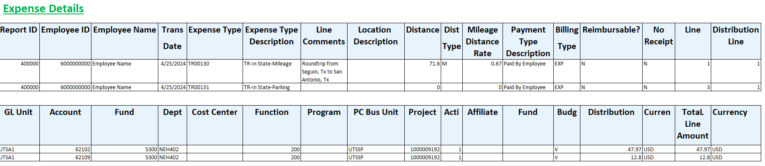
Expense Report Download Details Example

Slide 21
Contact Us
If you have questions about this job aid, you can contact us at
Disbursements & Travel Services
Website: Disbursements & Travel Services
Email: disbursements.travel@utsa.edu
Phone: (210) 458-4213

Slide 22

Thank you
utsa.edu/financialaffairs

