Slide 1
PaymentWorks
Vendor Onboarding Process
AM0591
Disbursements and Travel Services
Presenters: DTS Coordinator
Disbursements & Travel Services
Revised 12/09/2024

Slide 2
Important note
This PowerPoint file is optimized for assistive technology.
Please use the PDF instead if you:
Don’t use a screen reader
Aren’t sure if you use a screen reader
To ensure you have the most current information, please get this job aid from the website rather than referring to a locally-saved version.

Slide 3
Agenda
Overview
Roles and Responsibilities
Initiator Role
Navigate through PaymentWorks
Search for Suppliers
Invite a Supplier
Onboarding Tracker Color and Icons
View Status of Onboarding Vendor Registration
Tips & Tricks
Online Help, Training Resources & Demo

Slide 4
Overview (1)
What is PaymentWorks?
Digital platform designed to streamline and secure the process of vendor management and supplier onboarding
Helps organizations manage their vendor relationships by automating tasks such as vendor verification, compliance checks and payment processing
Reduces the risk of fraud and ensures that all vendor data is accurate and up-to-date
Includes a vendor onboarding registration process

Slide 5
Overview (2)
UT Shared Environment
UTShare campus cost-sharing with similar design and integration
UTSA
UT Tyler
UT System Administration
UT Permian Basin
UT El Paso
UT Arlington
UT Rio Grande Valley

Slide 6
Overview (3)
Benefits
Enhanced Security: Reduces the risk of payment fraud through sophisticated verification processes and secure data management.
Automated Onboarding: Simplifies and speeds up the vendor onboarding process by automating data collection and verification.
  Departments send e-invitation to prospective vendors to initiate the onboarding process
Compliance Assurance: Continuously monitors vendors to ensure they meet regulatory requirements, reducing compliance risks
Efficient Data Management: Maintains accurate and up-to-date vendor information in secure, cloud-based environment

Slide 7
Overview (4)
Benefits
Cost and Time Savings: Automates repetitive tasks, reducing administrative costs
Improved Vendor Relationships: Allows vendors to manage their profiles directly, leading to better communication and more efficient interactions
Additional Verifications: Compliance-related identity verification attributes, such as tax ID information, address and monitoring of government sanction lists
Viewable Payment History: Once supplier/vendor user accounts are set up, vendors can view payment information
Applicable to domestic and foreign vendors: W9 and W8 BEN forms integrated

Slide 8
Roles & Responsibilities (1)
Initiator role (departments) is designed to allow users to send and track new vendor invitations:
Sends invitations: Initiators can send invitations to potential suppliers, enabling them to register with UTSA.
Track Invitations: They can monitor the status of these invitations to ensure vendors complete the registration process.
Basic Access: This role is often configured as a base role, providing essential access to the system without extensive permissions.
  Can access portal hyperlink in PeopleSoft within the UTSA Business Solutions Center tile

Slide 9
Roles & Responsibilities (2)
Supplier role is designed for vendors who need to register and manage their information within the platform:
Registration: Suppliers can register their business and provide necessary documents to set up their profile.
Information Management: They can update their information in real-time, ensuring that all details are current and accurate.
Communication: Suppliers can communicate with UTSA, addressing any queries or updates needed.
Suppliers can access portal hyperlink from DTS’s Supplier Setup webpage
This role is essential for maintaining accurate and up-to-date vendor information, which helps streamline the procurement and payment process.

Slide 10
Roles & Responsibilities (3)
PaymentWorks role
Verify Taxpayer Identification Numbers (TINs) and banking information
Verification check of vendor financial sanctions

Slide 11
Roles & Responsibilities (4)
Office of Research Integrity (ORI) - Export Control role
Screening and approval of foreign vendors
Back Office (DTS) role
Screening and approval of foreign vendors
Vendors are approved within 24-72 hours. However, this depends on expediency with which vendors complete registration and/or clearance of financial sanctions.

Slide 12
Roles & Responsibilities (5)
Vendor Onboarding Process
DTS
  Approves Vendor
Office of Research Integrity – Export Control
  Review and Approval of Foreign Vendors Only
PaymentWorks
  Verification of TINs
  Verification of Banking Information
  Checks for Financial Sanctions
Vendor
  Completes Registration
  Sets Up User Account
  Updates Company Information
  Grants Access to Company Users
Initiator
  Invites Vendor
  Monitors Invite Status

Slide 13
Initiator Role
Initiator Responsibilities
PeopleSoft users will have access to PaymentWorks. Once users log in, the role defaults to the Initiator role.
Initiator responsibilities
Note: A valid vendor email address is required

Slide 14

Navigating PaymentWorks (1)
Initiator Role Navigation
Log in to UTShare/PeopleSoft and select/click on the UTSA Business Solutions Center tile

Slide 15
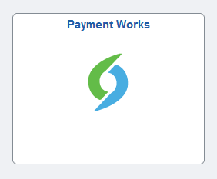
Navigating PaymentWorks (2)
Select the PaymentWorks tile
You may be prompted to use your SSO (Single Sign-On) to log in
Once logged in, you can
  Search for a vendor
  Send invite to onboard vendor

Slide 16
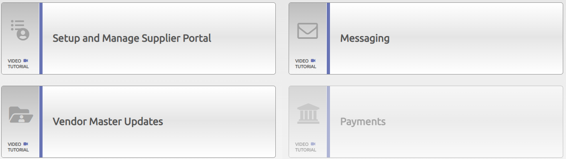

Search for Suppliers (1)
Search for Suppliers Option 1
Once logged in to PaymentWorks, select Setup and Manage Supplier Portal to send e-invitation to vendor.
Select the Suppliers tab.

Slide 17
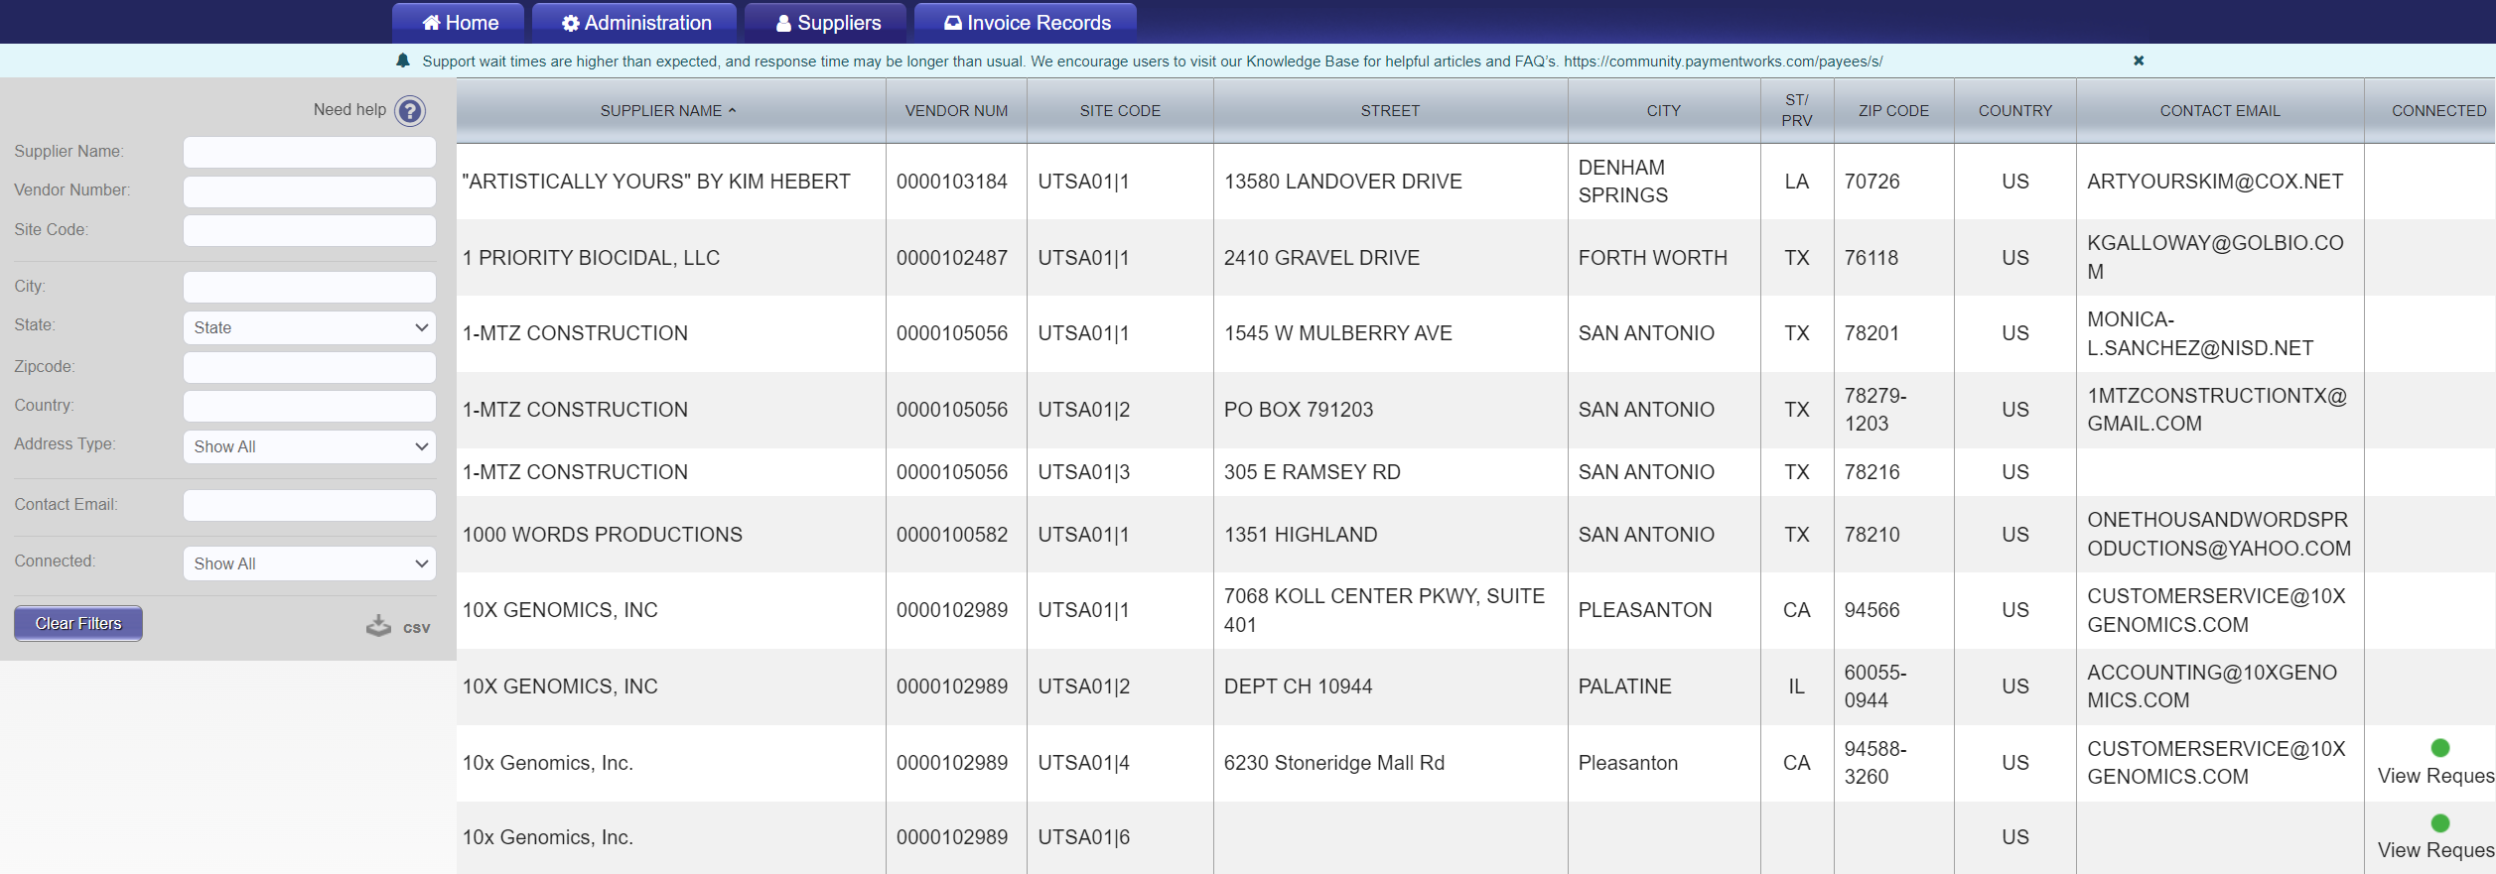
Search for Suppliers (2)
The Supplier list is displayed.

Slide 18
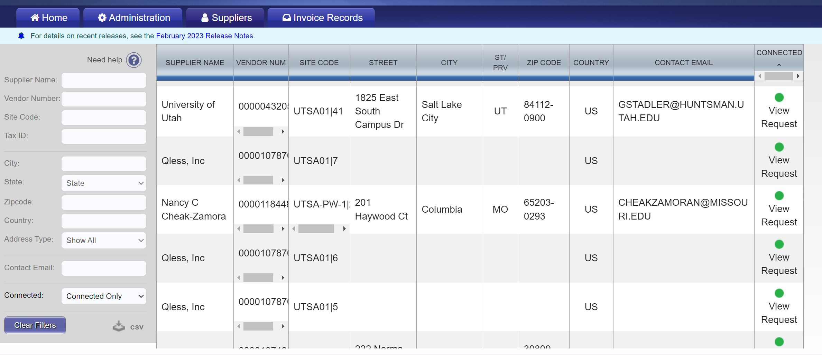
Search for Suppliers (3)
A vendor can be approved but not connected. Connected means the vendor/supplier has successfully interfaced from PaymentWorks into PeopleSoft and Rowdy Exchange.
To display Connected Suppliers only, select the Connected search field and select Connected Only. Verify vendor/supplier address to ensure correct vendor is used.

Slide 19
Search for Suppliers (4)
Search for Suppliers Option 2
Go back to Home and select Vendor Master Updates
Select the New Vendors tab

Slide 20
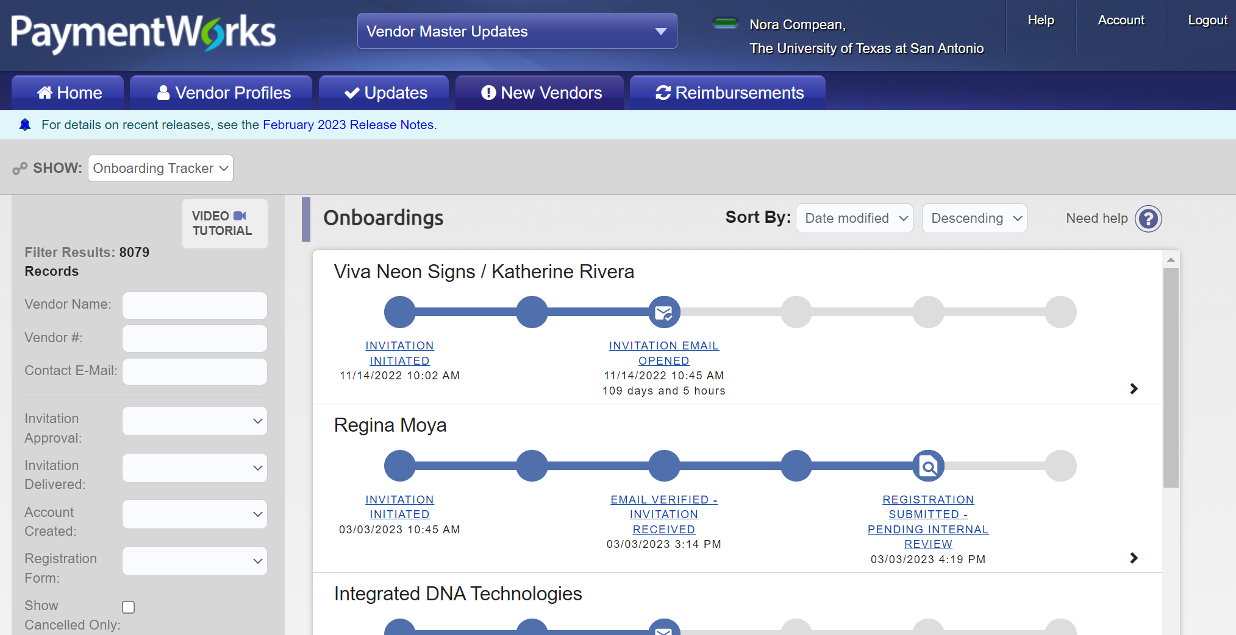
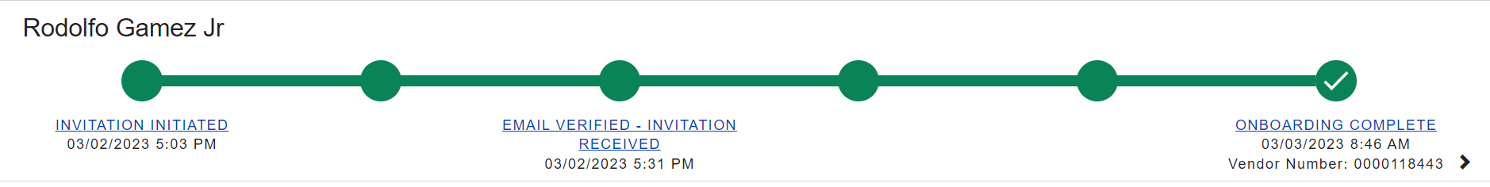
Search for Suppliers (5)
Search for Suppliers Option 2
The new supplier list is displayed. Scroll through the supplier list.
The supplier registration invitation has been sent by the department. Observe the different statuses of an invite.

Slide 21
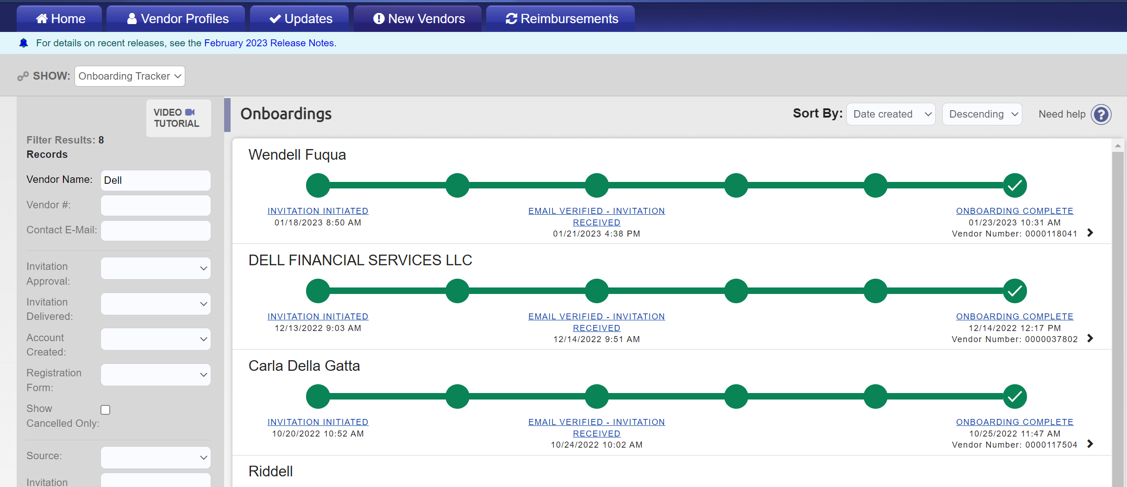
Search for Suppliers (6)
Search for Suppliers Option 2
The general supplier invitation is displayed.
Important: Verify email address before selecting supplier.

Slide 22

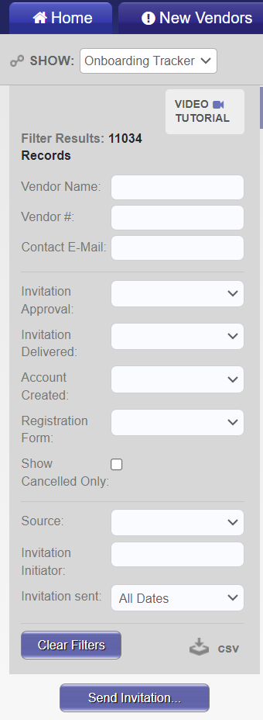
Search for Suppliers (7)
Search for Suppliers Not Listed
If a supplier is not found using Option 1 or Option 2, select the New Vendors tab.
In the Filter Results screen, search by Vendor Name, Vendor # (vendor ID) or Contact E-mail.
If the supplier is found: The supplier has been invited and is in some stage of the registration process, however, is still not connected and not available for use.
If the supplier is not found: Initiate a PaymentWorks invitation.

Slide 23
Invite a Supplier (1)
How to invite a supplier
Go back to Home and select Vendor Master Updates
Select the New Vendors tab

Slide 24
Invite a Supplier (2)
How to invite a supplier cont’d
A video tutorial is available here to help you navigate the screens.
Select the Send Invitation button.

Slide 25
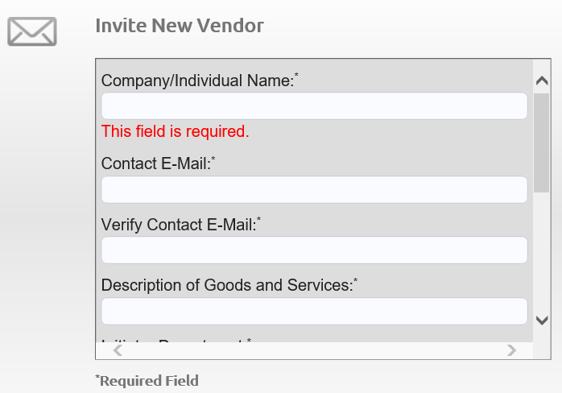
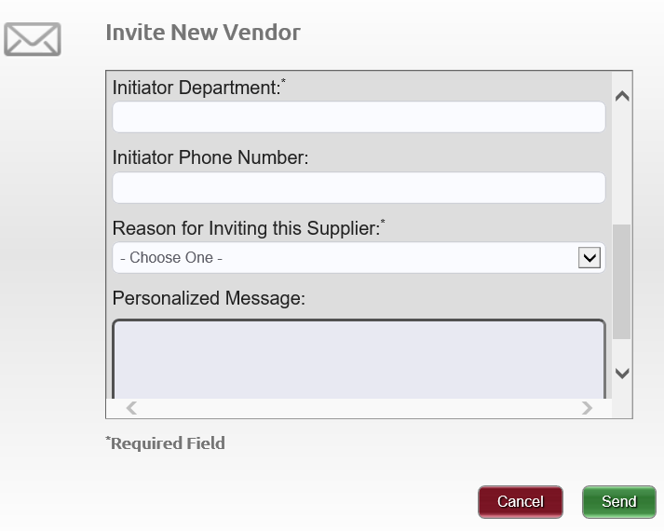
Invite a Supplier (3)
How to invite a supplier cont’d
The Invite New Vendor screen will appear. Complete the fields and select the Send button
Note: The Personalized Message box is disabled.

Slide 26
Invite a Supplier (4)
Naming Standards
The following are best-practice naming standards for creating suppliers in vendor files. These standards will provide consistency and accuracy when loading and maintaining suppliers in the vendor files.
Improper or lax standards can cause significant degradation of the accuracy of information generated from the system, fines and improper tax reporting, and loss of control
The naming conventions make it easier for development and maintenance teams to carry out their work
The Company/Individual Name is the vendor’s full name. This may or may not be the legal name shown on the vendor’s W-9

Slide 27
Invite a Supplier (5)
Naming Standards
All names should be in upper case (SMITH, JOHN)
Enter last, first name (SMITH, JOAN)
Do not use punctuation, such as periods or commas, in business names
Do not use abbreviations except when the last word in the company is CO, CORP, INC, LP or LLC
Do not use “the” in front of the name of an organization: for example, THE UNIVERSITY OF TEXAS

Slide 28
Invite a Supplier (6)
Naming Standards
Do not use abbreviations for vendors where it may cause confusion, such as
APA (American Payroll Association or American Psychology Association) or AARP (American Association of Retired Persons or American Association of Research Pathologists)
For vendors commonly known by their initials or an acronym, the initials or acronyms may be used rather than the full name
  Otherwise, do not use acronyms in place of full names
  Do not enter spaces or periods between the initials of a vendor

Slide 29
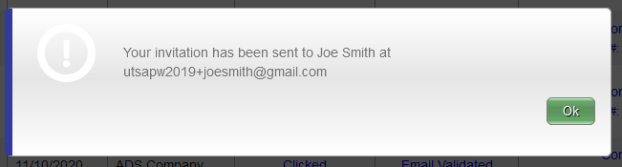
Invite a Supplier (7)
How to invite a supplier
Initiator receives a confirmation once the invitation is sent.

Slide 30
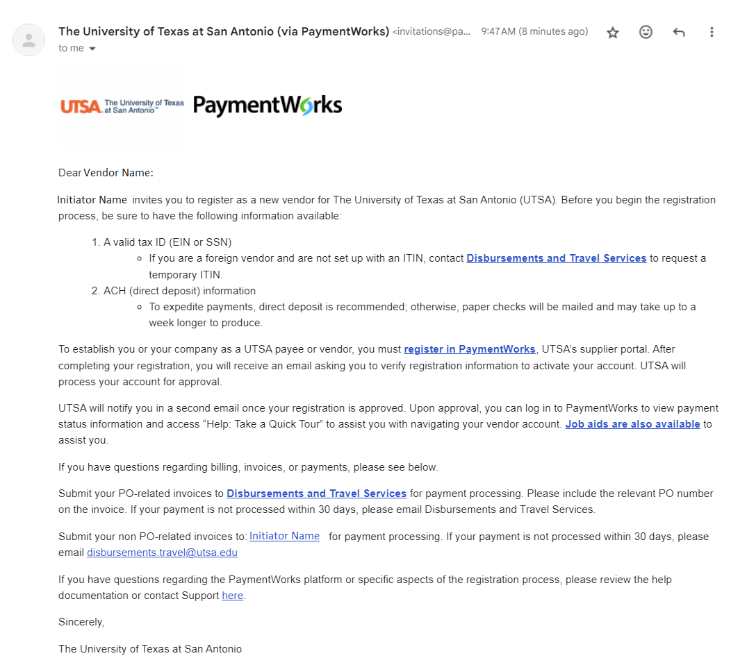
Invite a Supplier (8)
Sample of Supplier Invitation
Initiator's name self-populates
The “Job aids are also available” link will take you to UTSA’s vendor portal
Initiator’s email address self-populates
For help, supplier must contact PaymentWorks

Slide 31
Invite a Supplier (9)
Supplier Registration Process
Suppliers are prompted to join and set up a user account in PaymentWorks
After user account is set up, suppliers are asked to confirm an email address before completing the next step of the registration process (e.g., vendor name, address, SS# or TINs, banking information, etc.)
Once the registration process has been successfully completed and registration form submitted, suppliers will receive an e-confirmation

Slide 32
Invite a Supplier (10)
Existing Vendors
Existing suppliers must receive an invite from UTSA to
Set up a new user account in PaymentWorks
Update current vendor information in PeopleSoft
Once user account is established, vendors must then login to their user account to update current vendor information in PeopleSoft.
Once an invitation has been sent by a user, PaymentWorks does not allow other users to send additional invitations using the same email address. An alternate supplier email address is required to send new invites.

Slide 33
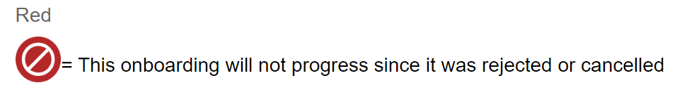
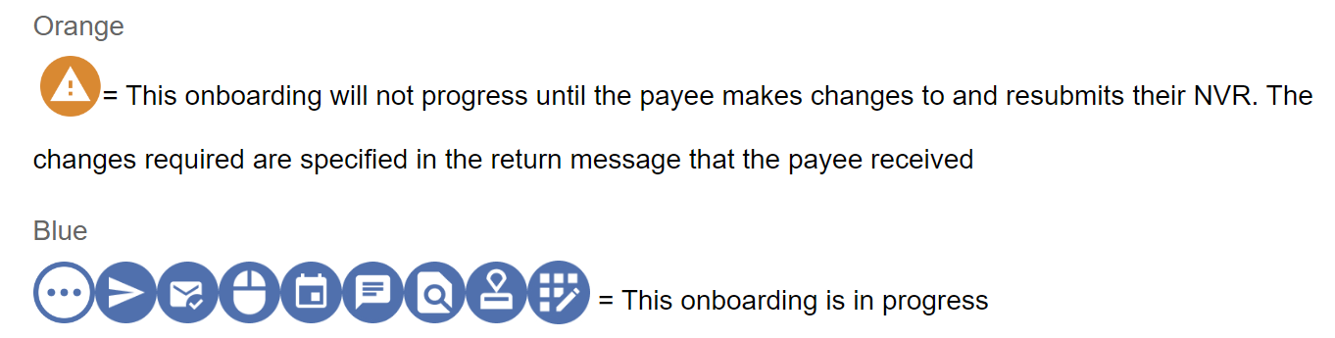
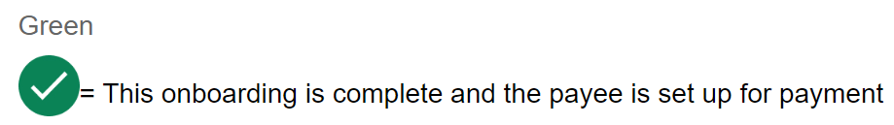
Onboarding Tracker Colors and Icons (1)
The Onboarding Tracker displays specific colors and icons for each onboarding record based on current status. Icons also display on the invitation action buttons.
Onboarding status by color:

Slide 34
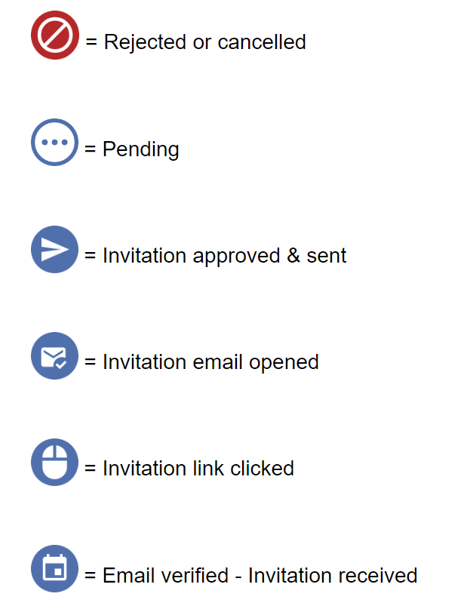
Onboarding Tracker Colors and Icons (2)
Onboarding status by icon:

Slide 35
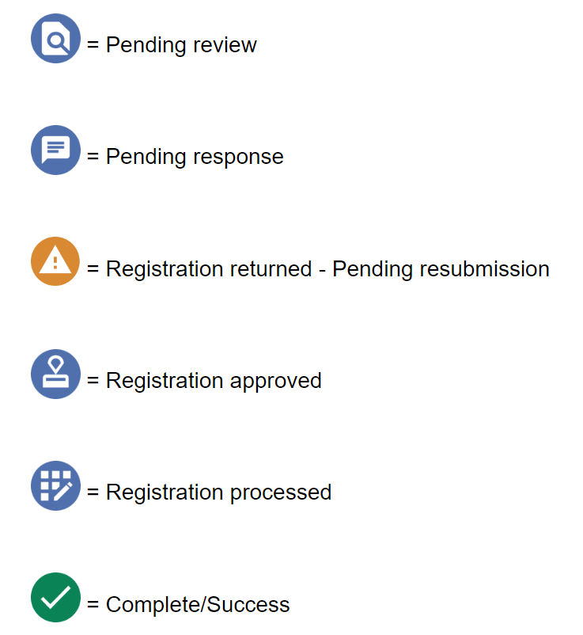
Onboarding Tracker Colors and Icons (3)
Onboarding status by icon cont’d:

Slide 36
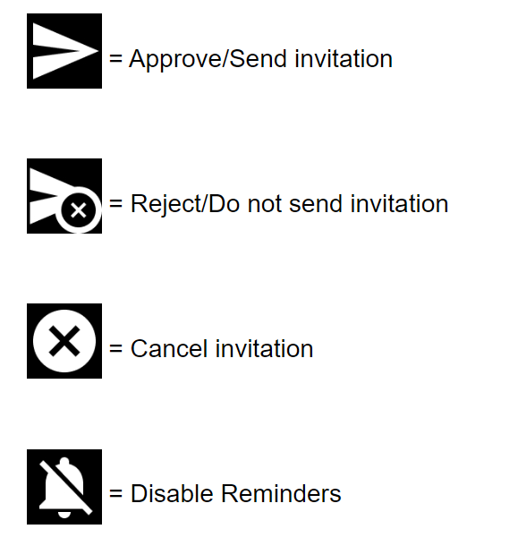
Onboarding Tracker Colors and Icons (4)
Buttons:

Slide 37
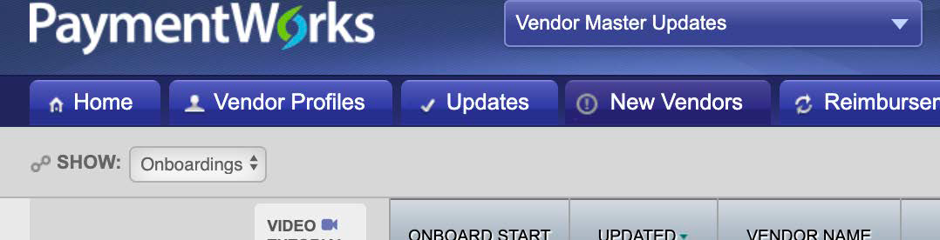
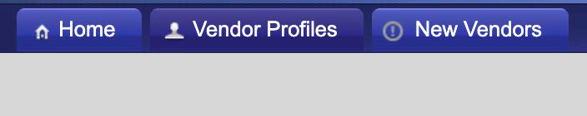
View Status of Onboarding Vendor Registration (1)
View Vendor Onboarding Status
Navigate to the Vendor Master Updates page
Select the New Vendors tab

Slide 38
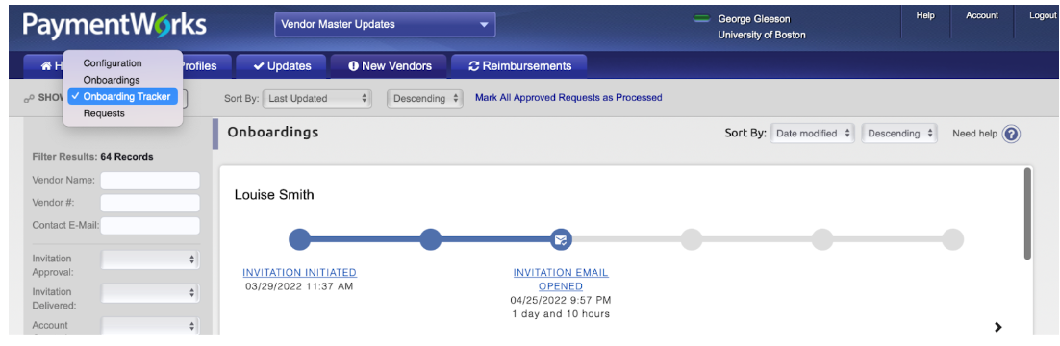
View Status of Onboarding Vendor Registration (2)
View Vendor Onboarding Status
Here, you can track the status of the supplier’s registration invitation (example, Invitation Email opened), vendor account and new vendor registration status.
A video tutorial is available here to help you navigate the screens.

Slide 39
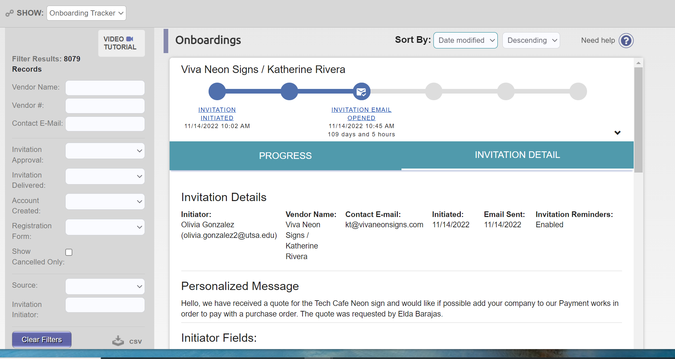
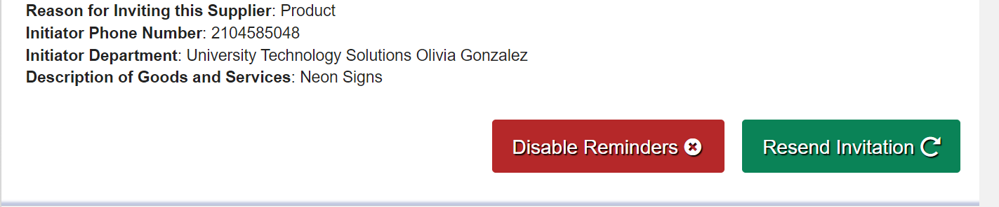
View Status of Onboarding Vendor Registration (3)
How to View General Information of Onboarding Vendor Status
Select the hyperlinks of the onboarding tracker to view general status information of onboarding vendor.
You can disable reminders or resend the invitation from this screen.
1
2

Slide 40
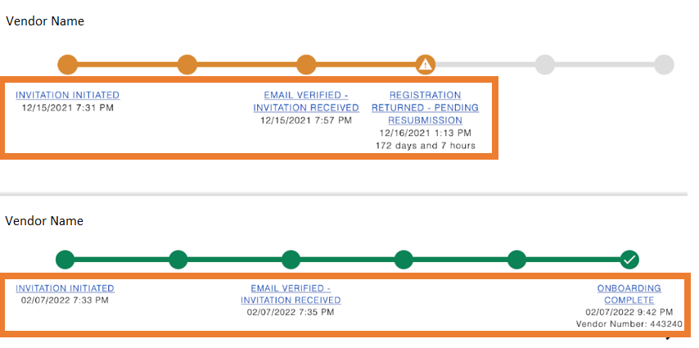
View Status of Onboarding Vendor Registration (4)
Onboarding Tracker List View
List View
Invitation Initiation
Invitation Receipt
Registration Submission (if onboarding not complete) or Onboarding Complete

Slide 41
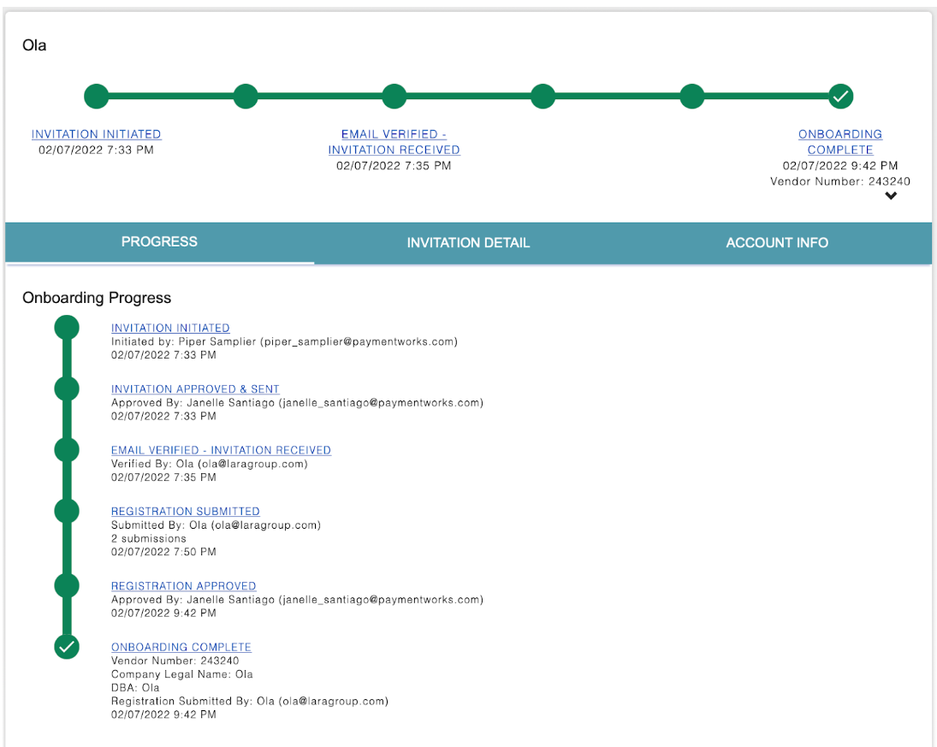
View Status of Onboarding Vendor Registration (5)
Onboarding Tracker Detail View
Details View
Progress: Created when the onboarding initiated
Invitation Detail: Created when the onboarding is initiated
Account Info: Created when the payee verifies their account

Slide 42
View Status of Onboarding Vendor Registration (6)
Onboarding Tracker
The are six general steps in the payee onboarding process:
Invitation initiation
Invitation approval
Invitation receipt
Registration submission
Registration approval
Onboarding completion

Slide 43
View Status of Onboarding Vendor Registration (7)
Status by Onboarding Tracker Circle
First Circle: Invitation Initiation
Invitation initiated = initiator sent an invitation
Invitation rejected = invitation rejected by UTSA approver (DTS or ORI)
Invitation cancelled = invitation cancelled by the initiator or another UTSA approver (DTS or ORI)

Slide 44
View Status of Onboarding Vendor Registration (8)
Status by Onboarding Tracker Circle
Second Circle: Invitation Approval
Invitation pending approval = invitation is awaiting approval from another payer user
Invitation rejected = invitation rejected by UTSA approver (DTS or ORI)
Invitation cancelled = invitation cancelled by the initiator or UTSA approver (DTS or ORI)

Slide 45
View Status of Onboarding Vendor Registration (9)
Status by Onboarding Tracker Circle
Third Circle: Invitation Receipt
Invitation email opened = payee opened email invitation
Invitation link clicked = payee clicked on the link in the email invitation to register with PaymentWorks
Email verified = invitation received; payee set up account with PaymentWorks and verified their email address

Slide 46
View Status of Onboarding Vendor Registration (10)
Status by Onboarding Tracker Circle
Fourth Circle: Registration Submission
Registration in progress = no New Vendor Registration (NVR) yet; payee began to fill out an NVR
Registration returned – pending resubmission = payee’s NVR was returned; the payee needs to make changes and resubmit the NVR
Registration submitted = payee completed and submitted their registration form and this registration form is no longer pending review

Slide 47
View Status of Onboarding Vendor Registration (11)
Status by Onboarding Tracker Circle
Fifth Circle: Registration Approval
Registration submitted – pending PaymentWorks review = payee completed and submitted their registration form. PW (PaymentWorks) is reviewing the payee’s banking information
Registration submitted - pending payee response = payee completed and submitted their registration form. PW called the payee and left a message; the payee needs to return the phone call

Slide 48
View Status of Onboarding Vendor Registration (12)
Status by Onboarding Tracker Circle
Fifth Circle: Registration Approval
Registration submitted – pending internal review = payee completed and submitted their registration form. PW reviewed the bank account. The registration is now awaiting internal review from DTS and ORI (applicable to foreign vendors)
Registration resubmitted – pending PaymentWorks review = payee completed and resubmitted their registration form. PW is reviewing the payee’s banking information

Slide 49
View Status of Onboarding Vendor Registration (13)
Status by Onboarding Tracker Circle
Fifth Circle: Registration Approval
Registration resubmitted – pending payee response = payee completed and resubmitted their registration form. PW called the payee and left a message; the payee needs to return the phone call
Registration resubmitted – pending internal review = payee completed and resubmitted their registration form. PW reviewed the bank account. The registration is now awaiting internal review from DTS and ORI (applicable to foreign vendors)

Slide 50
View Status of Onboarding Vendor Registration (14)
Status by Onboarding Tracker Circle
Fifth Circle: Registration Approval
Registration rejected = new vendor registration form was reviewed and rejected by DTS or ORI
Registration approved = new vendor registration form was reviewed and approved by DTS and ORI (applicable to foreign vendors)

Slide 51
View Status of Onboarding Vendor Registration (15)
Status by Onboarding Tracker Circle
Sixth Circle: Registration Approval
Registration processed = information from the new vendor registration form in PaymentWorks interfaced into PeopleSoft and Rowdy Exchange
Onboarding complete = payee is set up for payment. The new vendor registration is in PeopleSoft and connected (linked) to PaymentWorks. The payee can view their invoice data in PaymentWorks

Slide 52
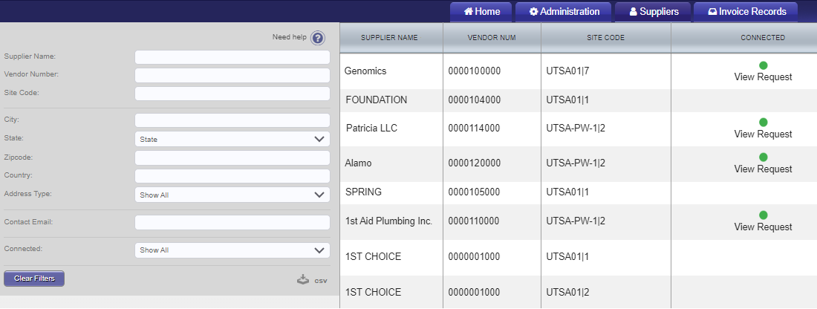
View Status of Onboarding Vendor Registration (16)
Suppliers with Connected Status
Suppliers with a connected status have successfully interfaced with PeopleSoft and Rowdy Exchange. Connected vendors will display a green dot in the connected column.
Note: Select Need Help for assistance with navigating screens

Slide 53
View Status of Onboarding Vendor Registration (17)
Supplier Reminders
Onboarding vendors receive emails until the registration is complete or reminders are cancelled. From the date the invite is submitted, reminder email notifications automatically generate as follows:
1st Reminder – 3 days
2nd Reminder – 7 days
3rd Reminder – 14 days
4th Reminder – 21 days
5th Reminder – 28 days

Slide 54
Viewing Invoices (1)
Initiators and vendors have access to view vendor payments (invoices) with a UTSA01 location:
Additional detailed payment information for all vendor locations remains housed in PeopleSoft
Select the Invoices tab to view invoice payments.

Slide 55
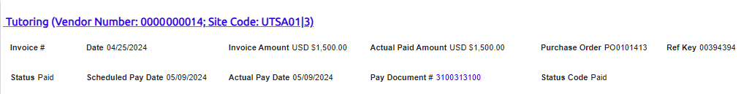
Viewing Invoices (2)
The window will expand when you select the invoice line.
Site Code: UTSA01 1 (mapped to location and sequence address in PeopleSoft)
Note: Payment updates are immediate but may encounter a small delay due to server data exchange. Vouchers created before a vendor update will retain old information. Vouchers created after a vendor update will reflect the update.

Slide 56
Setting up UTSA as a Vendor
Contact DTS to setup UTSA as a vendor on other similar automated platforms
DTS will establish user accounts on behalf of UTSA

Slide 57
Tips & Tricks (1)
Do not re-send an invitation unless the supplier notifies you that the initial email was not received:
Remember to check the vendor onboarding status before resending an invite
You can resend an invite only if the Invitation column status is on Sent, Delivered, Opened or Clicked and if the Vendor Account column states No Account.
You can correct an email address on an invite by clicking on the Resend Invite button and entering the correct email address.

Slide 58
Tips & Tricks (2)
Cancel/Disable reminders for the first invite when correcting a supplier email address; otherwise you will continue to generate reminders.
You cannot delete an invite, but you can disable it.
If a supplier will no longer be used, you can cancel/disable the invite by disabling the reminders.

Slide 59
Tips & Tricks (3)
Suppliers in an approved status and properly interfacing with PeopleSoft and Rowdy Exchange will display a connected status with a vendor number:
Suppliers in connected status have set up user accounts
Foreign vendors without a TIN must first contact DTS to request a temporary TIN:
TINs are required for account setup

Slide 60
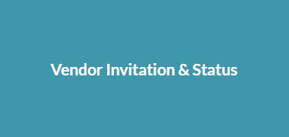
Online Help, Training Resources (1)
Online Help
Located at the top-right corner, Help is available to assist you with navigating and moving between screens
A tile for Vendor Invitation & Status within the Help feature also displays on the page.

Slide 61

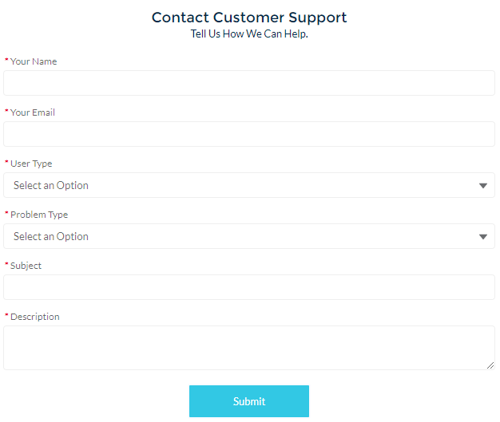
Online Help, Training Resources (2)
Online Help cont’d
For questions regarding the PaymentWorks platform, please use the Help feature and then select the Contact Support button.

Slide 62
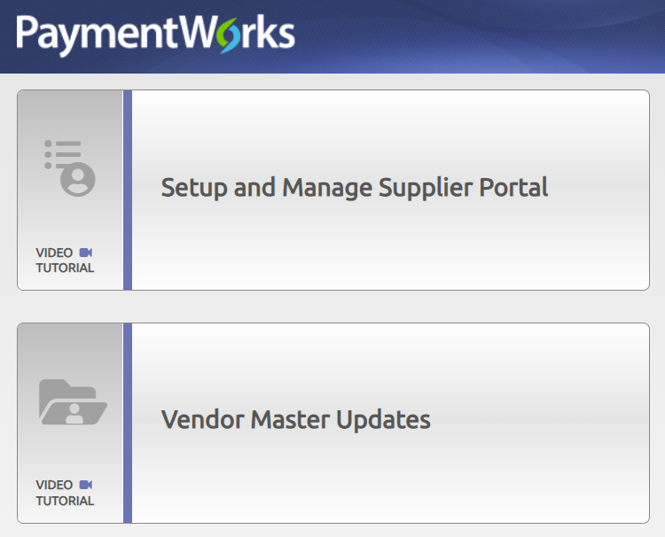
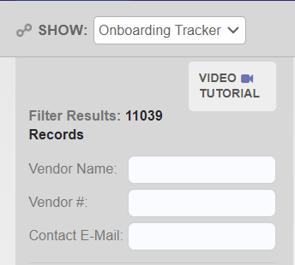
Online Help, Training Resources (3)
Online Help cont’d
The PaymentWorks homepage and onboarding pages contain video tutorials to assist with navigating through the online platform. Select each button to view them.

Slide 63
Online Help, Training Resources (4)
Contact Information
For supplier questions
PaymentWorks
  Vendors knowledge base support website > Select the Contact Support button
  Disbursements & Travel Services (DTS)
    Email disbursements.travel@utsa.edu

Slide 64
Online Help, Training Resources (5)
Contact Information cont’d
For security role access
University Technology Solutions (UTS)
  Email techcafe@utsa.edu

Slide 65
Online Help, Training Resources (6)
Training Resources
On the Disbursements & Travel Training webpage, under the PaymentWorks Vendor Onboarding Process drop-down, you will find
The Initiator Role job aid
The Vendor Role job aid

Slide 66
Contact Us
If you have questions about this job aid, you can contact us at
Disbursements & Travel Services
Disbursements & Travel Services website
Email: disbursements.travel@utsa.edu
Phone: (210) 458-4213

Slide 67

Thank you
utsa.edu/financialaffairs

