Slide 1
Office of the Vice President for Research,
Economic Development, & Knowledge Enterprise
Dr. Bernard Arulanandam
December 2, 2021

Slide 2
Key Performance Indicators (KPIs)
REDKE KPIs | FY18 | FY19 | FY20 | FY21
Number of Proposals | 922 | 1,046 | 1,038 | 1,074
Total Budget in Proposals | $368M | $488M | $466M | $679M
Number of Awards | 308 | 388 | 373 | 367
Total New Awards | $54M | $83M | $68M | $168M
Total Research Expenditures | $70M | $81M | $134M | $140M
Restricted Research Expenditures (RRE) | $44M | $51M | $64M | $68M
Federal Research Expenditures | $29.8M | $34.6M | $34.3M | $43M
NRUF Expenditures | $37.6M | $43.7M | $56.4M | $58M
RRE per T/TT Faculty FTE | $67K | $79K | $103K | $111K
Faculty Awards (CMUP) | 5 | 7 | 4 | 6
National Academy Memberships | 5 | 6 | 10 | 11
Total Patents Issued | 7 | 25 | 22 | 24
Strategic Partnerships | 3 | 38 | 22 | 26
Economic Impact | $2.9B | $2.7B | $2.4B | $3.0B

Slide 3

Disaster-Related Client Advising
Clients – 3,088
Advising Sessions – 10,665
Contact Hours – 14,291
Disaster-Related Non-Client Advising
Engagements – 709
Advising Sessions – 761
Contact Hours – 425
Disaster-Related Capital Funding
Clients Receiving Assistance – 1,652
Funding Transactions Approved – 869
Total Funding Approved - $60.4m
Disaster-Related Training Activity
Training Events - 636
Training Attendees – 11,993
Total Served
15,730 (clients, attendees, non-client engagements)

Slide 4
Research, Economic Development, and Knowledge Enterprise
National Research University Fund Eligibility
NRUF Criteria | FY2019 (Last NRUF Report April 2020) | FY2021 Actuals
Restricted Research Expenditures (>$45M) | $44M | $68M
High Quality Faculty | Summer 2021 THECB Review of Dossiers Fall 2021 THECB Onsite Review Spring 2022 NRUF Audit Decision
High Quality Graduate Education
NRUF
Tier One in Texas
NRUF Criteria | FY2019 (Last NRUF Report) | FY2021 Actuals
Freshmen Class w/High Academic Achievement (Top 25%) | 59% | > 50%
Phi Kappa Phi Member | Yes | Yes
** Not for distribution **
4

Slide 5
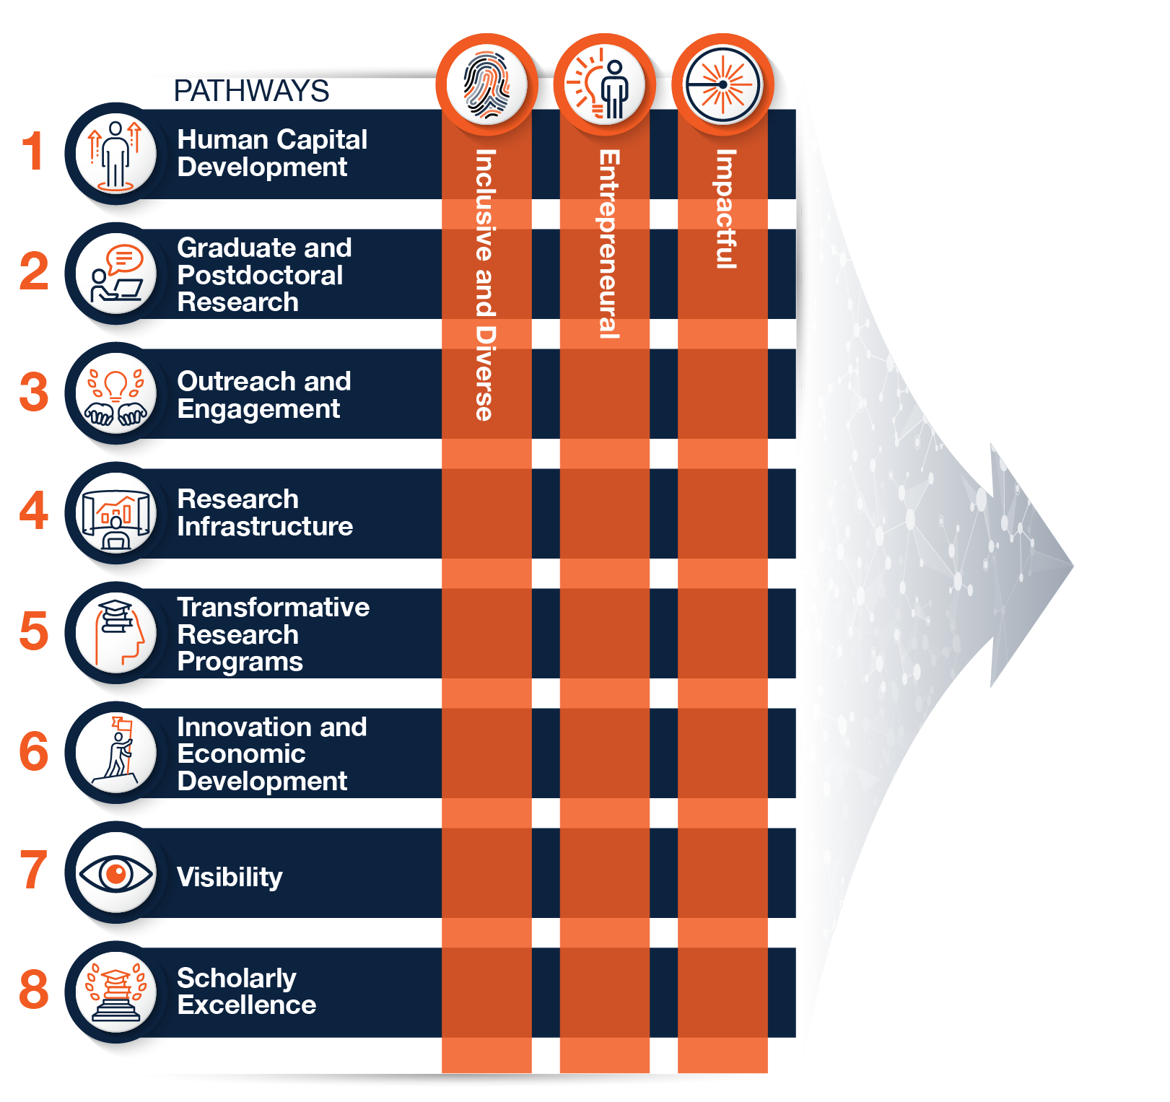
This is a heading
ACCELERATE 2030
FRAMEWORK FOR A BOLD NEW KNOWLEDGE ENTERPRISE
DESTINATION
A Hispanic thriving institution with global impact.
DO YOU HAVE A SUBHEADING?

Slide 6
December 2021
Feedback sessions & survey
Finalize research pillars
Finalize tactics and KPIs
January 2022
Feedback sessions & survey
Assign leads and responsibilities
Identify fiscal and material resources
February 2022
Finalize Accelerate 2030 draft
March 2022
Public launch and implementation
Implementation Process & Timelines
Accelerate 2030 Feedback Session
December 8, 2021 from 3:00pm – 4:30pm (Virtual or In person – GSR 2.106)
December 15, 2021 from 3:00pm – 4:30pm (TEAMS only)
January 7, 2022 from 8:00am – 9:30am (Virtual or In person – GSR 2.106)
January 15, 2022 from 1:00pm – 2:30pm (TEAMS only)
Registration

Slide 7
Accelerate 2030
Survey for Feedback
THANK YOU
Bernard Arulanandam
Ph.D., MBA
Vice President for Research, Economic Development,
& Knowledge Enterprise
@UTSAResearch | @UTSAInnovation | @UTSANSCC | @EconDevUTSA

