Slide 1


Chair’s Report
Chad Mahood, Ph.D.
Faculty Senate Chair
Associate Professor
Department of Communication
March 26, 2020

Slide 2
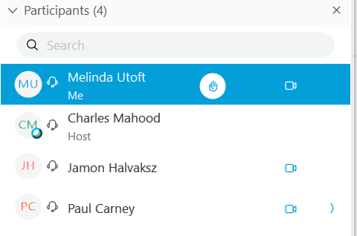
Welcome
We follow Roberts Rules so please wait to be recognized by the Faculty Senate Chair (or lead Administrative Assistant)
  Please use the hand-raise button and wait to be recognized
Consent Agenda
Welcome guests

Slide 3
Faculty Senate Chair
Moving to Electronic Voting
Current Senate By-laws state that “Voting may be conducted electronically at the discretion of the Chair of the Faculty Senate” unless “a minimum of five senators vote against the electronic voting procedure”
I propose that, on a case by case basis, if a vote is called and seconded that it be moved to an email vote with a set deadline (provided fewer than five Senators object)
This way Senators unavailable for a live vote (due to life/family circumstances) can still have a vote

Slide 4
Faculty Senate Chair
HOP 2.02 and HOP 2.50
Potential Changes to NTT faculty appointments
NTTs would become Fixed-Term Track (FTT) Faculty
More title options, more clarity on promotion process, and more opportunities for longer contracts
This is just an early opportunity to give feedback
  HOP 2.02 and HOP 2.50 will go through the normal process and we will have the opportunity for Stakeholder feedback

Slide 5
Faculty Senate Chair
Pass/Fail grades: Some possible options
Option A
  No change. Continue with existing grading procedures.
Option B (4-step process)
  1) Faculty members decide if their course is eligible/suitable for P/F option
        (at the course level, NOT the section level)
  2) Faculty members register a course with the Registrar as P/F option
  3) Students meet with Advisors; discuss pros/cons of P/F in each instance
  4) Students must opt-in to P/F option by a specific date
Option C
  University mandated P/F
Option D
  Abstain from vote

Slide 6
Faculty Senate Chair
Committee Updates
Monthly:
  University Leadership Council
  Joint President's Cabinet and University Leadership Council
  Space and Planning Advisory Committee (SPAC)
Occasionally:
  UT System Faculty Advisory Council (SYSFAC)
  University HOP Committee

