Slide 1
Faculty Senate Fall 2021 / Academic Affairs
Kimberly Andrews Espy, Ph. D. Provost & Senior Vice President
November 11, 2021

Slide 3
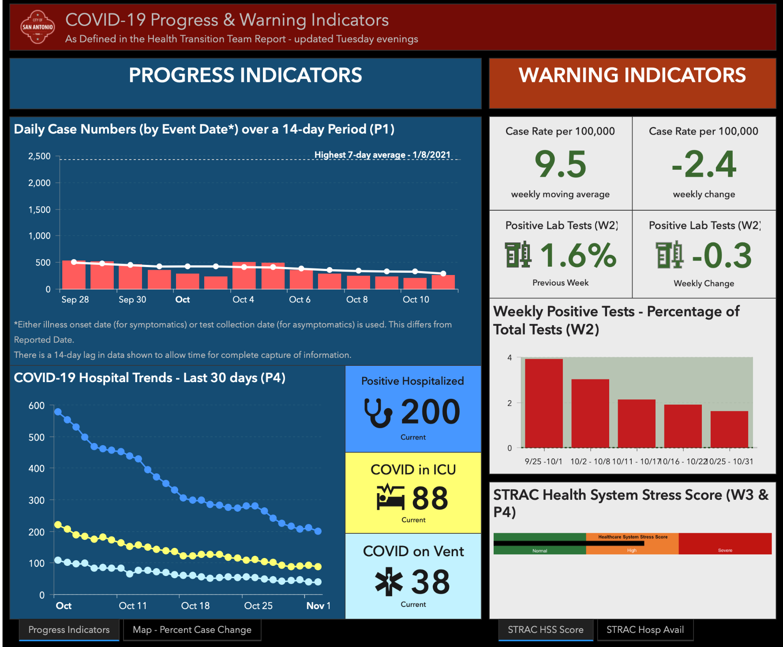
Destinations
Notes:
Several of you had asked about winter expectations, the SAMH risk level is now “low” and the leading indicators show significant improvement. Taylor spoke to Jason Bowling at UTHSA, who agreed that the IHME model does suggest that there may be a very mild uptick over the winter in Texas. Lots of folks are vaccinated or have had COVID once. Obviously, the virus is not eradicated presently, boosters are still a good idea, no real concerns presently about new variants, there does not seem to be prevalent concern around a Thanksgiving or winter break mini surge.

Slide 5
