Slide 1
Business Service Contracts
Policies and Procedures – AM541

Slide 2
Course Objectives
Defining and assess what a business contract is
Describe and differentiate contract execution
Discuss and illustrate various types of business contracts
Review most commonly used business contracts at UTSA.
Classify and understand other types of business contracts
Identify a click-wrap contract
Evaluate an agreements with employees and its requirements
Define an after-the-fact agreement and review submission process
Analyze various contract routing methods
Detail using Total Contracts Manager
Identify and discuss contract timelines

Slide 3
Business Contracts Office Staff
Contracts Specialists
Contracts Administrator
Frank Grijalva, MBA (ext. 4975)
Anthony Sanchez, J.D. (ext. 4680)
Todd Cheslock, J.D. (ext. 4899)
Kelli Morrison (ext. 4065)
Management
Richard Wollney, J.D. (ext. 4069)
Robert Dickens, (ext. 4065)

Slide 4
Defining a Contract
Contract Law 101

Slide 5
What is a Contract?
A contract is an agreement between two parties that creates an obligation to perform (or not perform) a particular duty.
A legally enforceable contract requires:
An Offer (I’ll mow your lawn this weekend, if you pay me $30)
An Acceptance (You’ve got a deal)
Consideration (The value received and given – the money and the lawn mowed)
Contract Law 101 - Determining the Initial Step

Slide 6
Establishing Offer and Acceptance:
A legally recognized offer and an acceptance creates a “meeting of the minds’, or mutual assent, between the parties.
Mutual Assent requires the presence of the following factors:
Both parties must exhibit a “contractual intent” [words spoken in jest or frustration will lack the requisite intent];
The terms of the offer must be clear and definite;
The acceptance must be clearly communicated.
“A Meeting of the Minds”

Slide 7
The Requirement
Required Clarity: For terms to be legally valid, a reasonable person must be capable of readily understanding them.
Four primary areas in determining definite terms:
the parties;
time for performance (term or service schedule);
the price; and
the subject matter or scope of service.
Clear and Definite Terms

Slide 8
Consideration
“Bargained-for-Exchange”
Consideration must be mutual. Both parties must receive something of value.
Involvement of money is not required.
The importance of the “Bargained Exchange”

Slide 9
Executing the Contract
Who can Sign?

Slide 10
Signature Authority
President-Delegated Authority:
Only an individual with a written delegation of authority from the President of UTSA may execute and deliver contracts on behalf of the University. A University contract without an authorized signature may be invalid and unenforceable.
Currently, the President has delegated to the following positions the authority to sign business contracts:
Vice President of Business Affairs
Director of Business Contracts, up to $100K
Business Contracts Manager, up to 50K
Vice President for Student Affairs, only in the extended absence of the VPBA, up to $1M
For UTSA’s full delegation listing, see http://www.utsystem.edu/documents/docs/delegation-authority/delegations-authority-academic-institution.
Who can sign?

Slide 11
Types of Contracts
Various types of contracts

Slide 12
Affiliation & International Program Agreements
Athletic-Specific, or Student-Specific Contracts (non- procurement in nature)
Entertainer/Artist Agreement
Interagency Cooperation Agreements (IAC) & Inter-Local Agreements
Museum/Exhibit Agreements
Revenue Generating Agreements
MOUs/MOAs
Participant/Speaker Agreement
Procurement Contracts; Vendor Services
Service Agreements (for individuals not organized as a business)
Click Wrap Agreements
Study Abroad Agreements
Software and/or Hosted License Agreements
Real Estate
Auxiliary Services

Slide 13
Specific Business Contracts
More commonly used business contracts

Slide 14
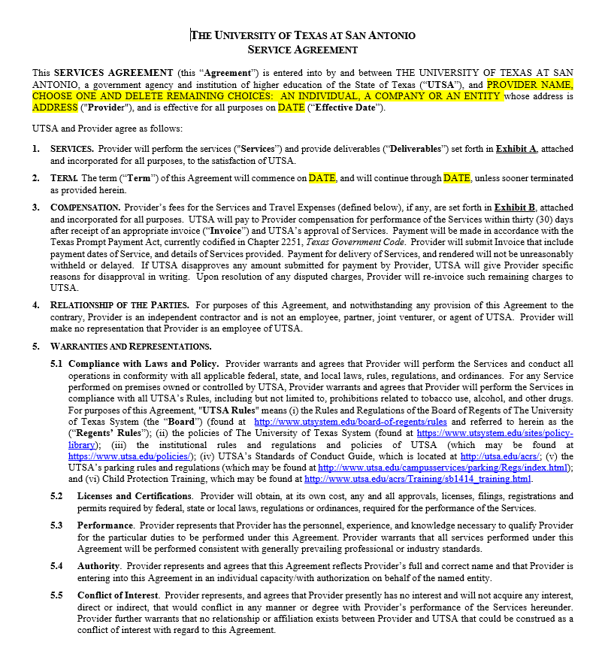
Service Agreement
Used for services from individuals or other entities not formally organized as a business
Small dollar: Total Value not to exceed $15,000 (including reimbursable expenses)
After the Fact Purchases (More detail to follow)
Details of Service Agreement (Critical Nature of Exhibits)

Slide 15
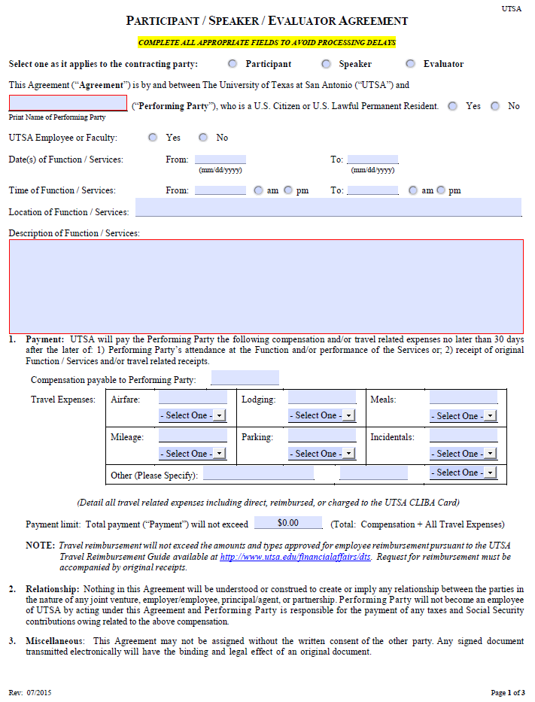
Participant, Speaker, Evaluator Agreement
Used for speakers, lecturers, evaluator, or to provide compensation to individuals participating in formal University events
Used to contract with individuals or other entities not formally organized as a business
Small dollar: Total Value not to exceed $15,000 (including reimbursable expenses)
Details of Participant/Speaker/Evaluator Agreement

Slide 16
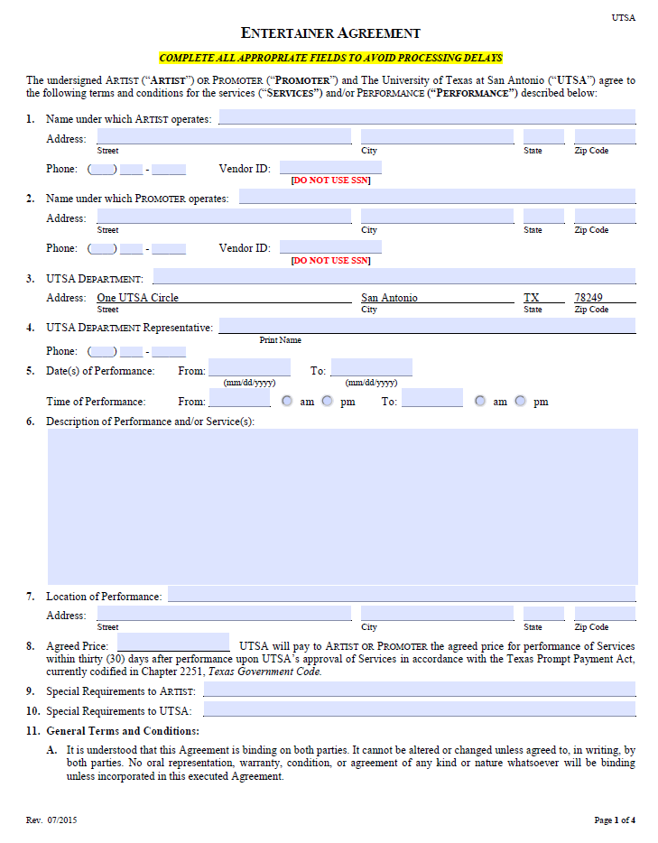
Entertainer, Artist, Promoter Agreement
Used for artists, entertainers, or performers
Used to contract with both individuals and companies
Exempt from Competitive Procurement: Value can exceed $15,000
Details of Entertainer/Artist Agreement

Slide 17
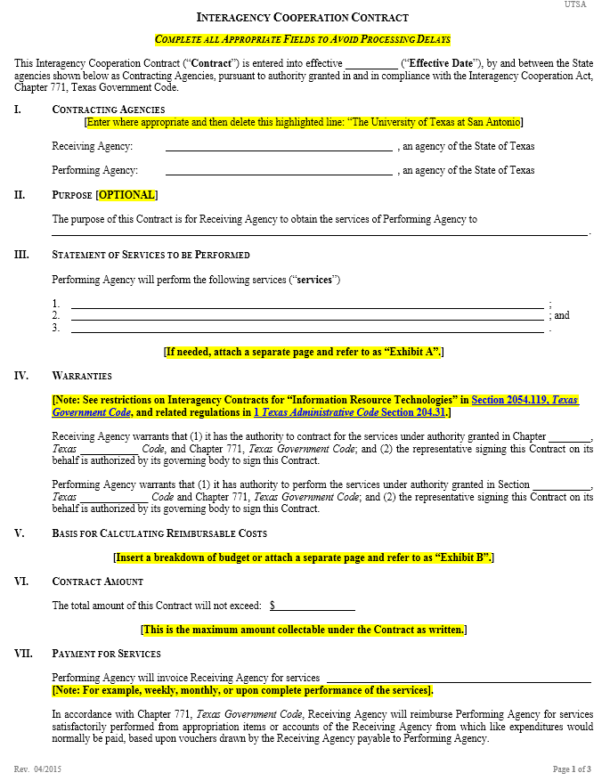
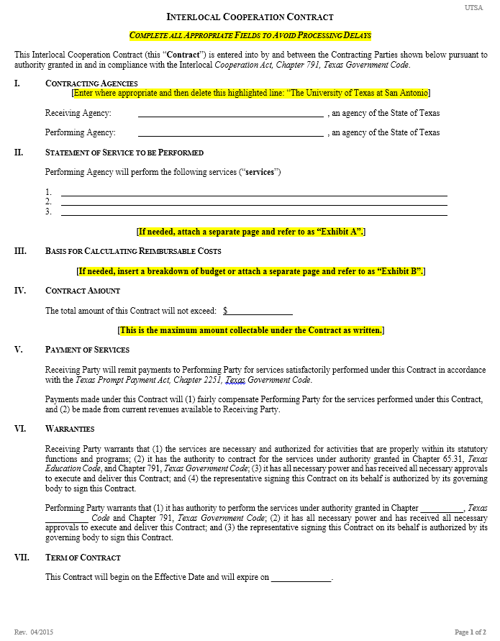
Interagency & Interlocal Agreements
Used for contracts with other State of Texas Government entities
Interagency: Contracts with other State agencies
Interlocal: Contracts with Texas municipal, county, and local government entities (also includes political subdivisions of the State, such as school districts)
Exempt from Competitive Procurement: Value can exceed $15,000 (with certain exceptions)

Slide 18
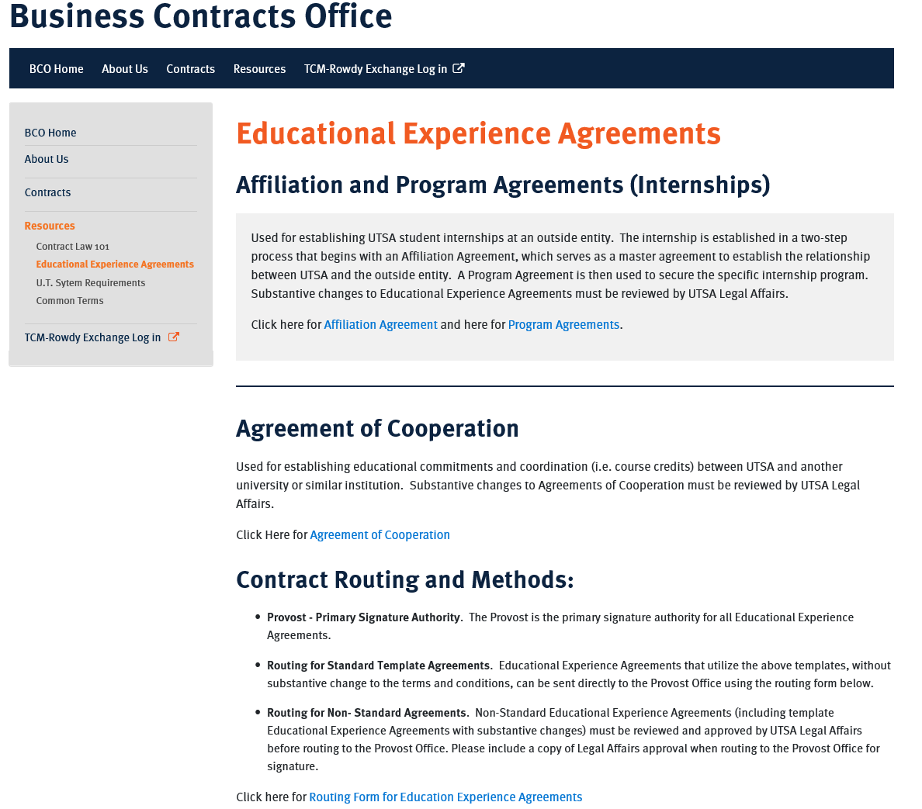
Educational Experience Agreements
Used to establish student internships
No exchange of funds
Changes to Standard Template Requires UT System Approval
Requires both Affiliation and Accompanying Program Agreement
Send Information Form to vendor

Slide 19
Other Types of Business Contracts
Review specific contracts and their processes

Slide 20
Clickwrap Agreements
A clickwrap agreement is a standard form agreement that is displayed on a website.
The user must indicate assent to the agreement by clicking on an icon which indicates acceptance of the terms of the agreement before access will be granted to the software, data, or other digital content.
Sample clause:
By clicking the acceptance button or installing or using the . . . software, the individual or entity licensing the product (“licensee”) is consenting to be bound by and is becoming a party to this agreement. If licensee does not agree to all of the terms of this agreement, the button indicating non-acceptance must be selected, and licensee must not install or use the software.
Defined

Slide 21
Clickwrap Agreements
A Clickwrap agreement will be binding on the University and can only be properly accepted by those individuals with President-delegated authority to bind the University to a contractual commitment.
ALL Clickwrap Agreement requests should be forwarded to the Business Contracts Office for review.
The Business Contracts Office will assist in securing the appropriate authorization for acceptance of a Clickwrap agreement and document it with the required offices.
How to Process

Slide 22
Agreements with Employees
Handbook of Operating Procedures 4.31 Conflicts of Interest Policy
Self-dealing/Transactions with Employees – Section H
Requires President’s Approval
Cost less than from any other known source
What you need to know

Slide 23
Agreements with Employees
ALL Agreements with Employees requests should be forwarded to the Business Contracts Office for review.
The Business Contracts Office will advise the department on the required steps in securing the appropriate approvals for an Agreement with an Employee and how to document it with the required offices.
How to process

Slide 24
After-the-fact
What is an After-the-Fact?
Services or Goods Secured Prior to an Executed Contract (includes PO)
Purchasing’s After-the-Fact Form found under Procurement Forms in Rowdy Exchange’s Shopping Dashboard
Fill out and follow steps outlined in form for all After-the-Fact purchases
What you need to know

Slide 25
After-the-fact

Slide 26
Contract Routing Methods
Using SciQuest TCM and other routing methods

Slide 27
Contract Routing Methods
The Business Contracts Office can receive an agreement utilizing one of the three methods below:
Electronic Submission through Rowdy Exchange's Total Contracts Manager (TCM)
Paper hard copy submission to the BCO
Email submission to the BCO email inbox (business.contracts@utsa.edu)
For more details on routing an agreement, see http://www.utsa.edu/bco/contracts/submitting.html
What you need to know

Slide 28
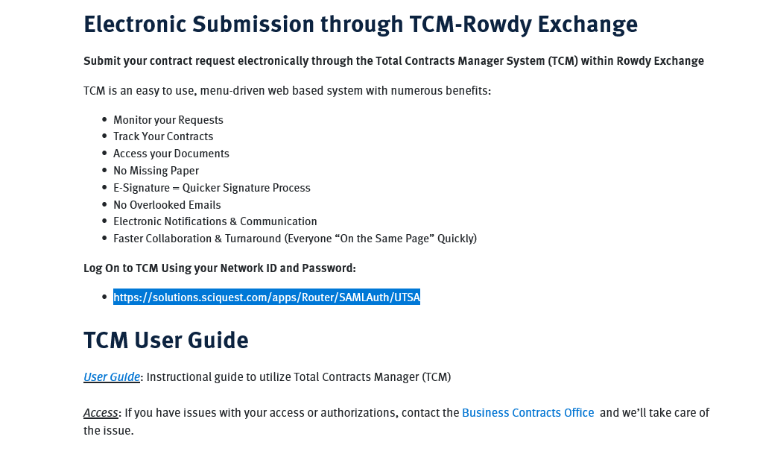
Routing using Total Contracts Manager (TCM)
Submit you contract requests and monitor them electronically
Easy upload of contract documents and required approvals
Access your department’s contracts and search all business agreements processed by the University
Single Sign-On (abc123)
https://solutions.sciquest.com/apps/Router/SAMLAuth/UTSA

Slide 29
Contract Timelines
How long will it take to complete?

Slide 30
General Timelines
Standard Template Agreements with all routing secured are typically signed within 3 business days upon receipt by the Business Contracts Office
Location for drop-off of agreements:
Business Contacts Office located is at the Central Receiving Building on West Main Campus
Delays Resulting from Improper Routing
Agreements with Substantive Modifications need to reviewed by the Business Contracts Office
What you should know.

Slide 31
Additional Information
Business Contracts Website

Slide 32
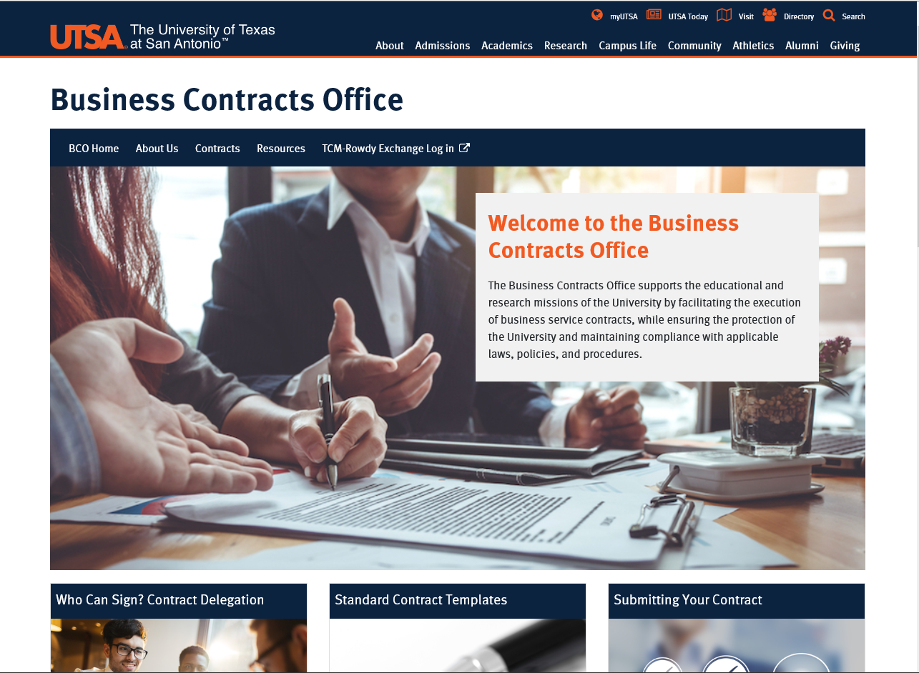
BCO Website
Quick tour of links and valuable information

Slide 33
Questions?

Slide 34
Thank You

