Slide 1
Administrative and Professional (A&P) timesheets
Learn when and how to submit your timesheet as an A&P employee
Payroll
Revised 05/21/2025

Slide 2
Important note
To ensure you have the most current information, please get this job aid from the website rather than referring to a locally-saved version.

Slide 3
When do I enter timesheets?
A&P employees submit timesheets only when one of the following applies:
You work on a holiday or skeleton crew day.
You use/report holiday or wellness compensatory (comp) time taken (you’ll use the STCTS – State Comp Taken Salaried code).
Timesheet entry and submission are in PeopleSoft—see the following slides for more information.

Slide 4
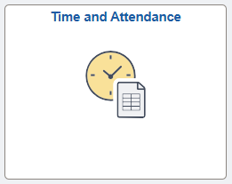
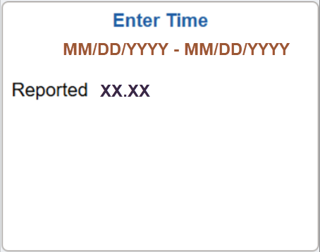
Access timesheet in PeopleSoft
Log into Peoplesoft: Go to my.utsa.edu, select UTShare/PeopleSoft, select UTSA if prompted, log in with your myUTSA ID.
Under Employee Self Service, select the Time and Attendance tile, then select the Enter Time tile.
Next, we’ll show how to enter your timesheets.

Slide 5
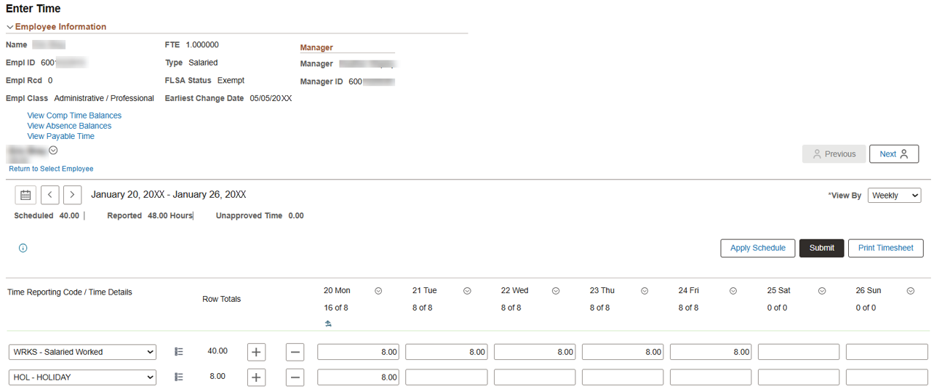
Worked on a holiday/skeleton crew day (1)
Example: You worked eight hours on January 20th, a holiday for Martin Luther King Jr. Day.
1. Leave the auto-populated holiday hours as they are.
3. Select Submit to begin submitting your timesheet.
2. Under the 20th, on the WRKS – Salaried Worked row, enter eight hours.

Slide 6
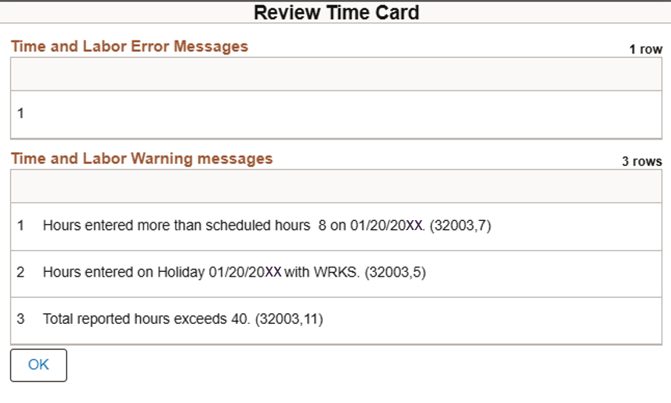
Worked on a holiday/skeleton crew day (2)
Review Time Card warning messages will appear (example below).
Review, then select OK to complete submitting your timesheet to your people leader for review and approval.
After approval, green checkmarks will appear on your timesheet.
Approved time worked on a holiday or skeleton crew day will earn you comp time at a 1:1 rate.

Slide 7
Used holiday/wellness comp time (1)
Example: You are scheduled to work eight hours a day, Monday to Friday.
Instead, this week you took Friday off using holiday comp time (eight hours off).
1. Under Friday, delete the hours shown on the WRKS – Salaried Worked row.

Slide 8
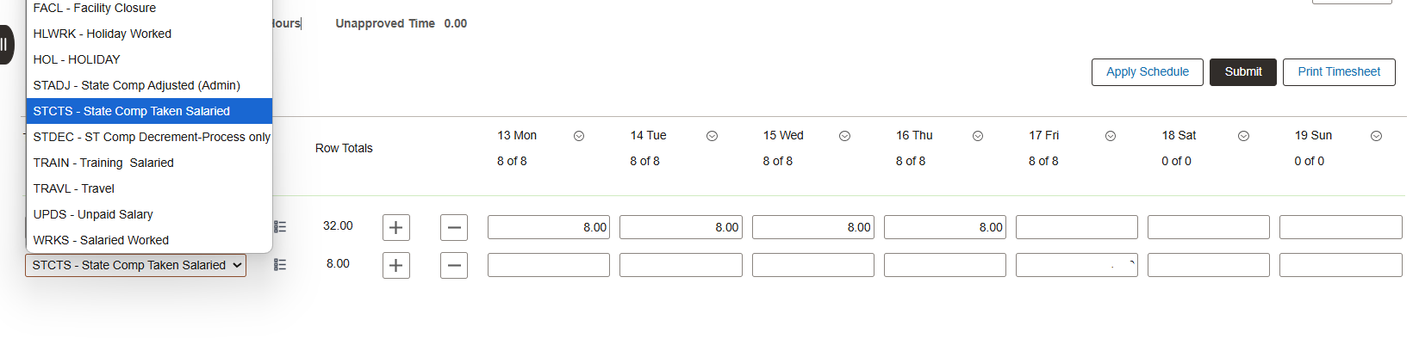
Used holiday/wellness comp time (2)
2. Select the + icon to add a row.
3. From the drop-down, select STCTS – State Comp Taken Salaried.

Slide 9
Used holiday/wellness comp time (3)
4. Under Friday, on the STCTS – State Comp Taken Salaried row, enter eight hours.
5. Select Submit. Your timesheet will then route to your people leader for review and approval.
After approval, green checkmarks will appear on your timesheet.

Slide 10
Contact Us
If you have questions about this job aid, you can contact us at
Payroll Management Services
Payroll Management Services website
Email: payroll@utsa.edu
Phone: (210) 458-4280

Slide 11
Thank you
https://www.utsa.edu/financialaffairs/

