Slide 1
Classified exempt timesheets
Learn when and how to submit your timesheet as a classified exempt employee
Payroll
Revised 05/27/2025

Slide 2
Important note
To ensure you have the most current information, please get this job aid from the website rather than referring to a locally-saved version.

Slide 3
When do I enter timesheets?
Classified exempt employees have work schedules in PeopleSoft.
You will need to submit a timesheet when any one of the following applies:
You deviate from your work schedule:
Your workday differs from your work schedule.
You work more hours or fewer hours than your work schedule.
You use/report straight compensatory (comp) time taken, also called STCTS - State Comp Taken Salaried.
You use/report any other absence taken.
Timesheet entry and submission are in PeopleSoft—see the following slides for more information.

Slide 4
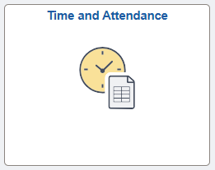
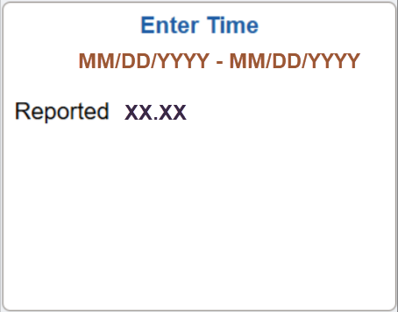
Access timesheet in PeopleSoft
Log into Peoplesoft: Go to my.utsa.edu, select UTShare/PeopleSoft, select UTSA if prompted, log in with your myUTSA ID.
Under Employee Self Service, select the Time and Attendance tile, then select the Enter Time tile.
Next, we’ll show examples of how to enter your timesheet.

Slide 5
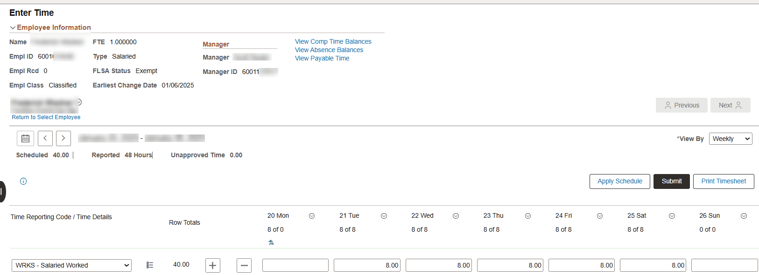
Workday differed from work schedule (1)
Example: Your work schedule is eight hours a day, Monday to Friday.
Instead, this week you worked Tuesday to Saturday, eight hours a day.
1. Under Monday, on the WRKS – Salaried Worked row, delete the auto-populated hours that you didn’t work.
Entering a zero isn’t required.
2. Under Saturday, on the WRKS – Salaried Worked row, enter the total hours you worked.
3. Select Submit to begin submitting your timesheet.

Slide 6
Workday differed from work schedule (2)
Review Time Card warning messages may appear.
Review, then select OK to complete submitting your timesheet to your people leader for review and approval.
After approval, green checkmarks will appear on your timesheet.

Slide 7
Worked more hours (1)
Example A: You are scheduled to work eight hours a day Monday to Friday, for a total of 40 hours per week.
Instead, this week you worked an additional two hours on Thursday.
1. Under Thursday, on the WRKS – Salaried Worked row, enter the total hours worked (including the additional hours).

Slide 8
Worked more hours (2)
2. This results in Reported time of 42 hours. The hours outside your scheduled hours will be added to your straight comp time balance.
As an exempt employee, you earn straight comp time rather than overtime.
3. Select the Submit button to begin submitting your timesheet.

Slide 9
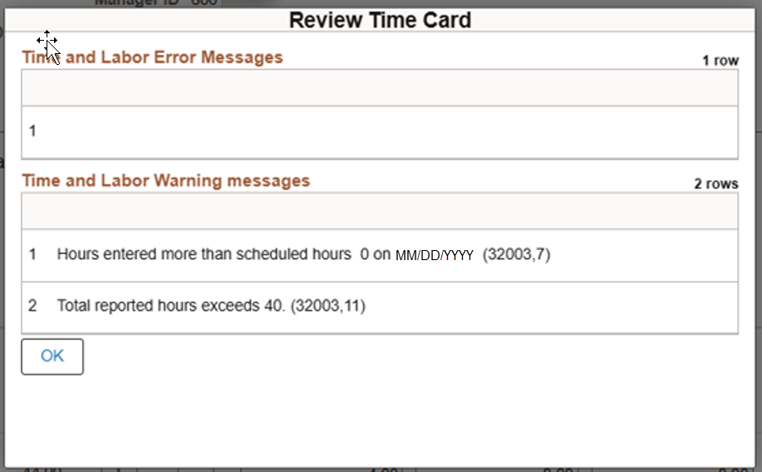
Worked more hours (3)
Review Time Card warning messages may appear (example below).
Review, then select OK to complete submitting your timesheet to your people leader for review and approval.
After approval, green checkmarks will appear on your timesheet.

Slide 10
Worked more hours (4)
Example B: You are scheduled to work eight hours a day Monday to Friday, for a total of 40 hours per week.
Instead, this week you worked an additional eight hours on Saturday.
1. Under Saturday, on the WRKS – Salaried Worked row, enter the total hours worked.
There was a university holiday on Monday, which PeopleSoft auto populated.

Slide 11
Worked more hours (5)
2. This results in Reported time of 48 hours. The hours outside your scheduled hours will be added to your straight comp time balance.
3. Select Submit to begin submitting your timesheet.
Review any Review Time Card warning messages, then select OK to complete submitting your timesheet to your people leader for review and approval.
After approval, green checkmarks will appear on your timesheet.

Slide 12
Worked fewer hours
If you worked less than your scheduled hours, you must submit a timesheet showing the reduced hours and either use straight comp time or submit an absence request to cover the difference.
If you don’t have enough accrued comp time or leave, you’re still required to report the absence, and your paycheck will be reduced to reflect the missed hours.
Next, we’ll show examples for using straight comp time and for using/reporting an absence.

Slide 13
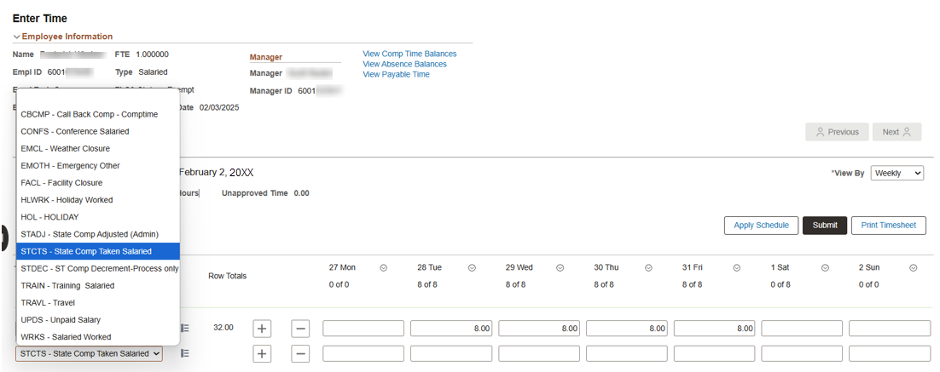
Used straight comp time (1)
Example: You are scheduled to work eight hours a day, Tuesday to Saturday.
Instead, this week you worked eight hours a day Tuesday to Friday, three hours on Saturday, then took straight comp time for the rest of Saturday.
1. On the WRKS – Salaried Worked row, select the plus icon, then select STCTS – State Comp Taken Salaried.

Slide 14
Used straight comp time (2)
2. Under Saturday, on the WRKS – Salaried Worked row, adjust the auto-populated hours to the total hours worked.
3. Under Saturday, on the STCTS – State Comp Taken Salaried row, enter the five hours of comp time taken.

Slide 15
Used straight comp time (3)
4. Select the Submit button to begin submitting your timesheet.
Review any Review Time Card warning messages, then select OK to complete submitting your timesheet to your people leader for review and approval.
After approval, green checkmarks will appear on your timesheet.

Slide 16
Used/reported absence (1)
First, you need to submit an absence request in PeopleSoft.
Then, PeopleSoft will auto populate your timesheet with the requested absence.

Slide 17
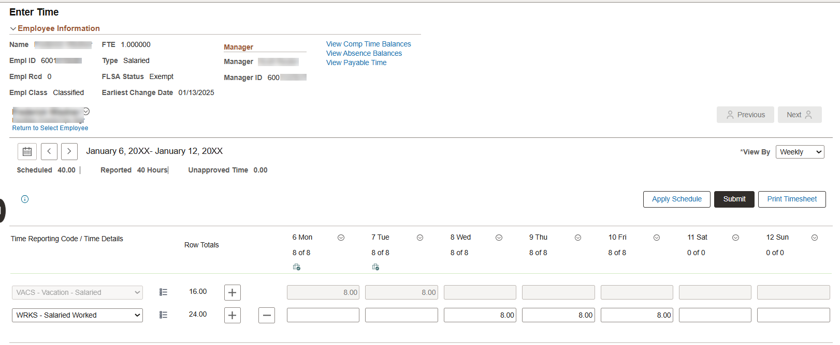
Used/reported absence (2)
Example: Your work schedule is eight hours a day, Monday to Friday.
Instead, you submitted an absence request and took vacation on Monday and Tuesday.
Your timesheet auto populates with the two vacation days on the VACS – Vacation – Salaried row.

Slide 18
Used/reported absence (3)
This leaves the default WRKS – Salaried Worked row populated for Wednesday to Friday.
Select Submit to begin submitting your timesheet.

Slide 19
Used/reported absence (4)
If a Review Time Card warning message (example below) appears, review, then select OK to complete submitting your timesheet to your people leader for review and approval.

Slide 20
Contact Us
If you have questions about this job aid, you can contact us at
Payroll Management Services
Payroll Management Services website
Email: payroll@utsa.edu
Phone: (210) 458-4280

Slide 21
Thank you
https://www.utsa.edu/financialaffairs/

