Slide 1
Classified nonexempt timesheets
Learn when and how to submit your timesheet as a classified nonexempt employee
Payroll
Revised 05/27/2025

Slide 2
Important note
To ensure you have the most current information, please get this job aid from the website rather than referring to a locally-saved version.

Slide 3
Submit timesheets weekly
As a classified nonexempt employee, you need to report total hours worked each day by submitting timesheets weekly.
Timesheet submission is in PeopleSoft.

Slide 4
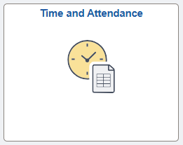
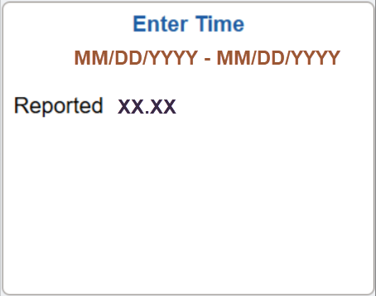
Access timesheet in PeopleSoft
Log into Peoplesoft: Go to my.utsa.edu, select UTShare/PeopleSoft, select UTSA if prompted, log in with your myUTSA ID.
Under Employee Self Service, select the Time and Attendance tile, then select the Enter Time tile.
Next, we’ll show examples of how to report hours and submit your timesheet.

Slide 5
Worked scheduled hours
PeopleSoft auto populates your timesheet with your total scheduled hours for each day.
If you work your scheduled hours, select Submit to submit your timesheet to your people leader for review and approval.
After approval, green checkmarks will appear on your timesheet.

Slide 6
Worked more hours (1)
Example A: You are scheduled to work eight hours a day Monday to Friday, for a total of 40 hours per week.
Instead, this week you worked two additional hours on Thursday, for a total of 42 hours.
1. Under Thursday, on the WRKS – Salaried Worked row, enter the total hours worked (including the additional hours).
2. Select the Submit button to begin submitting your timesheet.

Slide 7
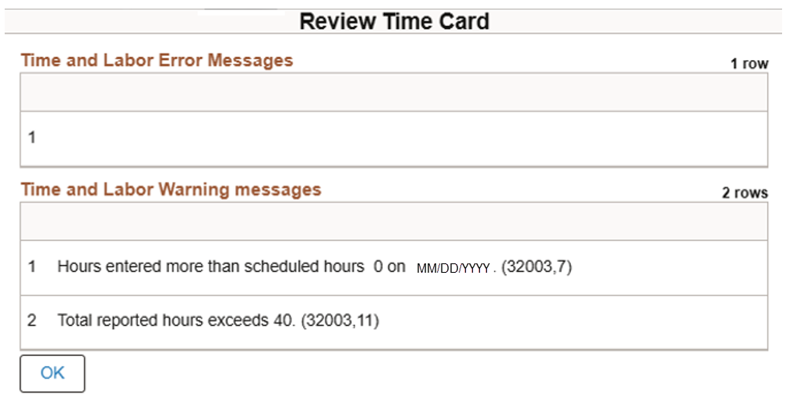
Worked more hours (2)
If a Review Time Card warning message (example below) appears, review, then select OK to complete submitting your timesheet to your people leader for review and approval.

Slide 8
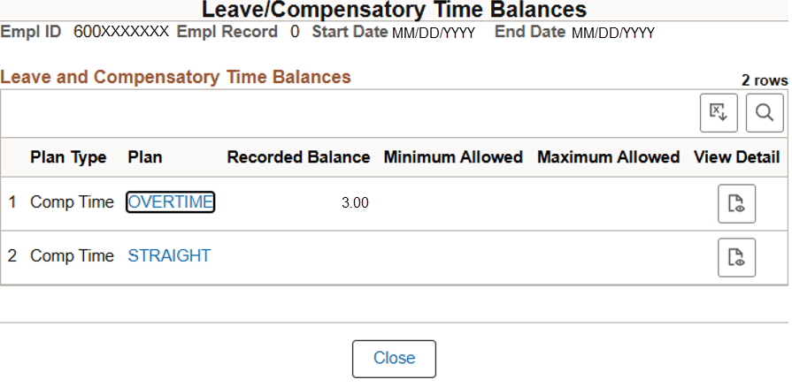
Worked more hours (3)
If approved, the additional hours will generate overtime comp time, at the rate of time and a half (1.5 times). The two additional hours will generate three hours of overtime comp time. After overnight processing, your overtime comp time balance will update.

Slide 9
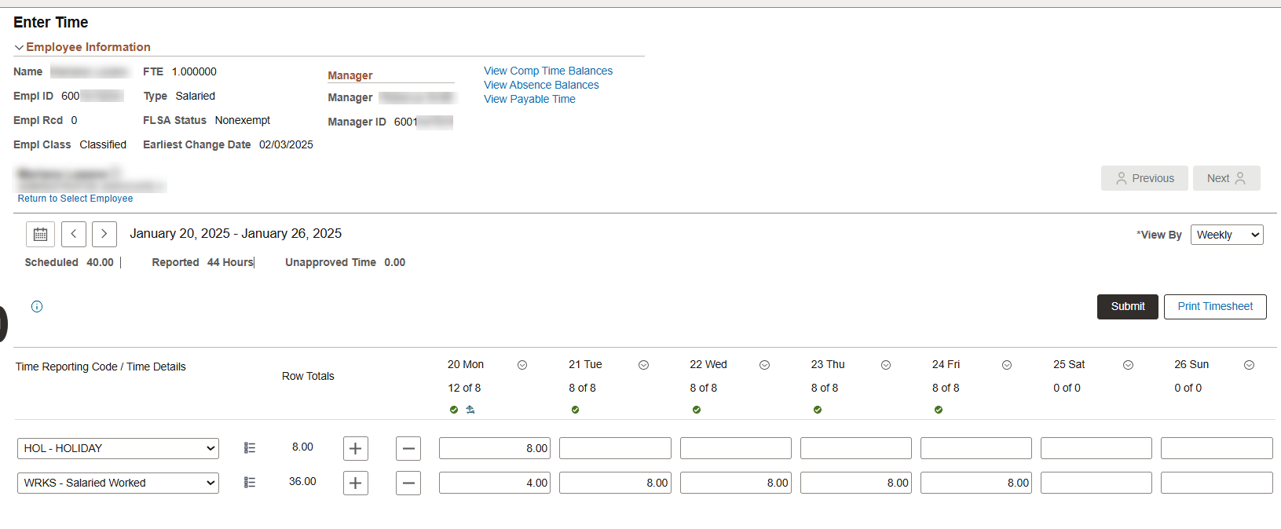
Worked more hours (4)
Example B: You are scheduled to work eight hours a day Monday to Friday, for a total of 40 hours per week.
Instead, this week, you worked four hours on Monday (a holiday, which PeopleSoft auto populates). You then worked Tuesday to Friday as scheduled.
1. Under Monday, on the WRKS – Salaried Worked row, enter the total hours worked (including the additional hours).
2. Select the Submit button to begin submitting your timesheet.

Slide 10
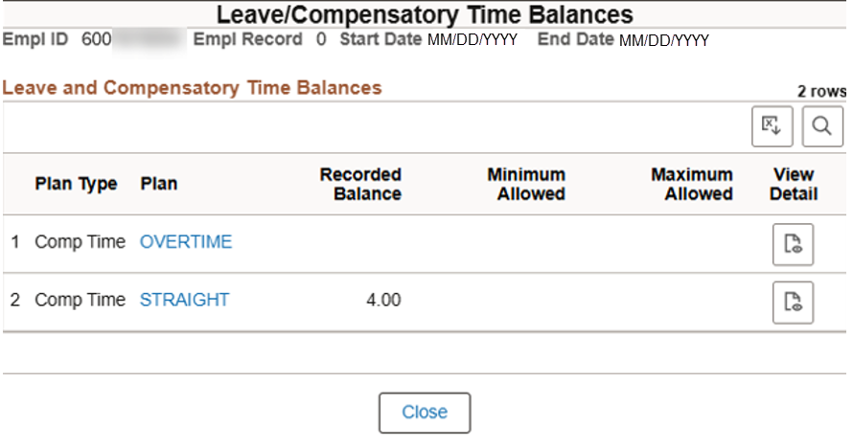
Worked more hours (5)
If a Review Time Card warning message appears, review, then select OK to complete submitting your timesheet to your people leader for review and approval.
If approved, the four additional hours worked will generate four hours of straight comp time. After overnight processing, your straight comp time balance will update. Because your total hours worked this week didn’t exceed 40, you earn straight comp time rather than overtime comp time.

Slide 11
Workdays differed from schedule (1)
Example: Your work schedule is eight hours a day, Monday to Friday.
Instead, this week you worked eight hours a day, Wednesday to Sunday.
1. Under Monday and Tuesday, on the WRKS – Salaried Worked row, delete the auto-populated hours that you didn’t work.
2. Under Saturday and Sunday, on the WRKS – Salaried Worked row, enter the total hours you worked.

Slide 12
Workdays differed from schedule (2)
3. Select Submit to begin submitting your timesheet.
If a Review Time Card warning message appears, review, then select OK to complete submitting your timesheet to your people leader for review and approval.

Slide 13
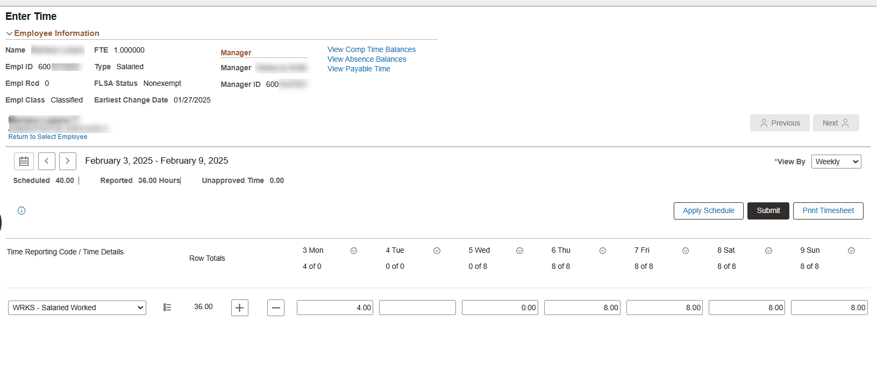
Workdays differed from schedule – worked fewer hours (1)
Example: Your work schedule is eight hours a day, Wednesday to Sunday, for a total of 40 hours a week. If you work only four hours on Monday and don’t work on Wednesday, your hours for the week will be fewer than your scheduled 40 hours.
Selecting Submit will result in an error (next slide).

Slide 14
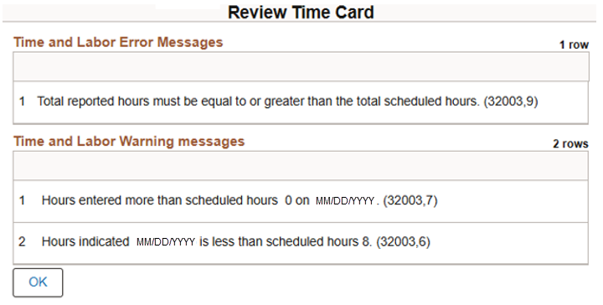
Workdays differed from schedule – worked fewer hours (2)
Review the Review Time Card error message (example below), select OK and correct your timesheet:
You will either submit an absence request or use comp time to cover the difference between the hours worked and your scheduled hours.
If you don’t have enough accrued leave or comp time, you’re still required to report the absence, and your paycheck will be reduced to reflect the missed hours.

Slide 15
Used/reported absence (1)
First, you need to submit an absence request in PeopleSoft.
Then, PeopleSoft will auto populate your timesheet with the requested absence.

Slide 16
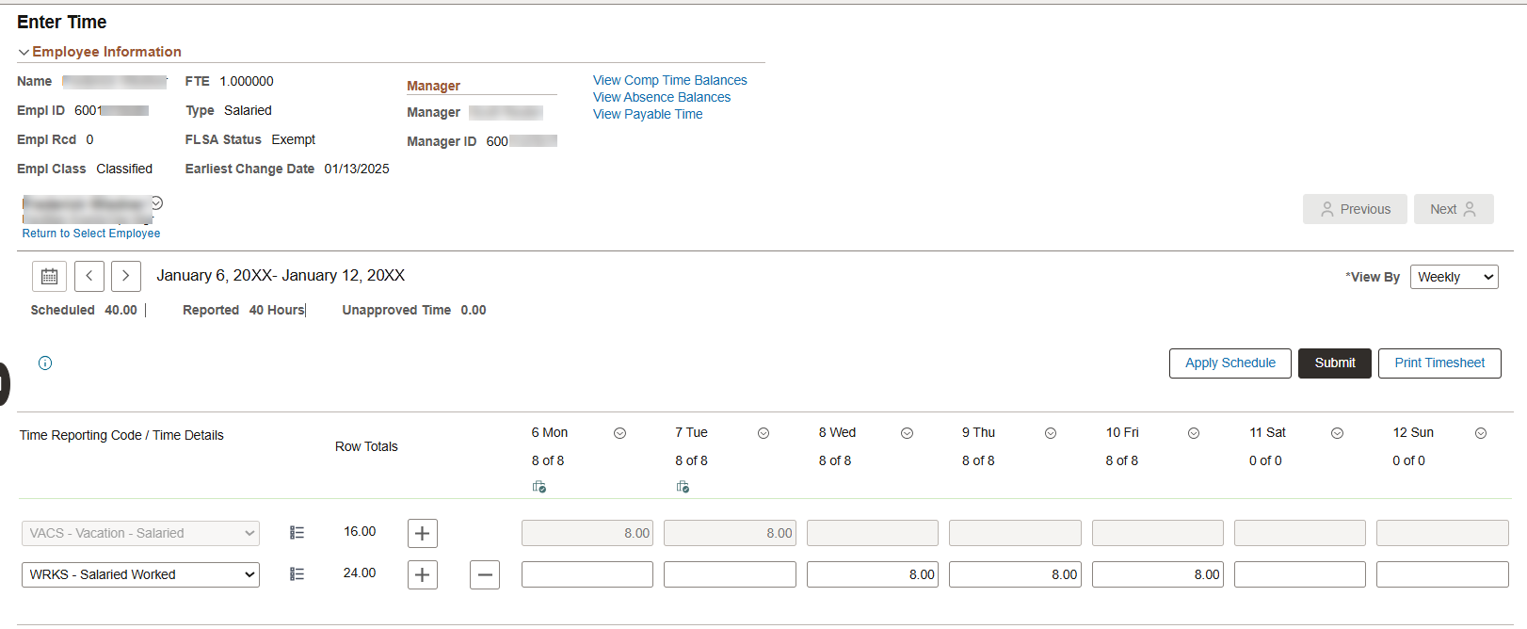
Used/reported absence (2)
Example: Your work schedule is eight hours a day, Monday to Friday.
Instead, you submitted an absence request and took vacation on Monday and Tuesday.
Your timesheet auto populates with the two vacation days on the VACS – Vacation – Salaried row.

Slide 17
Used/reported absence (3)
This leaves the default WRKS – Salaried Worked row populated for Wednesday to Friday.
Select Submit to begin submitting your timesheet.

Slide 18
Used/reported absence (4)
If a Review Time Card warning message (example below) appears, review, then select OK to complete submitting your timesheet to your people leader for review and approval.

Slide 19
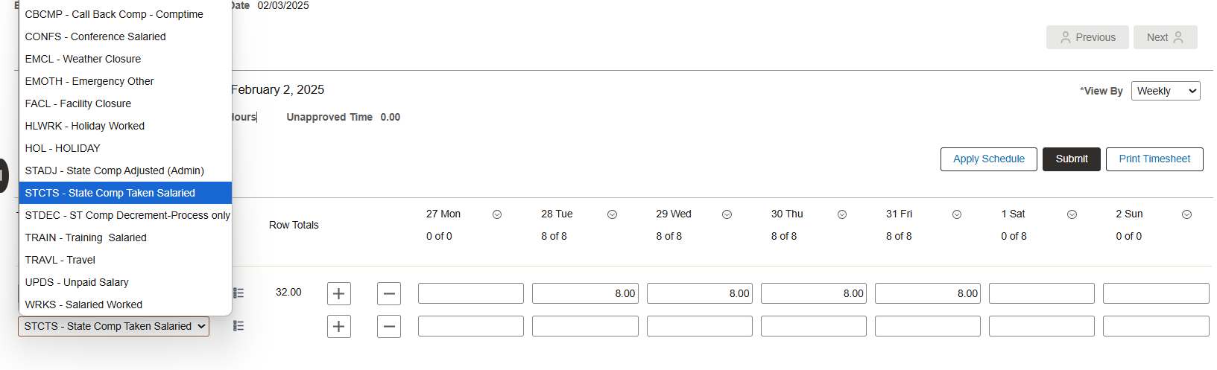
Used straight comp time (1)
Example: You are scheduled to work eight hours a day, Tuesday to Saturday.
Instead, this week you worked eight hours a day Tuesday to Friday, three hours on Saturday, then took time off using straight comp time the rest of Saturday.
1. On the WRKS – Salaried Worked row, select the plus icon, then select STCTS – State Comp Taken Salaried.

Slide 20
Used straight comp time (2)
2. Under Saturday, on the WRKS – Salaried Worked row, adjust the auto-populated hours to the three hours worked.
3. Under Saturday, on the STCTS – State Comp Taken Salaried row, enter the five hours of straight comp time used.

Slide 21
Used straight comp time (3)
4. Select the Submit button to begin submitting your timesheet.
If a Review Time Card warning message appears, review, then select OK to complete submitting your timesheet to your people leader for review and approval.

Slide 22
Used overtime comp time (1)
Example: You are scheduled to work eight hours a day, Monday to Friday.
Instead, this week you worked eight hours a day Monday to Thursday, then took time off using overtime comp time on Friday.
1. On the WRKS – Salaried Worked row, select the plus icon, then select OTCTS – Overtime Comp Salaried Taken.

Slide 23
Used overtime comp time (2)
2. Under Friday, on the WRKS – Salaried Worked row, delete the auto-populated hours that you didn’t work.
3. Under Friday, on the OTCTS – Overtime Comp Salaried Taken row, enter the eight hours of overtime comp time used.

Slide 24
Used overtime comp time (3)
4. Select Submit to begin submitting your timesheet.
If a Review Time Card warning message appears, review, then select OK to complete submitting your timesheet to your people leader for review and approval.

Slide 25
Contact Us
If you have questions about this job aid, you can contact us at
Payroll Management Services
Payroll Management Services website
Email: payroll@utsa.edu
Phone: (210) 458-4280

Slide 26
Thank you
https://www.utsa.edu/financialaffairs/

