Slide 1
Find my employee classification
Your employee classification determines the type of timesheet you need to submit
Payroll
Revised 05/20/2025

Slide 2
Important note
To ensure you have the most current information, please get this job aid from the website rather than referring to a locally-saved version.

Slide 3
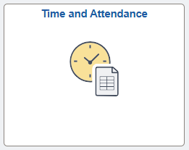
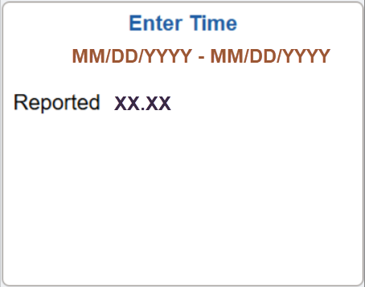
Access PeopleSoft
Log into Peoplesoft: Go to my.utsa.edu, select UTShare/PeopleSoft, select UTSA if prompted, log in with your myUTSA ID.
Under Employee Self Service, select the Time and Attendance tile, then select the Enter Time tile.

Slide 4
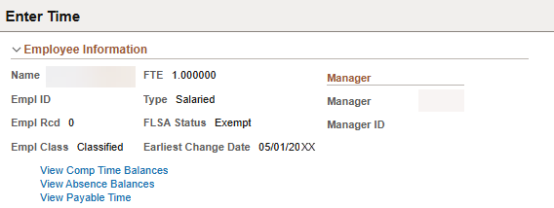
See Employee Classification
This takes you to the Enter Time view, which shows the following information:
Your Employee Type is either Salaried or Hourly
Your FLSA Status is either Exempt or Nonexempt
Your Employee Classification is either Administrative and Professional (A&P), Classified or Student
1
3
2

Slide 5
Contact Us
If you have questions about this job aid, you can contact us at
Payroll Management Services
Payroll Management Services website
Email: payroll@utsa.edu
Phone: (210) 458-4280

Slide 6
Thank you
https://www.utsa.edu/financialaffairs/

