Slide 1
Overtime comp (compensatory) payout for my employees
For people leaders of classified nonexempt employees
Payroll
Revised: 05/22/2025

Slide 2
Important note
To ensure you have the most current information, please get this job aid from the website rather than referring to a locally-saved version.

Slide 3
Overtime comp (compensatory) payout
Classified nonexempt employees need to have first accrued overtime comp time before they can receive overtime comp payout.
As their people leader, if you have received authorization to pay out overtime, you will submit the overtime comp payout in PeopleSoft.

Slide 4
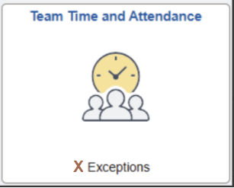
Access timesheet and view balance in PeopleSoft (1)
Log into Peoplesoft: Go to my.utsa.edu, select UTShare/PeopleSoft, select UTSA if prompted, log in with your myUTSA ID.
Select Manager Self Service > Team Time and Attendance tile > Enter Time > Filter.

Slide 5
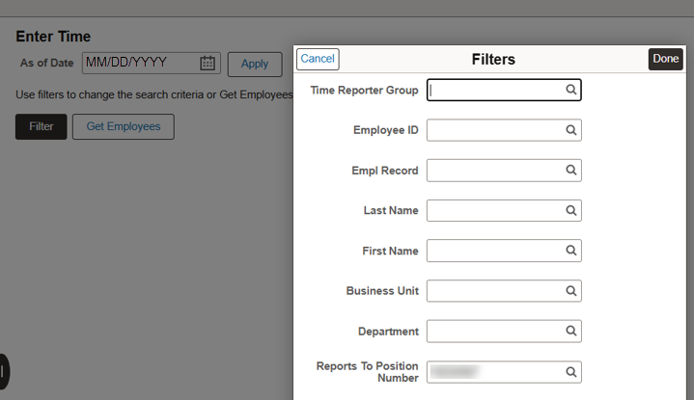
Access timesheet and view balance in PeopleSoft (2)
On the Filters pop-up window, your position ID will be auto populated in the Reports to Position Number field. Select Done.

Slide 6
Access timesheet and view balance in PeopleSoft (3)
This displays a list of employee(s). Select the employee receiving the overtime comp time payout.
This displays the employee’s timesheet.
Select View Comp Time Balances. Ensure the employee has a sufficient overtime comp time balance for the amount you intend to pay out.
Select Close to return to the employee’s timesheet.

Slide 7
Submit overtime comp payout (1)
1. On the employee’s timesheet, on the WRKS – Salaried Worked row, select the plus icon to add a new row.

Slide 8
Submit overtime comp payout (2)
2. From the drop-down menu, select OCP – Overtime Comp Payout.

Slide 9
Submit overtime comp payout (3)
3. On the OCP – Overtime Comp Payout row, on one of the workdays, enter the amount of overtime comp you intend to pay out.

Slide 10
Submit overtime comp payout (4)
4. Select Submit to approve the overtime comp payout.
Payroll Management Services will then process the overtime comp payout to your employee.

Slide 11
Contact Us
If you have questions about this job aid, you can contact us at
Payroll Management Services
Payroll Management Services website
Email: payroll@utsa.edu
Phone: (210) 458-4280

Slide 12
Thank you
https://www.utsa.edu/financialaffairs/

