Slide 1
Reporting work hours that cross days
Learn how to submit your timesheet for work hours that span different days
Payroll
Revised 05/05/2025

Slide 2
Important note
To ensure you have the most current information, please get this job aid from the website rather than referring to a locally-saved version.

Slide 3
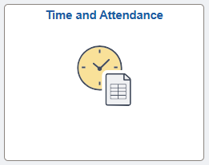
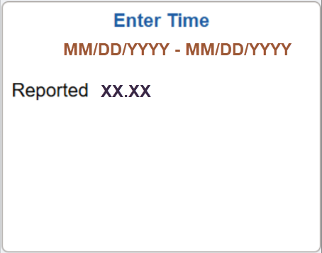
Access timesheet in PeopleSoft
Log into Peoplesoft: Go to my.utsa.edu, select UTShare/PeopleSoft, select UTSA if prompted, log in with your myUTSA ID.
Under Employee Self Service, select the Time and Attendance tile, then select the Enter Time tile.
This takes you to your timesheet, where you will enter hours worked that cross days.

Slide 4
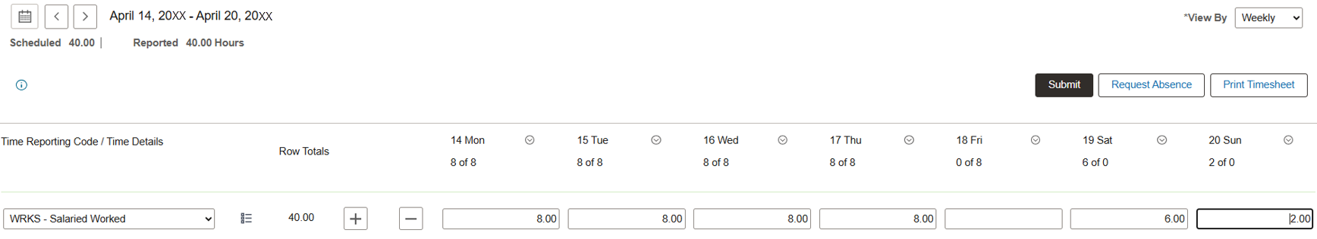

Enter work hours that cross days (1)
Under each day, enter the total number of hours worked.
Example: You worked from 6:00 PM on Saturday until 2:00 AM on Sunday.
1. On the WRKS – Salaried Worked row, enter six hours under Saturday and two hours under Sunday.
2. Select Submit to begin submitting your timesheet.

Slide 5
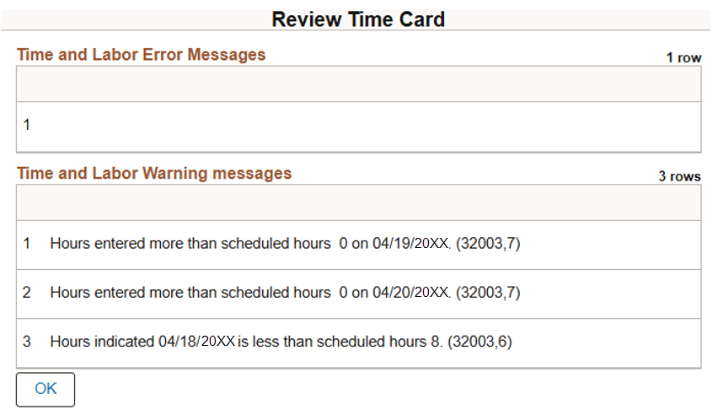
Enter work hours that cross days (2)
Review any Review Time Card warnings (example below), then select OK to complete submitting your timesheet.
Your timesheet will then route to your people leader for review and approval.

Slide 6
Contact Us
If you have questions about this job aid, you can contact us at
Payroll Management Services
Payroll Management Services website
Email: payroll@utsa.edu
Phone: (210) 458-4280

Slide 7

Thank you
https://www.utsa.edu/financialaffairs/

