Slide 1
Review and Approve Absence Request
in Manager Self Service (MSS)

Slide 2
Reviewing Submitted Absences
Review and Approve Absence Requests using Multiple Absences Approval
From Manager Self Service, click on the Team Time and Attendance Tile and select Multiple Absences Approval.

Slide 3
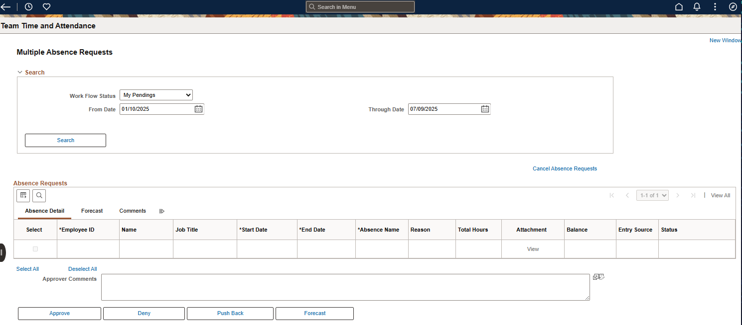
Reviewing Submitted Absences
This page allows you to Search and Approve all employee Absence Request and Cancelation Request

Slide 4
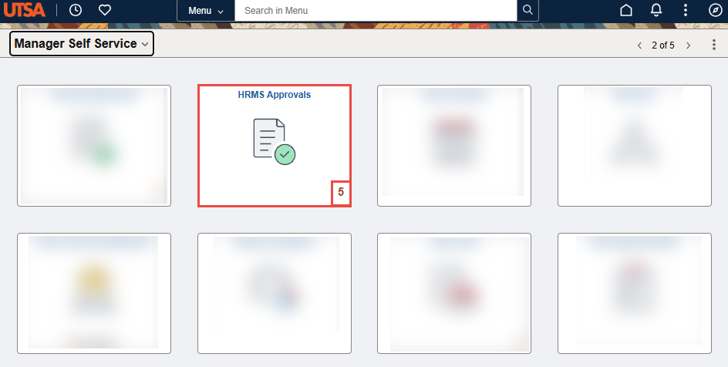
Reviewing Submitted Absences
Review and Approve Absence Requests using HRMS Approval Tile
Step 1
From the Manager Self Service or Employee Self Service, click on the HRMS Approvals Tile.
In the lower right corner of the tile, the number displayed shows how many transactions require approval

Slide 5
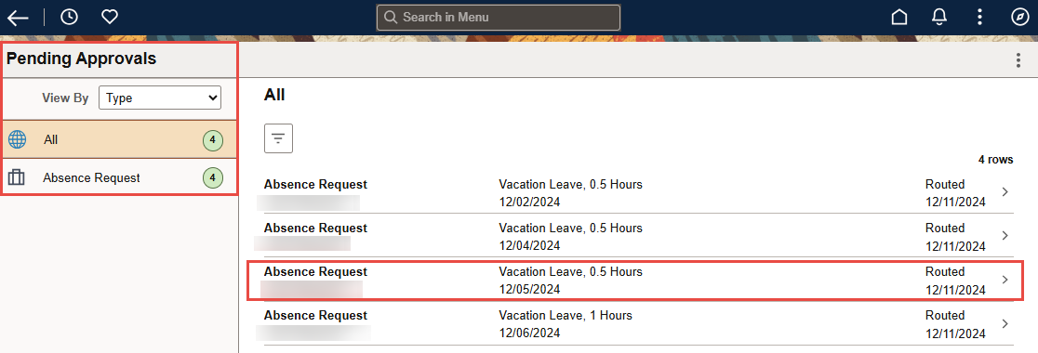
Reviewing Submitted Absences
Step 2
The Pending Approvals page opens with a list of items that have been routed for approval.
The default display setting shows All items by Type—the manager may click on the item from this view to drill down to the action to approve.
To view only Absence Requests that need approval, click Absence Request in the collection menu on the left side of the page. The Absence Request view displays employees alphabetically by date.

Slide 6
Reviewing Submitted Absences
Step 3
From the Pending Approvals, click on the line for Absence Request for an employee to approve the absence.
There may be multiple lines for the same employee if the employee has submitted multiple absence requests or the manager has not approved previous requests.
The Absence Request approval page opens for the employee for the selected date. Review the date and total hours of the request.
The employee’s current balance for that leave type is displayed with a disclaimer.
Any comments the employee provided will display under Requester Comments.

Slide 7
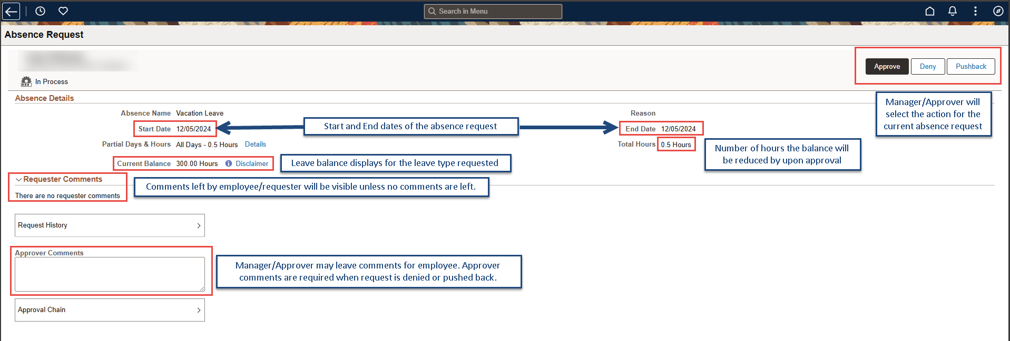
Reviewing Submitted Absences
Step 3 Continued

Slide 8
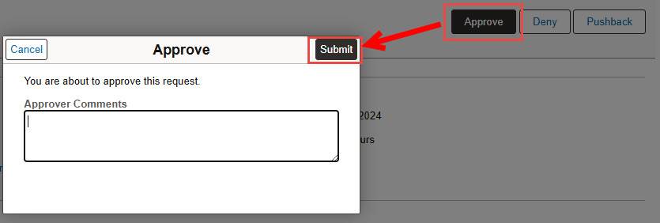
Reviewing Submitted Absences
Step 4
After reviewing the request, click the Approve button.
An Approve pop-up window opens for the user to verify the submission.
The pop-up allows the user to edit any comments entered in the Approver Comments box, or if none were entered, comments may be entered in the Approve pop-up in the box.
Click the Submit button to finalize the approval the absence.

Slide 9
Reviewing Submitted Absences
Step 5
Once Submit is clicked, the system returns the manager to the Pending Approvals page with the list of Absence Requests by employee, and a green banner confirmation appears for three seconds at the top of the page confirming the approval.
Select the next employee and follow the same steps.

Slide 10
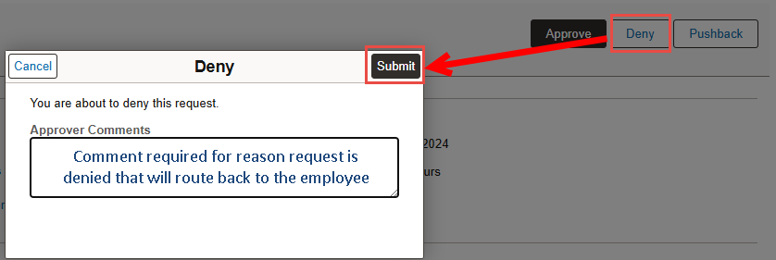
Reviewing Submitted Absences
Step 6 (As Needed)
Deny Request. Deny is also a function for the manager if the request is not approved, or the employee needs to make a change. If the manager clicks Deny on the Absence Request, the Deny pop-up box opens. The manager must enter Approver Comments in the box to Submit a denial. ​
*Note: If a mistake has been made, the manager can Cancel their action at the window and return to the Manager Absence Request page for this request.

Slide 11
Reviewing Submitted Absences
Step 7 (As Needed)
Once Submit is clicked, the system returns the manager to the Pending Approvals page with the list of Absence Requests by employee, and a green banner confirmation appears for three seconds at the top of the page confirming the denial of the request.

