Slide 1
Submit or Modify an Absence Request
In Employee Self Service (ESS)

Slide 2
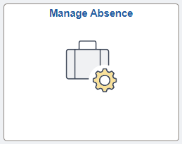
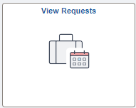
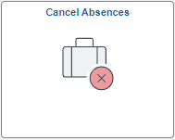
Manage Absences in ESS
Employees will use the following tiles in under Time and Attendance in ESS to submit, cancel and modify absences:
Manage Absences ​
This tile is used by the employee to submit an absence request and view absences.
View Requests​
This tile is used by the employee to view absences and access returned items for rework (modification) when in submitted status prior to manager approval.​
Cancel Absences​
This tile is used by the employee to request a canceled absence for supervisor approval and access returned items for rework (modification) when in canceled status after manager approval.

Slide 3
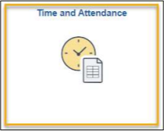
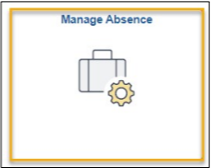
Submit an Absence
Employees can log in to PeopleSoft to access their Employee Self Service landing page and access their Time and Attendance tile to submit an absence using the Manage Absence tile.
Step 1
Access the Employee
Self-Service Landing page
Step 2 ​
Select the Time and Attendance tile
Step 3 ​
Select the Manage Absence tile

Slide 4
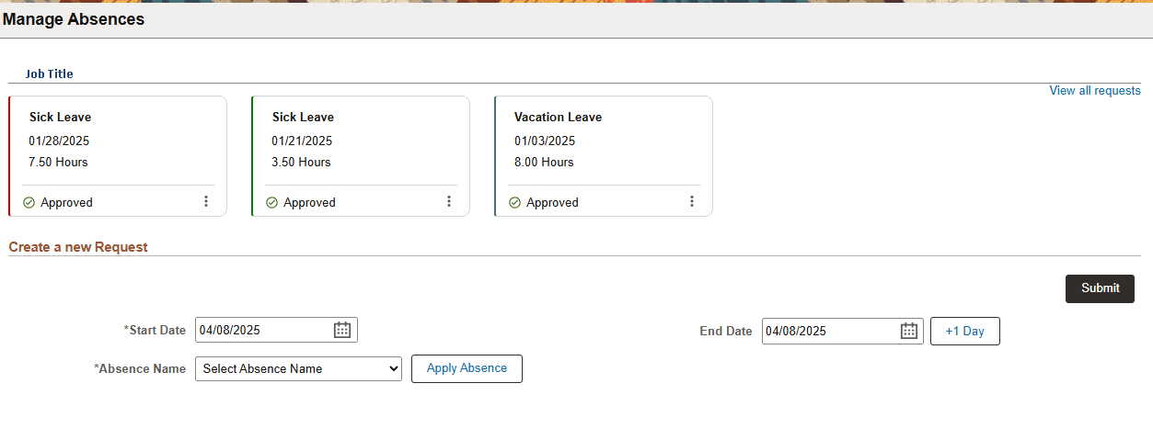
Submit an Absence
The Manage Absences page displays the following:
View Absences: View the status of your last three actionable absence requests or view all requests.
Create a new Request: Submit an absence request.

Slide 5
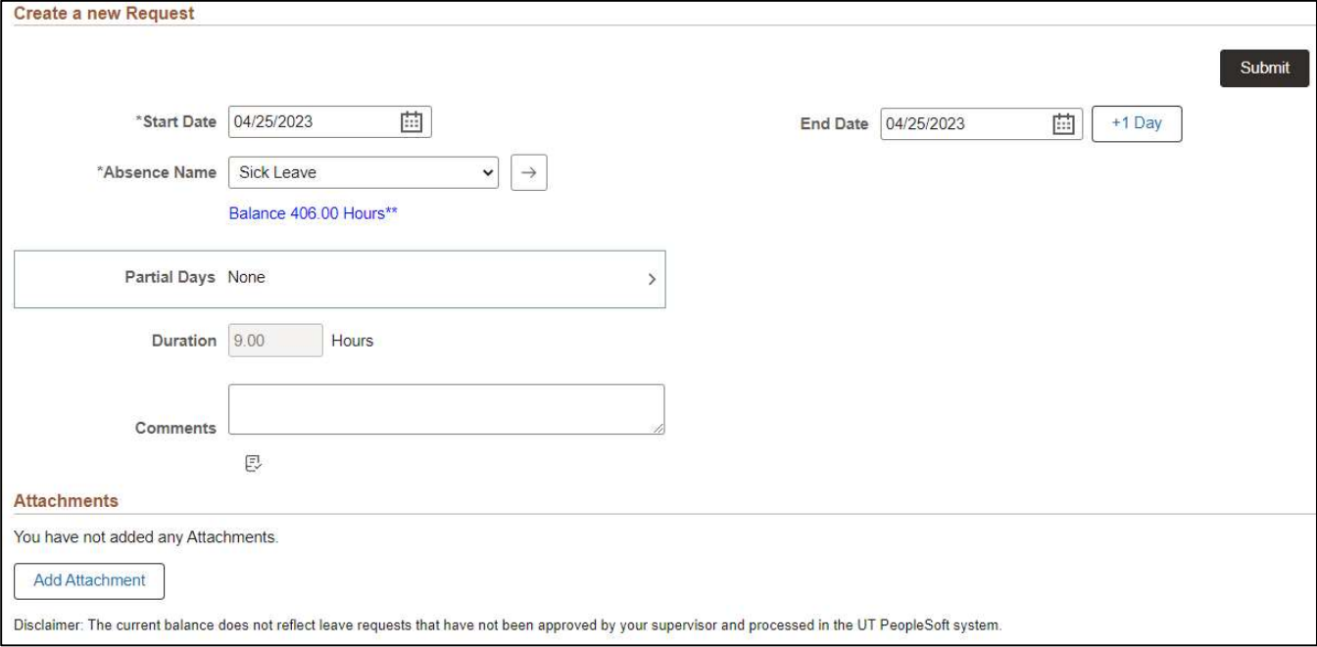
Submit an Absence
View after clicking the Apply Absence button

Slide 6
Submit an Absence
Step 4
To submit an absence request, update the Start Date and End Date of the absence request.
The +1 Day button may be used to increment the End Date of the date range.
*Note: The End Date is auto populated to the current date when accessing the page. The End Date does not change when submitting a previous dated request or when the absence request is in progress upon applying the Absence Name.

Slide 7
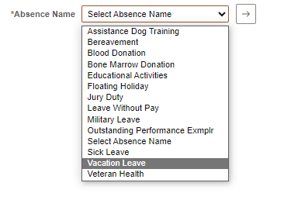
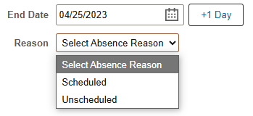
Submit an Absence
Step 5
Select the Absence Name from the drop-down menu. Only sick and vacation absence request will include an optional reason field that is not required to proceed. Then click the Apply Absence Name button.

Slide 8
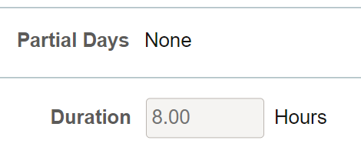
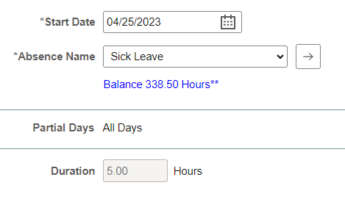
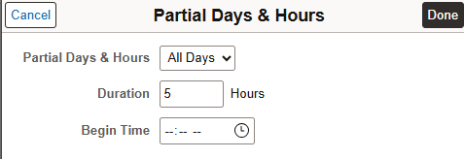
Submit an Absence
Step 6
If taking a full day off, Partial Days will remain as None.
Duration will display the scheduled hours for the period.
If taking anything less than a full day off (ex: 5 hours), select the Partial Days box. You will then select All Days from the dropdown and enter the number of hours in the duration field. The Begin Time field is optional and not required to submit the absence request. Then click Done and verify the duration.

Slide 9
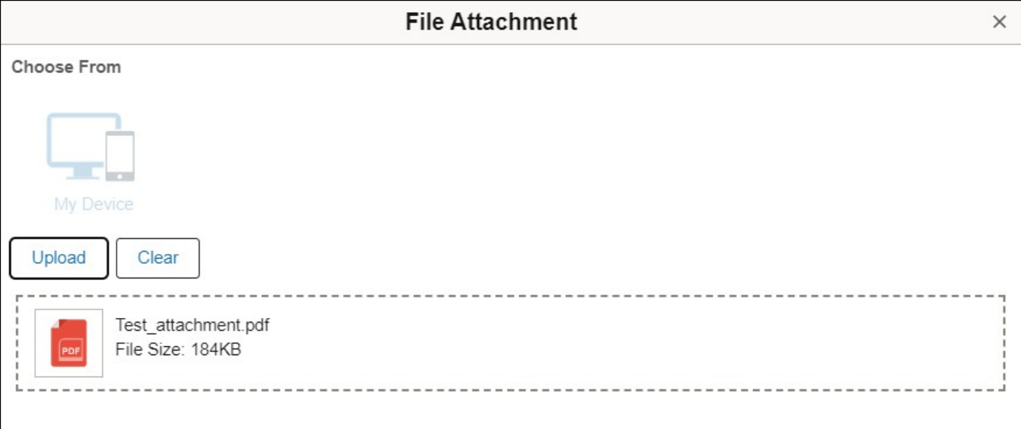
Submit an Absence
Step 7
If necessary, enter comments in the Comments box field.
*Note: These comments will be routed with the request to the supervisor. Do not Include any Personal Health Information.
Step 8
If necessary, select the Add Attachments button. The Add Attachments can be used to documents for refence related to the absence request submitted (i.e.: Document for Veterans Health Leave).
To upload the document, select My Device, select the file and select Open and click upload. Then click Done.

Slide 10
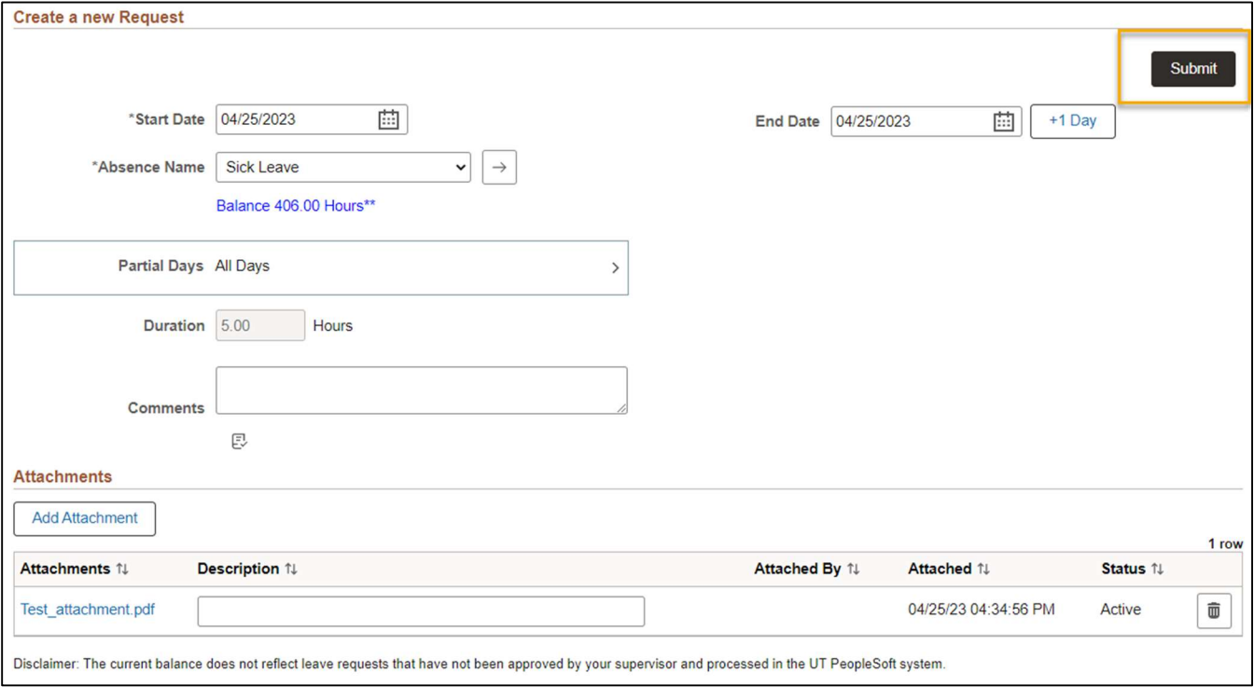
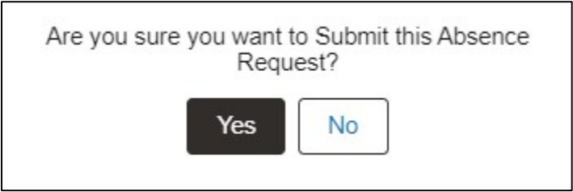
Submit an Absence
Step 9
Review the absence request to verify information is accurate. Then select Submit.
There will then be a pop-up window to confirm submission, select Yes or No on the confirmation message.
Yes, will submit the absence request.
No, will return you to the absence request to make any necessary changes.

Slide 11
Submit an Absence
The status of the absence request may be viewed from the Manage Absence page. If the request
is not visible on this page, the View all requests link or the View Request tile may be used to view the status of submitted absence requests.
Absence balances will be depleted upon approval and processing of the absence request. Current absence balances may be viewed on the Absence Balance Details page.

Slide 12
Modify Absence Request

Slide 13
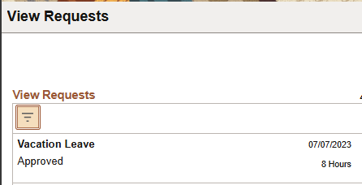
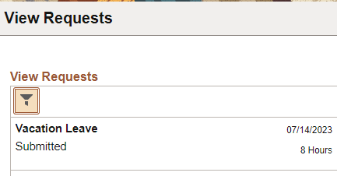
Modify Request Overview
Modifying an absence request is a joint effort between the employee and supervisor and is dependent on the workflow status of the absence.
Approved Absence Status
Submitted Absence Status

Slide 14
Modifying an Absence Request in Submitted Status
If the absence request is in a
Submitted status and in the
managers queue; managers will
initiate the process using the
following steps:
Staff | Step Item
 | Request Status: Submitted (for Supervisor approval)
Supervisor | Log in to PeopleSoft system
Supervisor | Access Manager Self Service landing page
Supervisor | Access Team Time and Attendance tile
Supervisor | Access Multiple Absence Requests or HRMS Approval tile
Supervisor | Push Back (Return) Absence Request
 | Request Status: Rework (for Employee Rework)
Employee | Log in to PeopleSoft system
Employee | Access Employee Self Service landing page
Employee | Access Time and Attendance tile
Employee | Access View Requests tile
Employee | Access Reworked Absence Request
Employee | Modify and Resubmit Absence Request
 | Request Status: Submitted (for Supervisor approval)

Slide 15
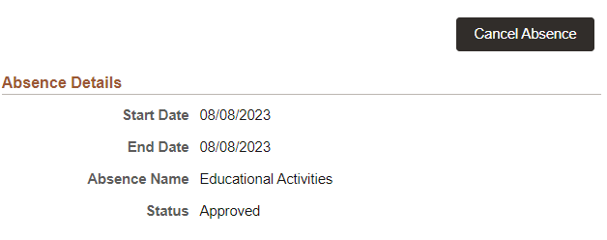
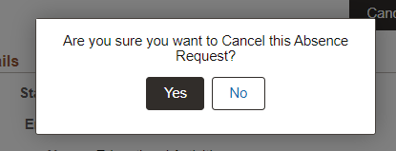
Modify Absence Request in Approved Status
Staff​ | Step Item​
Employee​ | Log in to PeopleSoft system​
Employee​ | Access Employee Self Service landing page​
Employee​ | Access Time and Attendance tile​
Employee​ | Access Cancel Absences tile​
Employee​ | Access Approved Absence Request​ Needing to Modify
Employee​ | Click Cancel Absence and confirm Request to Cancel
​ | Request Status: Submitted (for Supervisor approval)​
Supervisor​ | Log in to PeopleSoft system​
Supervisor​ | Access Manager Self Service landing page​
Supervisor​ | Access Team Time and Attendance tile​
Supervisor​ | Access Multiple Absence Requests or HRMS Approval tile​
Supervisor​ | Approve Absence Cancelation Request​
​ | Request Status: Approved (for Employee Review)​
Employee​ | Log in to PeopleSoft system​
Employee​ | Access Employee Self Service landing page​
Employee​ | Access Time and Attendance tile​
Employee​ | Access Manage Absence tile​
Employee​ | Modify and Resubmit Canceled Absence Request​
​ | Request Status: Submitted (for Supervisor approval)​
If the absence request is in an Approved status, employees will initiate the process following these steps:

