Slide 1
The Formal Founding of Psychology: Wundt in Right Place at Right Time
As it is commonly known, Wilhelm Wundt receives credit for the formal founding of psychology in 1879 at the University of Leipzig.
His tremendous scholarly productivity, despite a large and varied teaching load, provided a substantive basis for the success of the new discipline.

Slide 2
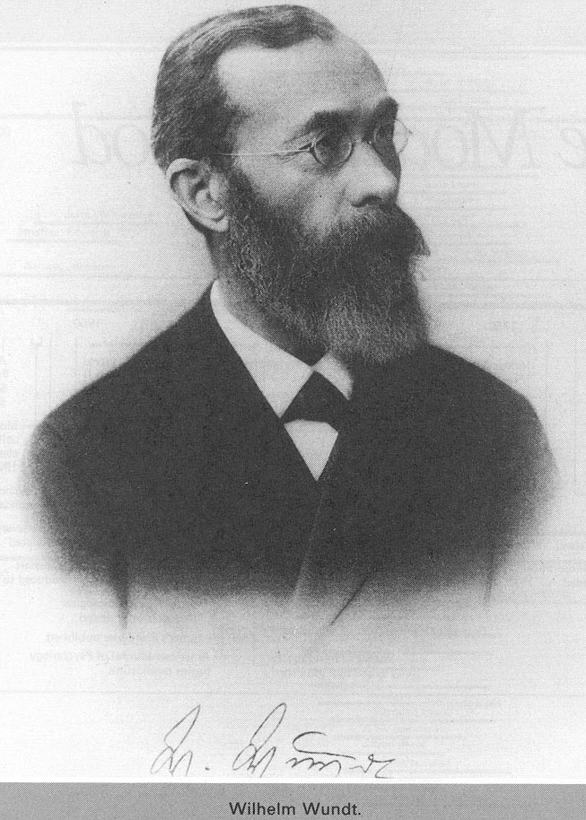
*Image via Bing

Slide 3
Wilhelm Wundt (1832-1920)
In 1874, published Principles of Physiological Psychology.
  Note: the name “physiological psychology” predated the concept ‘experimental psychology.’
  The book was part of Wundt’s efforts to create an independent science of psychology.
  By 1890, Wundt succeeded in creating the first school of psychology (at Leipzig), attracting large numbers of students who wanted to work with him.

Slide 4
Psychology as Science
Wundt distinguished between physical science and psychological science according to the “type” of experience.
  The physical world is experienced, observed and measured from outside the event.
  The psychological world is experienced, observed and measured “as it occurred.”

Slide 5
Subjective Science
Mediate experience – associated with physical science, it is experience that is mediated by some device of accurate measure. (For example, using a thermometer to determine how hot/cold it is).
Immediate experience – the experience of the psychological researcher. It is not mediated by anything external or objective.
  Wundt argued that psychologists must attempt to isolate the experience of the “elements of thought.”

Slide 6
Wundt’s Methods
Wundt’s methods combined scientific experimentation and introspection.
  As you may recall, Plotinus and St. Augustine were among the first to use introspection as a soul-searching process.
  Descartes used introspection for his “contemplative meditation”
  What Wundt wanted was “experimental introspection” to only address sensory experiences.

Slide 7
Rules for Introspection
Must determine best time to introduce introspection
Must maintain a state of “strained attention”
Must be capable of repetition (of observation)
Must be capable of isolating the mental process at any moment by employing variations in the strength and quality of the stimuli

Slide 8
Elements of Thought
Two types: sensations and feeling.
All sensations are accompanied by feelings.
Wundt proposed a tri-dimentional model of feeling, in which each sensation has a subjective value within those three attributes of feelings.
  Pleasantness-unpleasantness
  Excitement-calm
  Strain-relaxation

Slide 9
Tri-dimensional Model
Excitement
Relaxation
Pleasure
Displeasure
Strain
Calm

Slide 10
Perception
Perception involves many elements of thought which are experienced simultaneously.
Attention, or “apperception,” is the clear, active perception of a narrow range of elements.
With attention, the elements of thought can be arranged and organized at will - in a process of “creative synthesis.” (similar to Locke)

Slide 11
Wundt’s Experimental Methods
Reaction Time (RT) – method had been introduced earlier by Helmbolts & Donders.
  Wundt hoped to create a “mental chronometry,” or a record of various mental activities and the time they took to be performed.
  Found reaction times to be too varied, and gave up on “standard” reaction times.

Slide 12
Wundt’s other methods
Word Association: inner vs. outer association
  Inner Associations showed an intrinsic connection between words (e.g., snake-reptile, light-dark, man-woman)
  Outer Associations were more accidental & involved connections established through habits of speech. (e.g. George-King, Fly-Wheel, Three-Christmas).

Slide 13
Wundt’s other methods
Feelings were studied through use of paired comparisons (using the tri-dimensional model – see slide 8).
Principles of Connection - associations were the “glue” that held elements of consciousness together

Slide 14
Higher Mental Processes
Wundt believed that higher processes could not be studied and understood via experiments. The essence of higher mental processes could only be captured by studying collective human activity (group, social, and cultural activity).
Volkerpsychologie (Ethnic Psychology, Folk Psychology) - study of collective activity, in particular, language, myths, & customs.
Modern Social Psychology?

Slide 15
Wundt’s Impact
At first, Wundt received worldwide attention for his creation of a new science. Many sought to learn and spread his “experimental psychology.”
Soon, though, behaviorists took over experimental psychology with much more if not truly objective behavioral methods. Clinical psychologists took over the subjective psychology, but they did not adhere to Wundt’s rigorous experimental approach.

Slide 16
Wundt’s Impact
With the rise of cognitive psychology in the 1960s, subjective methods were once again incorporated into of experimental psychology.
At that time, psychologists started to regain an appreciation of the foundation that Wundt had created for subjective science.
This regained appreciation of Wundt also inspired the rise of subjective social sciences.

Slide 17
Subjective Social Sciences
Wundt personally opposed the idea of social science, but he saw social research as the vehicle for capturing higher mental processes.
Sociology made use of subjective methods with groups (gender, age, ethnicity, socioeconomic status) as well as societies (regions, cultures, economies) to create Wundt-like experimental methods for exploring society.

