Slide 1
Keeping a Laboratory Notebook
Gail P. Taylor
Asst. Program Director
UT San Antonio
RISE/MARC-U*STAR programs

Slide 2
Acknowledgements
Kathy Barker, At the Bench: A laboratory Navigator. Cold Spring Harbor Laboratory press. 1998.
Guidelines for Keeping a Laboratory Record. David Caprette, Rice University. http://www.ruf.rice.edu/~bioslabs/tools/notebook/notebook.html
Guidelines for Keeping a Laboratory Notebook. Colin Purrington, Swarthmore Univ. http://www.swarthmore.edu/NatSci/cpurrin1/notebookadvice.htm
Laboratory Record Keeping. Todd E. Garabedian, Nature Biotechnology v. 15 (August 1997) pp.799-800
http://biotech.about.com/gi/dynamic/offsite.htm?site=http%3A%2F%2Fwww.wiggin.com%2Fpubs%2Farticles_template.asp%3FID%3D102187242000
Office of Research Integrity, U.S. Dept. of Health and Human Services http://www.unh.edu/rcr/
Responsible Conduct of Research Online Study Guide. Julie Simpson, University of New Hampshire http://www.unh.edu/rcr/
Francis L. Macrina, Scientific Integrity: An Introductory Text with Cases. ASM Press. 2000.

Slide 3
What is a Lab Notebook?
Complete record of procedures, reagents, data, and thoughts to pass on to other researchers
  Why experiments were initiated, how performed, and results, comments
  Place to compile data/charts/photos/ideas
  Place of clues, to troubleshoot problems
  Place to observe whole picture and think
  Legal document, to prove patents
  Defense against accusations of fraud or lawsuits

Slide 4
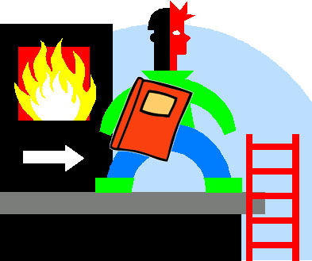
How Important?
Very- Often has all original data in it…

Slide 5
Type and Format…
Ultimately dictated by your PI/company
Type | Advantages | Drawbacks
Bound book (stitched) | No lost sheets Proof against Fraud | Entered as done No logical order
Duplicate “Bound” Book (yellow sheets) | Double record. Easy copies | Diff. To Read. Not true duplicate
Loose Leaf (folders/notebooks) | Order by expts Easy recording | Lost sheets Authenticity prob.
Computer | Easy to read Easy calculations | Lost data Authenticity prob

Slide 6
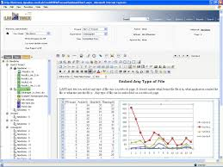
Electronic Notebooks?
ELN – Electronic Lab Notebook
LES – Lab Executive System
Pros and Cons
  Arise from…
    Reading and Writing
    Mobility
    Security
    Storage
    Proof from tampering (how to prove w electronic)
http://blog.labguru.com/blog-labguru/10-reasons-to-ditch-paper-and-switch-to-electronic-lab-notbooks
http://www.the-scientist.com/?articles.view/articleNo/8408/title/Electronic-Lab-Notes/

Slide 7

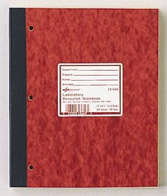
Characteristics of a Good “Paper” Notebook
Paper:
  Large- >= 8.5x11 at least (attaching stuff)
  Bound (stitched) pages to ensure integrity
  Numbered pages
  White gridded
  Acid free paper (30 years)
  Duplicate pages (differing opinions)
  Written in Pen

Slide 8
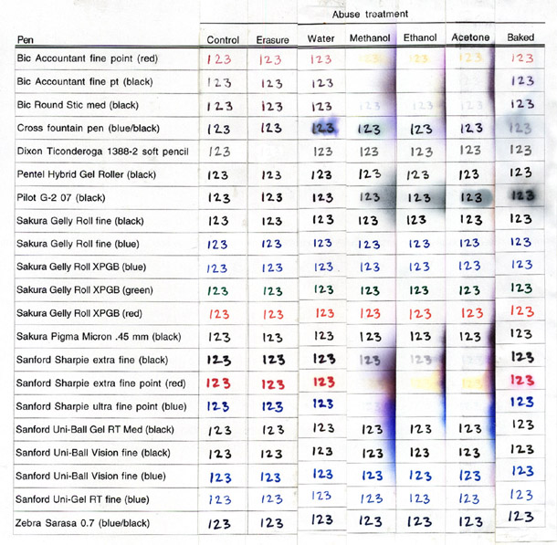
What is best for writing?
http://www.swarthmore.edu/NatSci/cpurrin1/images/penexp2.jpg

Slide 9
Preparing a New Lab Notebook
Save Space for Table of Contents
First two facing pages at least.
List experiments by:
  Title
  Date
  Page Number
Particularly helps when more than one project

Slide 10
For Every Experiment, Record:
Start Date on all pages
Title
Why: Brief statement of purpose
How:
  Description/protocol with reference of origin Calculations (on empty adjoining page): MW, concentrations, dilutions, etc.
What Happened:
  All that happens (protocol changes; on floor, kicked)
  Taped in Information (if it does not fit, keep an associated folder)
What It Means:
  Your interpretation (summation with oddities and comments)
What’s Next

Slide 11
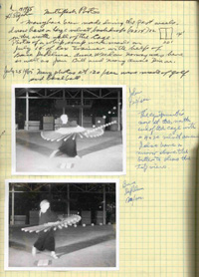
Attached Materials
Computer generated data
Photographic data
All other data
Printed graphs (make as you go)
Datasheet templates
Product labels
Who provided plasmids, etc.
Notes (or pasted copies) of discussions, conversations, emails, readings related to exp’t design or goals
Archive locations of plasmids, probes, etc.
X-rays and other large items may be kept in a separate folder if they don’t fit in the lab notebook.
Always write on these materials the date and other identifying information in case they get separated!

Slide 12
Remember the little things…
Lot numbers
Other people involved
Incubation times
# washes
Machine Settings
Unexpected delays
Problems Encountered
Media and Buffers
Calculations
Problems with individual subjects

Slide 13
The importance of timing…
Always record, update, review…
Record as you go
Input paper towel and post-it info ASAP!
At the LATEST, insert data the next day!
Do a weekly checkup
  1 hour to review
  Make sure everything is attached securely, all summaries written, future directions written, record in table of contents

Slide 14
More Helpful Tips
The institution owns “your” notebook
Do NOT remove your notebook from the lab (unless this is an acceptable lab practice)
You may get permission to take copies at graduation, but do not take original pages
Do NOT read another person’s notebook without permission (even the PI won’t look at advanced researcher’s notebooks secretly).
Should be kept for at least 5 years

Slide 15
A little Lab Notebook History

Slide 16
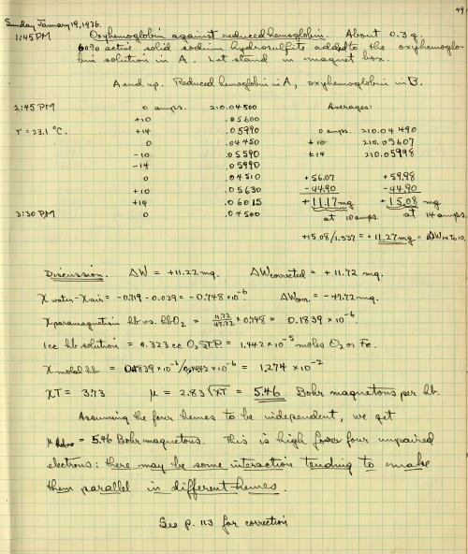
Linus Pauling Notebooks
Nobel Prizes
  Chemistry (chemical bonds/orbital hybridization)
  Peace
Competitor of Watson and Crick
PhD Physical Chem and Mathematical Physics at age 24
Caltech/Stanford
Taken from the online Linus Pauling Research Notebooks, http://osulibrary.orst.edu/specialcollections/rnb/index.html

Slide 17
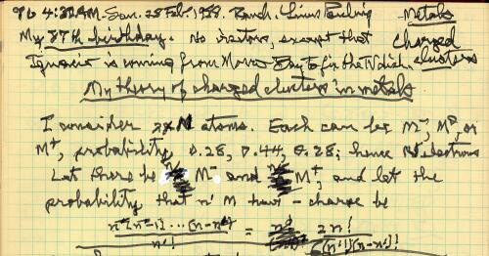

Slide 18
Notebook Ethics:
"Many people say that it is the intellect which makes a great scientist. They are wrong: it is character." -- Albert Einstein

Slide 19
Characteristics that help prove integrity
No longer for Patenting Purposes
Was “first to invent” but now is “first to file” in 2011
However, solid lab notebooks protect from accusations of misconduct:
Permanently bound pages
Put a full date (international date problems…) w month spelled out
Consecutively number in ink
Use same pen/ink type day to day
Write legibly
Never remove original pages or attachments
Cross out mistakes lightly
Cross out unused parts of pages
Record all discussions/meetings/ideas relevant to the project
Record as much detail as possible
Sign and date each entry
Have an independent witness sign and date each entry (industry)
Do NOT omit any result, no matter how odd
Do NOT falsely increase the “N” of any expt.
Do NOT make up a result

Slide 20
Research Integrity
The NIH Office of Research Integrity defines misconduct in science as:
  Research misconduct is defined as fabrication, falsification, or plagiarism in proposing, performing, or reviewing research, or in reporting research results, according to 42 CFR Part 93.
  “The integrity of research depends on accurate, detailed, organized, complete, and accessible data” Office of Research Integrity
  http://grants.nih.gov/grants/research_integrity/research_misconduct.htm

Slide 21
Consequences of Research Misconduct
(Could happen to your PI)
Debarment from eligibility to receive Federal funds
Prohibition from service on advisory committees, peer review committees, or as consultants
Certification of information sources that is forwarded by the institution
Certification of data by the institution
Supervision by the institution
Submission of a correction or retraction of a published article
http://ori.dhhs.gov/html/misconduct/administrative_actions.asp

Slide 22
A bad notebook can mean a bad project...
http://www.youtube.com/watch?v=Fl4L4M8m4d0
(Note the notebook…)

Slide 23
Questions???

