Slide 1
Scientific and Engineering Papers
– An Approach for Better Reading
Modified by Dr. Gail P. Taylor
Originally developed by Beth Fischer and Michael Zigmond, Survival Skills and Ethics Program www.pitt.edu/~survival
Rev. 02/10/2014

Slide 2
The Knowledge Cycle in Science
From the coffee room to the coffee table…
  Idea Development/research design
  Idea Discussion/funding
  Research carried out
  Preliminary results/findings (shared/conferences)
  Results/findings are reported formally
    Reports with peer review
  Results/findings are generalized
    Within or across disciplines/ in textbooks
  Results/findings are Popularized
    "in the news or on TV"

Slide 3
Types of Information
Primary literature – original journal articles
Secondary literature – Review articles
Tertiary literature – textbooks, science magazines, Encyclopedias
Popular literature – newspapers, TV, etc

Slide 4

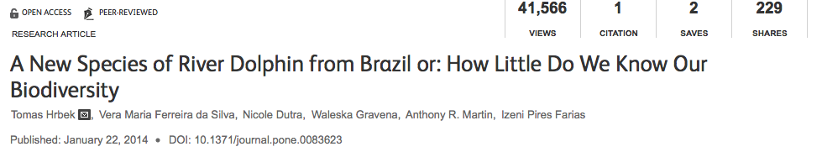
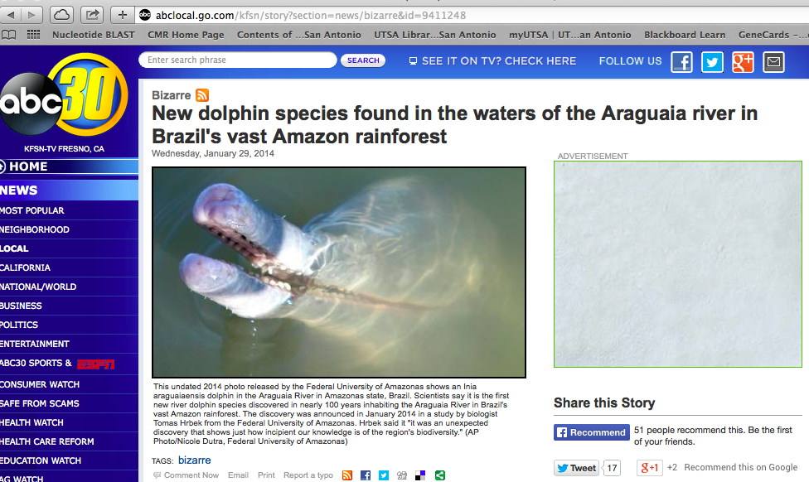
http://www.plosone.org/article/info%3Adoi%2F10.1371%2Fjournal.pone.0083623

Slide 5
The Currency of Science is the Scientific Paper!
Writing communicates the answer to the scientific questions that you asked!
“The goal of scientific research is publication…A scientific experiment, no matter how spectacular the results, is not complete until the results are published.”
Robert A. Day – How to write and Publish a Scientific Paper

Slide 6
What is a “Paper”?
Report of original work
Performed by you (and others)
Published in scientific journal
Reviewed by peers
Widely available
Form foundation for all research!

Slide 7
Why Publish?
Contributes knowledge
Ensures scientific rigor
Allows feedback (improves work)
Promotes career
  document productivity
  document impact on field/reputation
  Seminar invitations
  Advertises your lab for future trainees
Improves chances of funding
Fulfills an obligation (public monies)

Slide 8
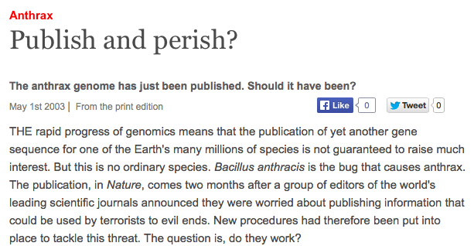

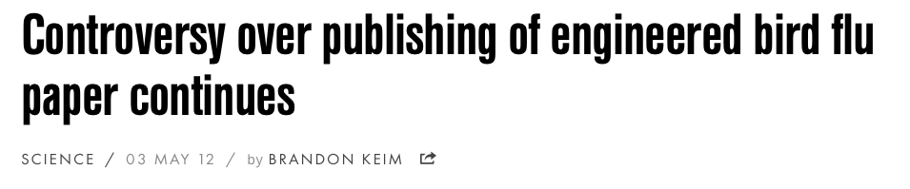
Can Cause Controversy

Slide 9
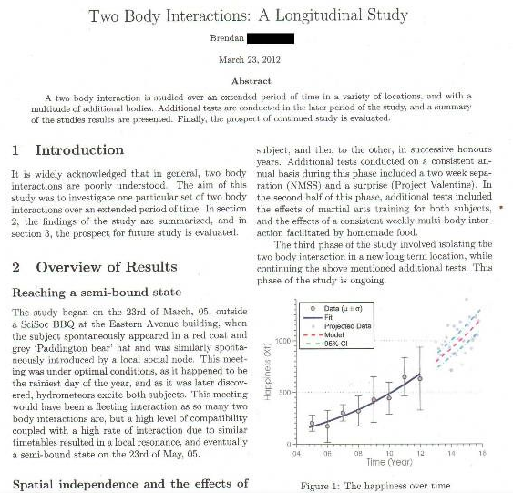
Several Types of Paper
Review Paper – State of the field
Rapid communication/brief note/letters – abbreviated report. Timely.
Techniques Papers – new methods
Standard research paper – Reports of new findings
  Experimental
  Descriptive

Slide 10
What is a Research Journal?
Magazine-like publication carrying:
  Original research reports
  Editorials
  Letters to editor
  Advertisements (jobs and scientific equipment)
Content can be general or specific
Varying prestige/reputation
Scientists submit their articles for free
  Try to be first with a discovery
  May even pay at publication
  Are looking for prestige
Articles are Peer-reviewed
Shared results create an overall body of knowledge

Slide 11
More on Journals
First was Philosophical Transactions of the Royal Society in the mid 1600s. England. http://www.jstor.org
  http://www.jstor.org/browse/03702316/ap000001?frame=noframe&userID=8173521a@utsa.edu/01cc99334140181046789dc1c&dpi=3&config=jstor
Published by scientific societies and subsidized by dues
In 1965, US government subsidize page charges
Demand still too strong
Commercial Publishers into field
  new journals and library subscriptions
  Very high rates
  Rates skyrocketing over time; as high as can bear
  Scientists pressure libraries…
Now, 100,000 journals….

Slide 12
Very Popular/Prestigious Journals
Impact Factor – Average # refs/paper published
Google Scholar – http://scholar.google.com/citations?view_op=top_venues&hl=en
Biological or Chemical Abstracts (ACS)
Biology
  Science = http://www.sciencemag.org
  New England Journal of Med
  Nature = http://www.nature.org
Elsevier publishing group: http://www.elsevier.com/wps/find/homepage.cws_home

Slide 13
State of Journal Publishing…
Owned by:
  MOST: Large publishing corporations
    Elsevier
    Harcourt/Pearson
    Academic Press
    MacMillan (Nature)
  Scientific Organizations and Societies
    Society for Neuroscience - Journal of Neuroscience
    American Chemical Society - http://pubs.acs.org/
    American Association for the Advancement of Science (AAAS) - Science
Many are now available online

Slide 14
Currently…Big Change…
Unrest about Anti-Trust and Cost of Journals
http://www.library.uiuc.edu/scholcomm/journalcosts.htm
Sample of what they cost: http://resource-cms.springer.com/springer-cms/rest/v1/content/31016/data/2015+Journals+Price+List+-+USD

Slide 15
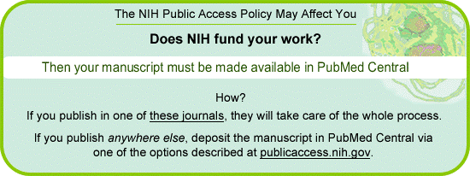
Currently…Big Change…
Research from Grants has to be made freely available!
Government archives…
http://www.pubmedcentral.nih.gov/
Or they will not give you your renewal

Slide 16
Getting a Paper into a Journal
May take a year!
Write and submit in proper format
Editor sends to peer reviewers
  Other scientists who are in your field
  They assess the quality of your work
Peer Reviewers (usually 2) make recommendations
  Accept
  Accept with revisions
  Reject
    Scientific value
    Not relevant to journal
Revisions/Resubmissions/rebuttals
Review proofs

Slide 17
What’s in a Paper?
Know where to look for various types of Information!

Slide 18
Anatomy of a Research Article
Title
Ethical Dimensions of Publishing Peer-Reviewed
Research Articles
Gail P. Taylor
Authors
Abstract
University of Texas, San Antonio, 78249
Peer reviewed research articles have long played a significant role in science – facilitating scientific progress by permitting the sharing of methods, results, and interpretations, and establishing a mechanism for judging the expertise and productivity of researchers. Perhaps because publications hold such value it should not be surprising that some individuals have sought to circumvent traditional publication practices so as increase their standing in the field. The damage that can be inflicted on the researcher, their colleagues, and the scientific enterprise by such incidents has led some scientific societies and journals to develop guidelines outlining responsible conduct with regard to publishing research articles. This chapter outlines some of the major ethical concerns with regard to publication practices, describes some of the points at which a conflict in values or obligations may arise, and discusses some of the mechanisms which have been developed to minimize such conflicts and their impact on the discipline. Although we focus specifically on peer reviewed research articles, many of the issues we discuss for example plagiarism, honorary authorship, and failure of scholarship are
Affiliation
Introduction
Peer reviewed research articles serve several essential roles in the sciences: they enable individuals to benefit from the work of others, help to safeguard the integrity of the research process, and provide a mechanism for assessing a scientist’s productivity. The first scientific journals were published in 1665; although much research had been done prior to that time, the results were not widely disseminated, in part because individual scientists had few reliable ways to establish priority
or ensure credit for their work. However, with the emergence of the first scientific journals and their dissemination to research laboratories and libraries, there evolved a generally available account of experiments performed, including the investigator’s methods, results, and interpretations. It now became possible to make work public while at the same time guarding one’s intellectual property rights. The ability to disseminate
Methods
Results
Discussion Acknowledgments
References

Slide 19
Anatomy of a Research Article
IMRAD
Title: what is this about (shortest summary)?
Authors: who did it?
Affiliations: where did they do it?
Abstract: what did they do (summary)?
Introduction: what was the question (ends in summary)?
Methods: how did they get their answer?
Results: what did they find out?
Discussion: what do results mean (begins w summary)?
Acknowledgments: who helped them out?
References: to whose work did they refer?

Slide 20
Title
Style/length may vary
Very brief summary of research
  Omit “A study of,” “Investigations of,” etc
  Put species studied
  Put limiting information (region)
  Avoid “cute” or abbreviations
May or may not give results
  Topic – Effects of phenobarbital on learning
  Conclusive – Phenobarbatal diminishes learning…
Helps people to find article (keyword search)
Helps others to choose to read

Slide 21
Authorship
“For each individual the privilege of authorship should be based on a significant contribution to the conceptualization, design, execution, and/or interpretation of the research study, as well as a willingness to assume responsibility for the study.”
Guidelines for the Conduct of Research in the Intramural Research Programs at NIH. http://www.nih.gov/news/irnews/guidelines.htm#anchor128256

Slide 22
Authorship (Order)
Significance depends on field
“First Author” a coveted position
Complicated by equal collaborations
Now most commonly:
  Janet DiMarci, Louis Hernandez, Arthur Smith, and Wen Zhou
day to day
responsibility
head of lab/PI

Slide 23
Authors’ affiliations and corresponding author
First Author
Principal Investigator
Wen Chu^{1*} and John Done^{2$}
Departments of ¹Biostatistics and ²Chemistry
University of the Atlantic
Baltimore, MD
________________
*current address: Dept. of Chemistry, University of the Pacific, Palo Alto, CA
$ to whom correspondence should be addressed

Slide 24
Abstract – The Summary of Work
Introduction
    state of knowledge (Big picture to specific)
    what is the question
    statement of hypothesis (optional)
Methods
Results
Discussion
Summary

Slide 25
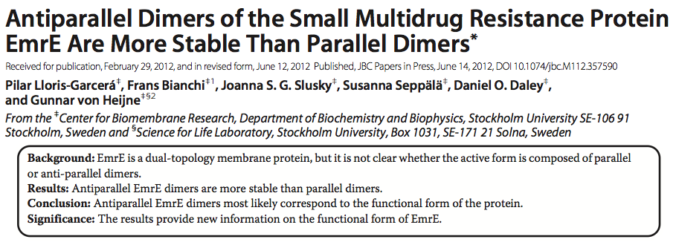
Or in other words…..
Few publications have their main points laid out for you

Slide 26
Introduction (body of paper)
Sets context and function of paper
Proper organization
  State of knowledge (Big picture to specific)
    NOT entire field
    Background of this study (1-2 paragraph)
    Building rationale for experiment (1-2 paragraph)
  What did authors address?
    Brief description of experiment.
  Statement of hypothesis (optional)
  Summary of results (optional)

Slide 27
Methods
Function of Methods Section
  Evaluation
  Replication
Experiments vs Techniques
How did they study the problem?
  Subjects, materials, apparatus, chemicals?
How did they proceed? - Experiments carried out
What controls were used?
Equipment/techniques used (usually have subheadings)
  Can reference then summarize, if published
  Do put equipment models, sensitivities, concentrations, times
  Do put reagent or animal sources (company; city, state)
  Do put how animals are maintained
  Do not detail common procedures
Special precautions

Slide 28
Results
Presents the findings
  Briefly describe experiments (no detail)
How long?
  Depends on number of experiments
  Enough to support tables/figures
Findings described in past tense:
  “Within 6 hours of tropical storms, atmospheric pressure decreased by 20 + 6%.”
Order results logically (most to least imp)
Table/figure data not repeated
Generally does NOT include explanations or discussion of results

Slide 29
Figures Legends/Captions
What is shown
A mini summary of entire experiment (including brief methods)
Explains abbreviations
Reveals statistics and significance values
Should stand alone

Slide 30
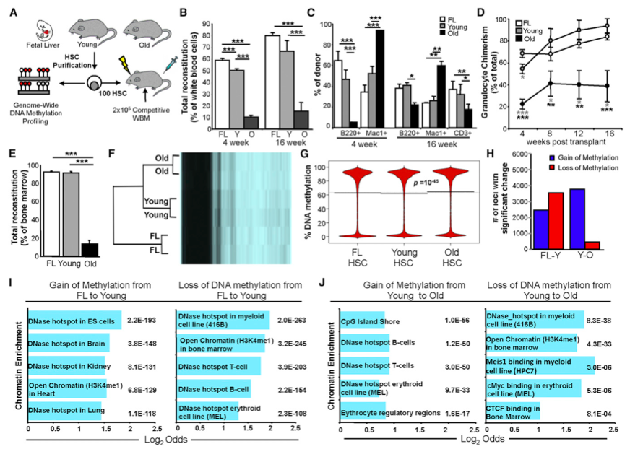
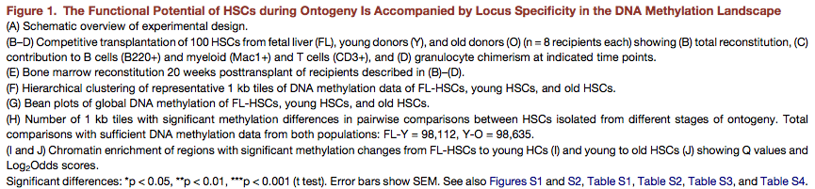

Slide 31
Discussion
What does it all mean?
Summary of major findings
Considers for each result:
  What patterns, principles, relationship do results show?
  How do results relate to expectations and literature (in intro)
  Are their plausible explanation?
  What additional research is needed?
Notes possible exceptions or odd results
Theoretical or practical implications
Can results extend to other situations/species?
Do they help us understand broader topic?
Future Directions

Slide 32
“Thank you” Acknowledgments
technical assistance
advice on research or manuscript
gifts of materials
assistance in preparing manuscript
financial assistance

Slide 33
Acknowledgments
“This work was supported by NIH (NS19806) and Biotech, Inc. A preliminary report was presented at the Pharmacology Society, May 25, 1999. We thank Jose Guera for technical assistance and assistance in the preparation of this manuscript. One of the authors (JD) is a paid consultant for Biotech, Inc.”
Notes:
Four things shown here:
Acknowledge funding- conflicts of interest
Prelim report: Not duplicating your research or double-dipping
Thanking people:
Revealing possible conflicts of interest

Slide 34
Importance of financial disclosure
Exposes possible conflicts-of-interest
  source of support can influence results
  disclosure will
    - remind you
    - alert reader
failure to disclose can raise alarms

Slide 35
Bibliography
Relevant literature
Cited references usually
  primary versus secondary
  original versus most recent
  theirs versus yours
  Must be addressed in paper
how many to cite
  per point
  per paper

Slide 36
Approaches to Reading A Paper

Slide 37
Quick Analysis!
First Author – first in list
Principal Investigator – usually last & to whom correspondence is addressed…
The Title – Very short summary of whole paper
Last few (1-2) sentences of Abstract, then whole abstract – Summary of entire paper
Last paragraph in the Introduction – Summary of Results
Figures/tables with captions headings – Shows all expts.
First paragraph of Discussion – Summary of results
End of discussion – Future directions
Methods- techniques used
Pay attention to headings in Methods

Slide 38
Thorough Approach to Paper I
Approach aggressively and actively
  Skim, then read
  Look up unknown words, techniques & Abbreviations
  Highlight
  Write Summary/flow chart/ analysis

Slide 39
How to Approach a Paper II
Skeptically/Critically
  See Next pages…
  Is it obscure and difficult to read?
  Share with others in study groups/journal clubs, etc

Slide 40
How to Approach a Paper III
File and care for your papers
Electronic?
  Endnote
  Backup frequently!

Slide 41
Paper Quality
Let the Reader Beware!!!
Fallacies:
  If it’s published, it must be true
  If it’s published, it must be important
  Scientists wouldn't obscure results/figures
  Scientists wouldn’t cheat or cut corners to get ahead
  Online free access journals wouldn’t blindly accept a paper
  Publishers won’t mess up a paper in printing

Slide 42
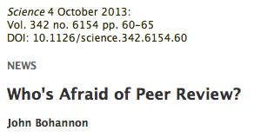
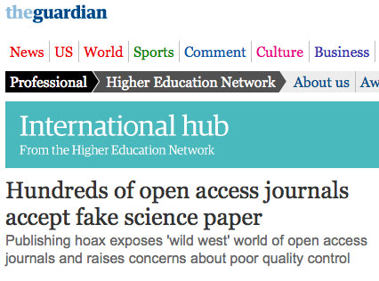

Slide 43
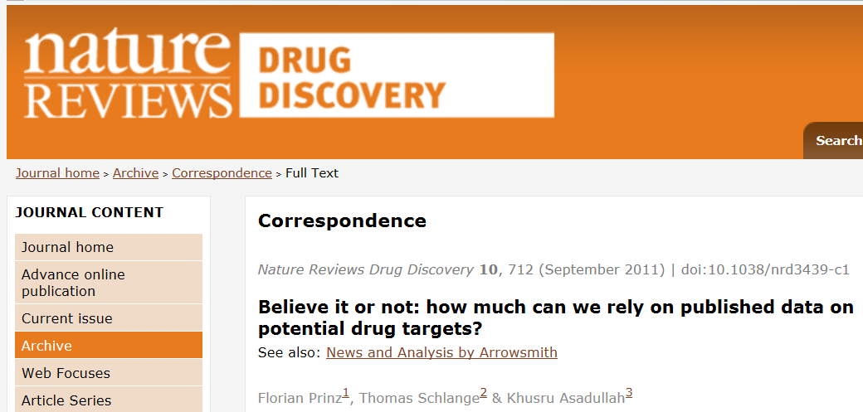
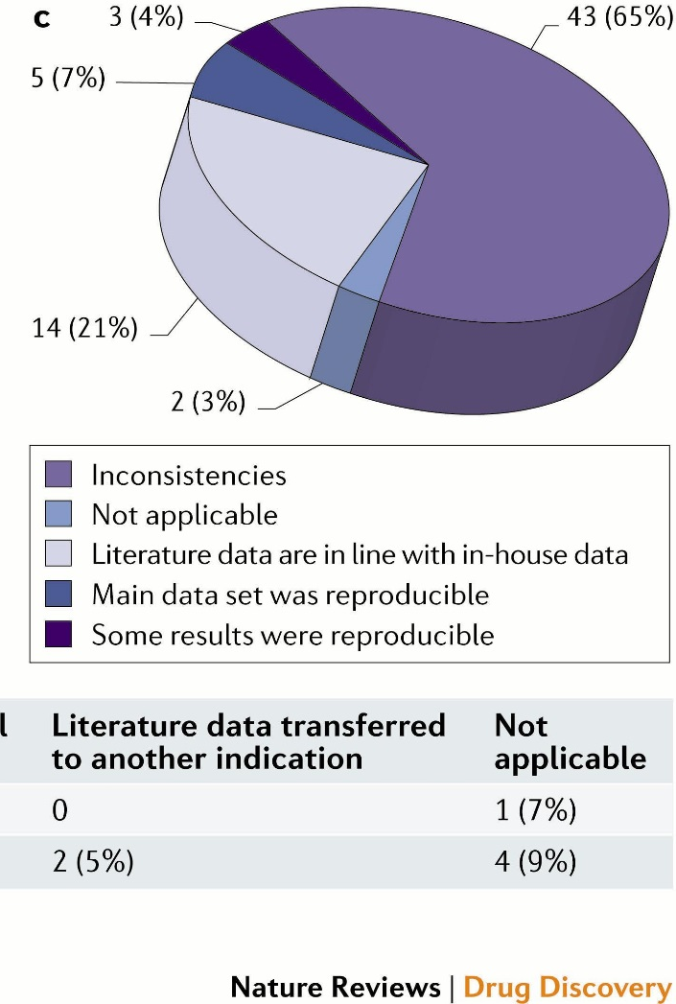
http://www.nature.com/nrd/journal/v10/n9/full/nrd3439-c1.html#f1

Slide 44
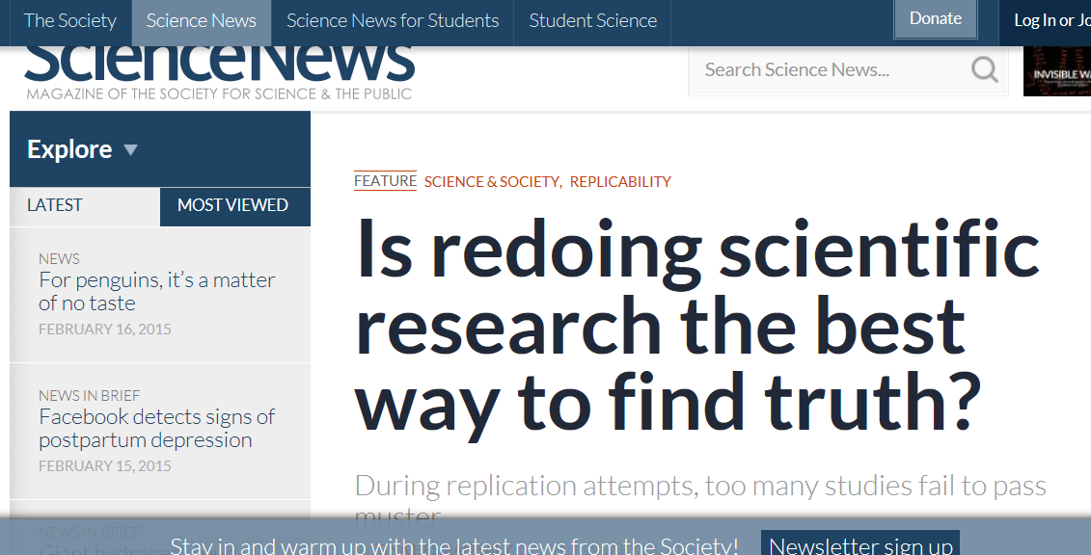
Replication?
https://www.sciencenews.org/article/redoing-scientific-research-best-way-find-truth

Slide 45
In Conclusion….
If you know what’s there, and where to look…you should be able to quickly pick out important parts of the paper…
Never accept anything in science blindly!! Be looking for problems as you read!

Slide 46

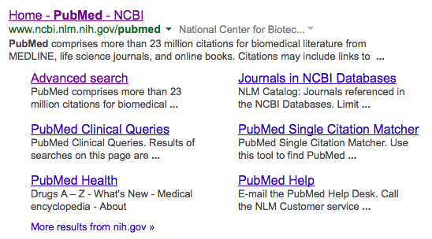
Finding publications on your own
lib.utsa.edu
www.ncbi.nlm.nih.gov/pubmed

Slide 47
Acknowledgments
E.B. White
Robert A. Day
Mary H. Briscoe
Council of Biology Editors
Survival Skills and Ethics Program:
  http://www.pitt.edu/~survival
  Beth Fisher and Michael Zigmond
  Department of Biology, Bates College http://abacus.bates.edu/~ganderso/biology/resources/writing/HTWtoc.html
  University of Wisconsin: http://www.wisc.edu/writing/Handbook/ScienceReport.html
Beyond the Beakers. Gail Slaughter, Ph.D. National Science Foundation (20005)

