Slide 1
Taking Charge of Your Training to Maximize Your Future…
Adapted from Dr. Gail P. Taylor,
University of Texas at San Antonio
Revised 5/2013

Slide 2
You’ve decided on Research as a Career…

Slide 3
Why Research?
Reasons diverse as there are researchers
Discovery
Help others
“Born” researcher
Curiosity
Always something new going on
Exciting environment
Bored when not learning new things
Can change fields

Slide 4
How can you set yourself up for a very solid career?

Slide 5
Planning is bringing the future into the present so that you can do something about it now
~Alan Lakein
Notes:
“Time = Life, therfore, waste your time and waste your life, or master your time and master your life”

Slide 6
What is your Focus??
What do you need to get into grad school?
What do you need to excel in grad school!
Grants!
How do you find the right grad school?

Slide 7
Plan to Achieve Your Objectives!
Deep Research Experience(s)
Cultivate Letters of Recommendation
Take the correct coursework!
For program, not degree
Learn, not just grades
Evaluate Grad Schools
Prepare for Standardized Tests
Broader Impact experiences
Theses/Proposals
Reassess as needed!

Slide 8
Set yourself up for Faculty reviews!
Strong grasp of your course work
Strong work ethic and productivity
Responsibly finish what is assigned to you
Work to solve own problems
High level critical thinking (take time to think!)
How do you approach problems?
What is the next step of your project?
What are the implications of your project?
Show enjoyment of what you are doing
Teamwork
Respect self and others
Good communication
Teaching ability
Honesty/Integrity

Slide 9
Other Things to Learn in Lab
Techniques
Lab culture
Reading the literature/High level reading
Designing Experiments
Data Analysis
Writing Abstracts
Conferences
Poster and Oral Presentation
Grad Courses (mentor recommended)
Writing Theses

Slide 10
Other Benefits to UG Research
Academic:
Validates coursework
Intro to balancing school and research
Deeper Faculty contact/mentoring
Personal:
Self-confidence
Maturity
Knowledge that you can have an impact
Generally, an increase in motivation
Professional
Observe a “high level” career
Learn to speak like a professional
CV/Resume that stands out
Letters of recommendation
Publications

Slide 11
Overcome “Weaknesses” Now
Fear #1
Oral presentations
Writing
Passivity
Anxiety
Single-mindedness
Self-doubt/Imposter Syndrome
Reassess as needed!
Counseling Center
Academic Coaching TRC

Slide 12
Path might not be direct…
Undergraduate -> PhD (Biosciences)
Undergraduate -> Start MS -> PhD (others)
Undergraduate -> MS -> PhD (others)
Undergraduate -> Postbacc -> PhD
Undergraduate -> Job (research) -> PhD
Depends on:
Research Experience
Skill in lab
Letters
Confidence
Grades

Slide 13
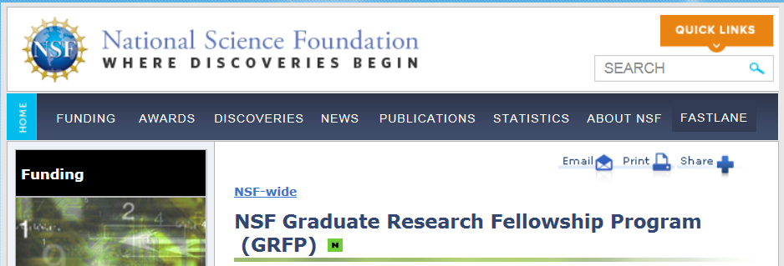
Set Yourself up For GRFP!!
Academic
Research
Letters
Project
Broader Impact
http://www.nsf.gov/funding/pgm_summ.jsp?pims_id=6201

Slide 14
Small opportunities are often the beginning of great enterprises….
~Demosthenes
Notes:
Greek orator,

