Slide 1

Taking Charge of Your Training to Maximize Your Future…
– Graduate Student Edition
Adapted by Dr. Gail P. Taylor,
University of Texas at San Antonio
Originally Developed by:
Beth Fischer and Michael Zigmond
Survival Skills and Ethics Program
http://www.pitt.edu/~survival
Revised 9/2009
01/16/2008

Slide 2
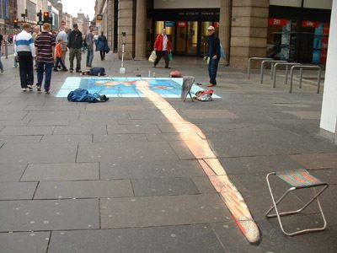
http://users.skynet.be/J.Beever/pave.htm

Slide 3
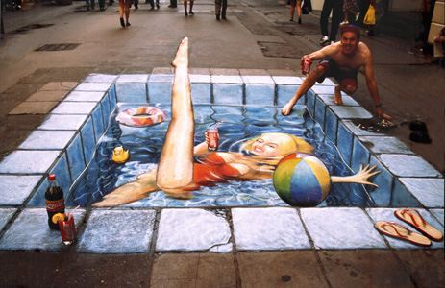
http://users.skynet.be/J.Beever/pave.htm

Slide 4
Your Point of View Really Matters in life…
Particularly Involving your Future

Slide 5
Thought Question #1:
How do you view your graduate career?

Slide 6
Attitudes about Doctoral Education
Something my parents made me do
Holding pattern until I figure myself out
A job to help me get by
Compromise because I didn’t get into Med School
I’m good at school…might as well get a Ph.D.
It’s all about grades!
It’s all about research!
It’s a way of life
It’s a guaranteed ticket for a good job
It’s a time to build credentials and develop yourself for a future career

Slide 7
Attitude Influences Performance
Sabotage degree completion or Career accomplishment
Other attitudes to watch for…
  Apathy
    Lack of commitment
    Lack of goals
    Lack of drive
  Arrogance – An Island - no assistance or advice
  Pride – Can’t make mistakes
  Anger – Hate bureaucracy, policies, etc…
  Fear - Imposter Syndrome

Slide 8
Balance is also important
Narrow Focus can lead to problems
  Classes only
  Research
  Degree only
  Grades only
  Completion only
Balance to prevent burnout
  Family
  Exercise
  Free time

Slide 9
Relationships are important
  70-80% of jobs obtained through people you know
Personal relationships – family
Your PI
Other mentors
Other faculty
People from conferences
Books!
Wonderful network of other students
  Tend to follow throughout life
  Collaborations
  Can assist and support now
    Old tests
    Study groups

Slide 10
Always be planning and focusing on the next step, after graduation!

Slide 11
Planning is bringing the future into the present so that you can do something about it now
~Alan Lakein

Slide 12
You Must Take Charge of Your Own Training!

Slide 13
Why You Must Take Charge…
Correct or resolve hindering attitudes
Begin to plan for your future!
You’re the only one thinking of mainly You!
  Mentor is busy with many responsibilities
  Committee is busy with many responsibilities
  Doctoral Studies Committee is very busy
  Your Spouse/Partner and Mom don’t really know what you’re doing…

Slide 14
Preparing for Success…
Find Correct Mentor and Project
.
Learn about career paths
  Look at least one step beyond - where do you want to go?
Make a decision…you can always change it…
What must you accomplish in GS?
  Tests, etc
  Determine what you need to gain
  Technical Skills
  Knowledge of Field
  Professional Skills
  Accomplishments (products of science)
  Network/References
  Confidence
  Time

Slide 15
PI Considerations
What do they study?
  Good field?
  Choose something that they do….
Do you like one another?
Reputation - Ability as educators and mentors
Ability as scientists
    Grants
      RO1 http://grants.nih.gov/grants/funding/r01.htm
    Publications
      Nature, Science
    Awards
      Nobel Prizes
    National Academy of Sciences Members
      http://www.nationalacademies.org/
  Know how to “Play the game” of science…
Ability to support you
Mentoring vs Reputation…

Slide 16
The most important person- your major or research advisor:
An advisor should give you:
  Advice
  Can be a mentor…
  Second-hand reputation
  Knowledge of professional activities
  Possible financial support/assistance
  Role model
  Introductions/networking
  Letters of recommendation
  Respect
http://bower-lab.org

Slide 17
Your responsibilities to your advisor and lab
A laboratory is an extended family!
  Your best effort
    Show up when you say you will!
  Honesty
  Productivity
  Assistance- Teamwork
  Feedback/communication
  Respect/Loyalty

Slide 18
How to Impress Faculty…
Strong grasp of your course work
Strong work ethic and productivity
Attitude- enjoyment of what you are doing
Teamwork
Respect self and others
Good communication
Honesty/Integrity
High level critical thinking (take time to think!)
  How do you approach problems?
  What is the next step of your project?
  What are the implications of your project?

Slide 19
Standard Ph.D. Training Path
1-2 Yrs
Post Bacc
Research
3 - 6 Yrs
Academics
Academic Postdoc
4 - 7 Yrs
Government
Postdoc
UG –
Sciences
Government
Doctoral
Studies
Industry Postdoc
UG –
Engineering
Industry
Continue
Education
M.S. Degree
Other Career
Other
Engineering
Work

Slide 20
What are Your Objectives?
Desired career path
  Doctoral Program?
  Postdoc?
    Where
    Field
    With whom
  Professional Position…?
    Industry?
    Government?
    Law
    Contractor
    Etc

Slide 21
Activities for Degree I
Find correct laboratory
Required courses/exams – LEARN material
Other valuable courses – Career path
Forming committees
Research
Presentations
Develop Network
Manage weaknesses
Exams
Thesis
Abstract/conferences
Scientific Papers!

Slide 22
More Activities for Degree
Volunteer Activities
Additional Training – Business? Management? Certifications?
Patents
Invited Lectures
Collaborations
Mentoring Students
Service on Committees
Teaching
Grant writing
Line up postdoc…or next position!
Write and complete thesis (Papers?)

Slide 23
What you gain, overall…
Techniques and their application
Problem solving/Critical thinking
Experimental design
Literature/foundation in your field
Specific knowledge of problem area
How to learn and adapt
Communication/publication skills
Ethics/acceptable practices
Laboratory support – finances/grants
How to work cooperatively with others
Laboratory management
Networking!

Slide 24
Where do you learn necessary skills?
Mainly through experience, from your Research Advisor/Mentor…
Through other Mentors
Increasingly through lectures or classes such as this one…

Slide 25
Make a Plan – Timetable
Include all activities on it!

Slide 26
Small opportunities are often the beginning of great enterprises….
~Demosthenes

Slide 27
Typical Progression Thru Doctoral Education
Year 1: Courses; rotations (3); Choose lab
Year 2: Courses; Exam
  Form Qualifying Examination Committee
  Written: Over coursework
  Oral Exam; mock oral proposal NRSA 10 page format. (can be own research; can also submit it)
Year 3: Proposal; Research/Seminars
  Form Dissertation Committee
  Final real proposal presented
Year 4 Research; Seminar courses
Year 5 Research; Seminar courses; Writing
Year 6 ?? Research; seminars; Writing

Slide 28
How to Efficiently Progress
Select Advisor(s) and Committees
  Advisor
  Advising committee
  Mentor(s)
Develop plan to complete degree milestones
  Courses
  Exams
  Research
Accomplish Personal Goals…
Handle problems along the way
Prepare to move on…

Slide 29
What Research Project do You Want to Tackle?
You must be interested in it!
Best if it is also your Mentor’s grant project…
Likely to yield results!
Presence of other local sources of expertise
Consider future marketability!
Availability of a “secret weapon”
  What is unique in the lab or environment?
    Methodology
    Insights
    Preliminary data
    Resources/equipment

Slide 30
Selecting a Research Problem: Additional Considerations
Determining how many Problems/Specific Aims
  more than one
  less than four
Developing hypotheses
Working collaboratively
Knowing when to start, publish, quit…

Slide 31
Problems that may occur:
Your advisor...
has different priorities from yours
does not provide much feedback
leaves the institution
feels you are not working hard enough
does not get along with others in department
does not get along with you
behaves in a way you find irresponsible

Slide 32
Problems that may occur:
You...
Have a major life change
Want to change advisors
change your research interests
change your career objectives
become overwhelmed
become under-whelmed

Slide 33
When Things Get Tough…
Grad school has very stressful times
Most have a “burn out” time
Try to stick it out!
  Talk to people
  Reach Out/Don’t isolate
  Get counseling if needed
Keep your eye on the prize!
You will evolve; you must become a colleague to your mentor, as you develop as a scientist…

Slide 34
Overall…
Develop a great perspective!
Take steps to plan your future
Take advantage of opportunities
Build credentials
Achieve your dreams

Slide 35
P.S…
A good perspective at the beginning will assist you in progressing efficiently through your training and launching into a career…

Slide 36
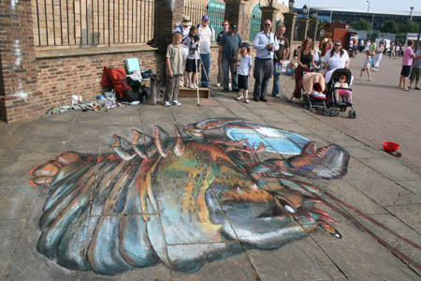
http://users.skynet.be/J.Beever/pave.htm

Slide 37
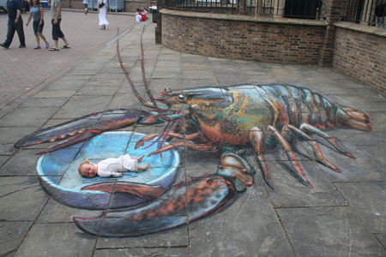
The End…?
http://users.skynet.be/J.Beever/pave.htm

