Slide 1
Fleet Maintenance Update
Improving Maintenance, Budgeting & Compliance
Presented by UTSA Fleet Management on behalf of
Real Estate & Property Management (RPM)

Slide 2
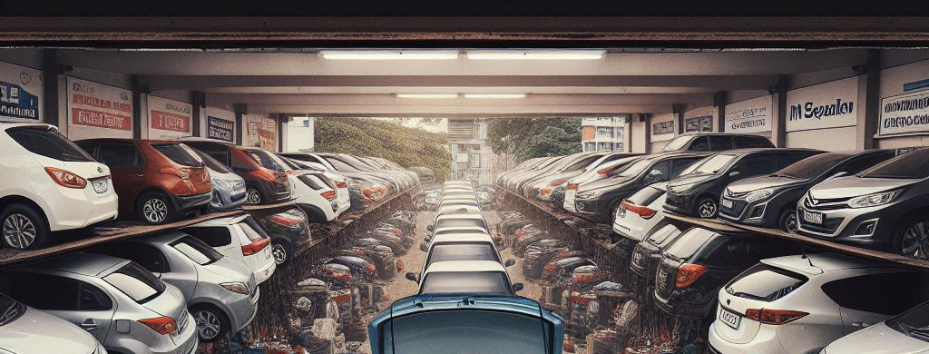
Agenda
Fleet Overview
Self-Service Maintenance
How to Enroll
Next Steps
Expected Outcomes:
By the end of this session, fleet owners and custodians will understand next steps to ensuring adequate maintenance of their fleet.
Notes:
Now required to capture under new program
Notification for requirements, oil, tire, inspect, manufacture update
Customer requirements
Accounting and cost center, 6 digit code

Slide 3
Fleet Overview
UTSA Fleet Today
217 total registered state-owned vehicles
    47% of fleet over 10 years old
    9% licensed vehicles 20+ years old
    39% in compliance with state requirements
Currently staffed for equipment and golf carts
Notes:
State usually required 10 year EoL model..Maintenance is paramount
VEHICLE BELONGS TO THE STATE
UTSA fleet maintenance team lacked capacity to maintain large fleet
Difficulty sourcing parts in a timely manner
Large backlog leading to increased vehicle down time and poor service reliability
Last 3 years total 2.7 shop personnel
61% UTSA staffing doesn’t receive notification of maintenance services
Explain where we are now and transitioning to self service

Slide 4
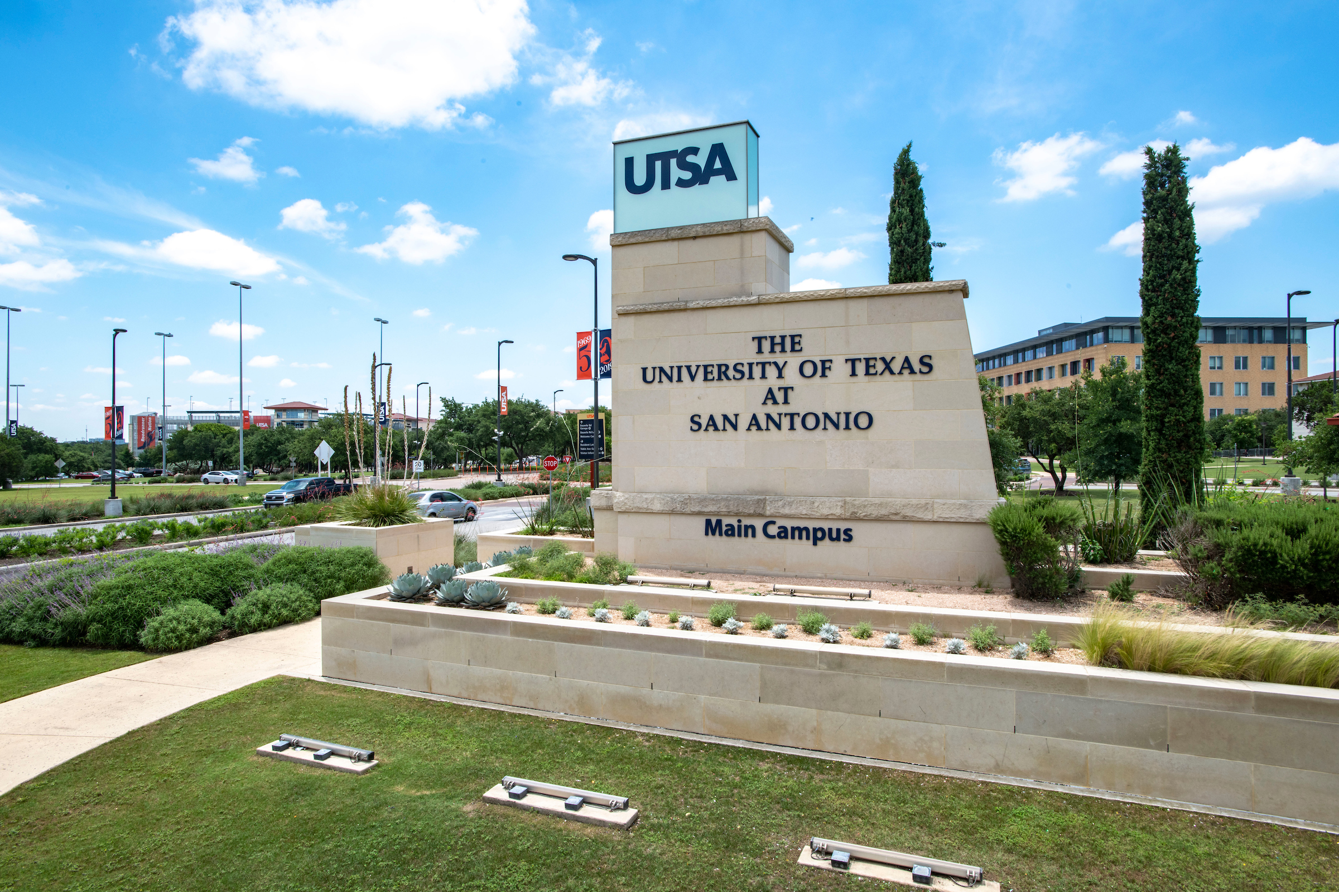
Self-Service Enterprise Maintenance Program
Adequate maintenance and reporting requires:
  Comprehensive understanding and support of maintenance requirements for state owned vehicle
  Structured plan to inform fleet owner’s fleet maintenance budget
  Support in complying with state reporting
Self-service maintenance ensures Vehicle Custodians:
  Have support in maintaining and reporting
  Informed with live data, including accrued service costs for budgeting
  Access to modern fleet management support such as service networks, digital platforms, 24/7customer service.
Notes:
- Texas Government Code §2171 and Texas Administrative Code (TAC) Title 34, Part 1, Chapter 5, Subchapter C guide how state agencies must manage their vehicles.
This progressive approach is common among large, comprehensive, distributed universities, providing a model for efficient and effective fleet management
Self service frees owners from restrictions of in house support use only and partnership with external entities ensures owners have access to modern fleet management support
Top section- Fleet management responsibility
bottom section is the vehicle custodians responsibility

Slide 5
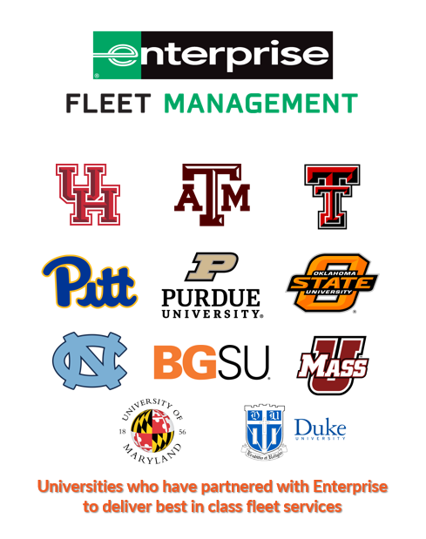
Self Service Maintenance:
UTSA & Enterprise partnership
The Enterprise Fleet Maintenance Program is a comprehensive self-service fleet management partnership designed to facilitate maintenance and quality control to be more responsive to customer and transparency for organizations that operate fleets.
Notes:
***And allows our vehicle to comply with state regulation
Allows us to assist with maintenance IAW vehicle type

Slide 6
How Can Enterprise Help You
Key areas:
Maintenance support
Repair and service cost tracking
Alerting for PMs, registration, recalls, & updates
35 partnered shops within 5 mile radius of campus
Consolidated invoice
Controlled labor cost & validation
Notes:
Comply with regulations
Assist with retaining value of state purchased vehicle
Improve efficiency of vehicle and minimizing catastrophic repairs
Allows for repairs to be completed considerable redux in industrial cost, (labor and parts)
Towing 24/7, roadside assistance, CONTIGUOUS for repairs, major updates,
C/w manufacture recall, updates, TSB, bulletin (notification)
Vice President of Business Affairs Business Service Center

Slide 7
Maintenance Statistics
Overall Fleet Enrollment Breakdown
  217 Total *Registered Fleet
    25 leased vehicles (12%)
    81 UTSA owned vehicles (38%)
    111 not in compliance (50%)
Notes:
Add long term lease 2 or more-year program, does not include short term lease 1 year or less

Slide 8
Roles & Responsibilities
Roles and Responsibilities
Enterprise Fleet Management
UTSA Fleet Management
Self Service: Vehicle Custodian
National Service Department (Auto Integrate) validates maintenance, provides roadside assistance, billing and escalation support, as well as fleet analytics
Maintenance approvals/coordination, internal reports, fuel program, registration, compliance with state regulation, fleet evaluation
Daily inspection, fuel transactions, transporting to maintenance, accident reporting, ensuring reporting to UTSA Fleet Management, monitoring and payment, cleanliness.
Notes:
Fleet management-Providing dashboard to monitor key metrics. Providing maintenance approvals to customer selected limit. Providing data warehousing. Monitoring cost and value of vehicles based on inputs. enerating internal reports on key metrics, approving repair orders, monitoring fuel and purchases, and managing data entry into TXFS.
Vehicle Custodian is responsible for the asset

Slide 9
Enrollment
Cost & Frequency:
S&M varies depending on age, vehicle type and mileage. Serviced according to manufacturer’s recommendations, or at least twice per year. Reporting includes odometer reading, fuel*, and services received.
$6 monthly enrollment fee
Anticipated first year, $2K cost per vehicle
Vehicle receives minimum of two maintenance services (yearly)
Custodian shares monthly reporting metrics
Secondary label
Secondary label
Secondary label
Secondary label
Stat detail
Stat detail
Stat detail
Stat detail
Notes:
Fuel is captured via Voyager, so long as custodians are ensuring only voyager fuel cards are used to fuel vehicles. With enterprise, odometer readings are captured every time a vehicle is serviced, and the enterprise dashboard will automatically log all services received.
- Maintenance catchup or serviceability and safety
- Additional year cost depending on year, make , model

Slide 10
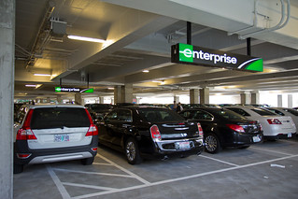
Enrollment Scope
January 2026, all licensed vehicles* must be enrolled
Specialty service vehicles like police pursuit vehicles and buses can enroll but are subject to exceptions
Notes:
We can provide additional services to tailor your specific needs.
- Overhead reporting

Slide 11
Enterprise Enrollment
How it Works
Registered vehicles will be enrolled in the program
The requesting vehicle custodian receive an initial consultation that includes: ​
    Enterprise​ Overview
    Overview of enrollment responsibilities and cost
    Early Enrollment Deadline, November 14, 2025 for mandatory billing
Notes:
*NOTE- estimated preliminary costs based on vehicle condition. And age
The department identifies how they will finance their enrollment in the program.
Enterprise Bills 3rd week, monthly

Slide 12
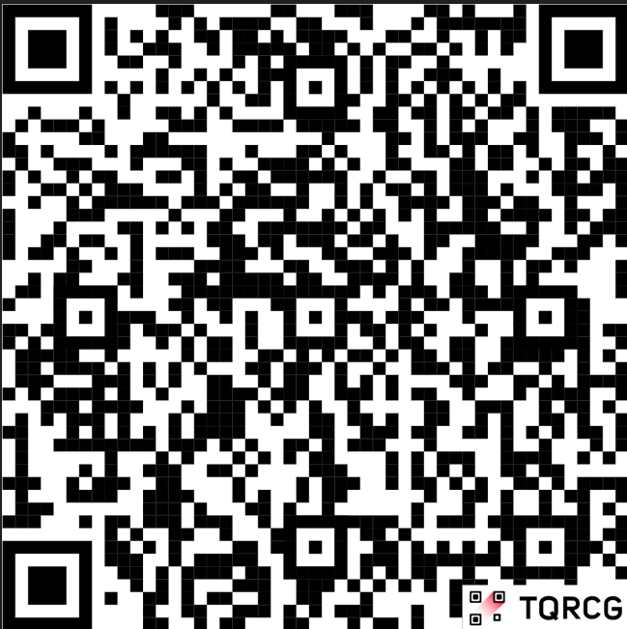
Additional UTSA Fleet Services Information
Driver authorization
Accident Reporting
Asset Transfer Assistance/Vehicle Surplus
Fuel PIN & Card Responsibility/Rules
New Vehicle Purchase Guidelines UTSA
Fleet Services
Notes:
We can provide additional services to tailor your specific needs.
- Highest

Slide 13
QUESTIONS?
Fleet Manager:
Jerry Coward
Email: edwin.coward@utsa.edu
Phone: 210 458-7681
Secondary label
Secondary label
Maintenance Lead:
Thomas Ocampo
Email: thomas.ocampo@utsa.edu
Phone: 210 627-1856
Stat detail
Stat detail
Stat detail

