Slide 1
Racing to Reaccreditation
SACSCOC Reaffirmation of Accreditation 2020

Slide 2
What is Reaffirmation of Accreditation?
Reaccreditation process for the Southern Association of Colleges and Schools Commission on Colleges (SACSCOC).
10-year cycle examining about 100 Principles of Accreditation. Includes a comprehensive report and on-site review.
Accreditation gives UTSA degree-granting authority and the ability to receive federal funding.
Institutional Effectiveness

Slide 3
Comprehensive Review
Institutional Mission
Governance and Administration
Institutional Effectiveness
Educational Programs, Graduate and Undergraduate
Faculty
Library
Student Affairs and Services
Resources, including Fiscal and Physical
Policy Compliance, including Federal Standards
Institutional Effectiveness

Slide 4
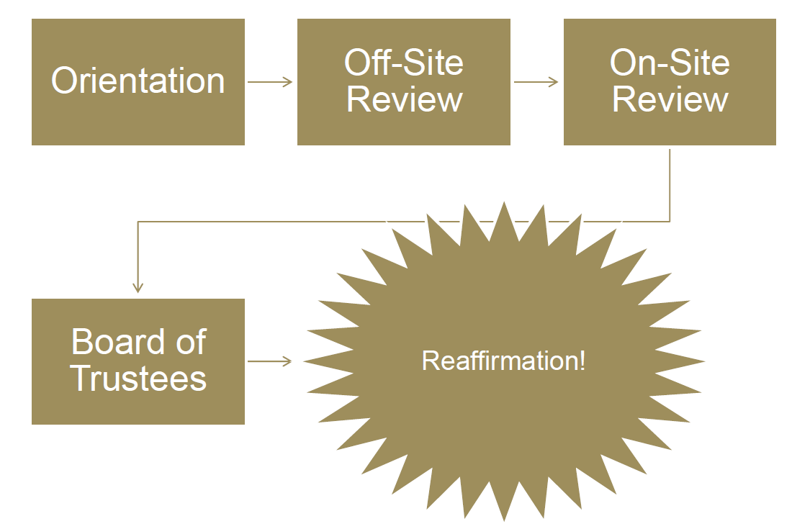
Status Check
Fall 2017
Spring 2018
Sept. 2019
Spring 2020
Compliance Cert. Report
Dec. 2020
From SACSCOC

Slide 5
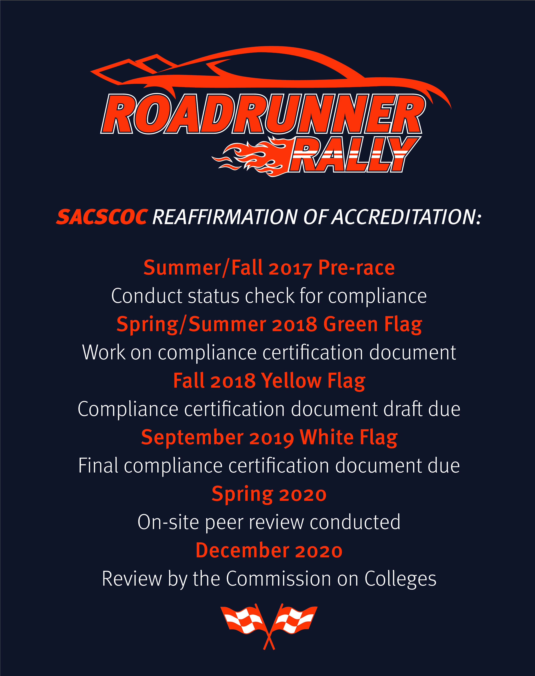

Slide 6
Desired Philosophy
Per Dr. Belle Wheelan, President of SACSCOC,
Students Are Central to Success
Institutional Effectiveness

